Slide 1
NGS Bioinformatics Workshop 1.3 Sequence Alignment and Searching
March 21st, 2012
IRMACS 10900
Facilitator: Richard Bruskiewich
Adjunct Professor, MBB
Deeply Grateful Acknowledgment:
Again, this week’s slides mainly courtesy of Professor Fiona Brinkman, MBB

Slide 2
Objectives
Be aware of the importance of sequence searching and sequence alignment
Appreciate the difference between sequence "similarity" and "homology"
Be familiar with some common algorithms and scoring schemes used in sequence alignment and sequence searching
Understand the benefits and pitfalls of the different methods presented

Slide 3
“It’s a Fact”
Sequence comparisons,
which are based on
evolutionary theory,
are the foundation of
bioinformatics

Slide 4
Alignments tell us about...
Function or activity of a new gene/protein
Structure or shape of a new protein
Location or preferred location of a protein
Stability of a gene or protein
Origin of a gene, protein, organelle, organism…

Slide 5
Similarity versus Homology
Similarity refers to the likeness or % similarity between 2 sequences
Similarity of sequences usually means sharing a statistically measured number of bases or amino acids
Similarity does not necessarily imply homology
Homology refers to shared ancestry
Two sequences are homologous if they are derived from a common ancestral sequence
Homology often implies similarity (note that structural, but not sequence, similarity may occur)
Notes:
When we are studying sequences we often compare their similarity with one another… Similarity refers to…

Slide 6
Similarity by chance – the impact of sequence complexity
MCDEFGHIKLAN…. High Complexity
ACTGTCACTGAT…. Mid Complexity
NNNNTTTTTNNN…. Low Complexity
Low complexity sequences are more likely to appear similar by chance
Can you think of examples of low complexity sequences that in Nature? Perhaps encoding certain structural features?

Slide 7
Similarity that likely does not reflect homology, but rather homoplasy (i.e. it has been observed to evolve multiple independent times)
Examples of low complexity sequences:
Hydrophobic transmembrane alpha-helical sequences in membrane proteins
CAG repeats in genes causing huntington disease, spinal and bulbar muscular atrophy, dentatorubropallidoluysian atrophy
Proline-rich regions in proteins
Poly-A tails in nucleotide sequence

Slide 8
Example of homology but little sequence similarity: The N-terminal domain of OprF and OmpA share only 15% identity but are homologous
OprF 1 -QGQNSVEIEAFGKRYFTDSVRNMKN-------ADLYGGSIGYFLTDDVELALSYGEYH
OmpA 1 APKDNTWYTGAKLGWSQYHDTGLINNNGPTHENKLGAGAFGGYQVNPYVGFEMGYDWLG
* * * * ** * *
OprF 52 DVRGTYETGNKKVHGNLTSLDAIYHFGTPGVGLRPYVSAGLA-HQNITNINSDSQGRQQ
OmpA 60 RMPYKGSVENGAYKAQGVQLTAKLGYPIT-DDLDIYTRLGGMVWRADTYSNVYGKNHDT
* * * * * * * *
OprF 110 MTMANIGAGLKYYFTENFFAKASLDGQYGLEKRDNGHQG--EWMAGLGVGFNFG
OmpA 118 GVSPVFAGGVEYAITPEIATRLEYQWTNNIGDAHTIGTRPDNGMLSLGVSYRFG
* * * * *** **

Slide 9
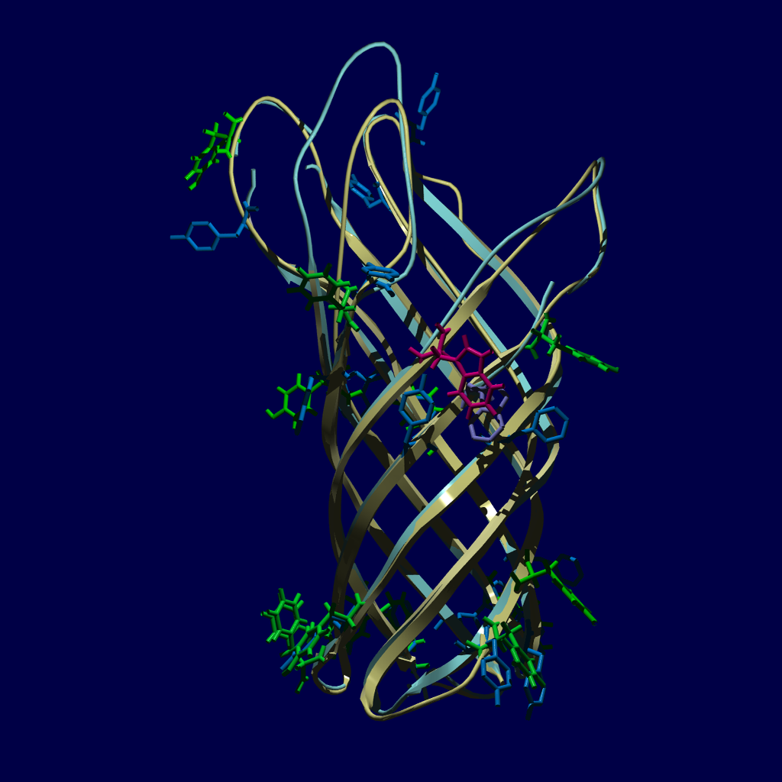
OprF model
(yellow and green) aligned with the crystal structure of OmpA (blue) – for the N-terminal domain
Many residues are in the same three dimentional environment, though on different strands

Slide 10
OprF and OmpA similarity
OprF 1 -QGQNSVEIEAFGKRYFTDSVRNMKN-------ADLYGGSIGYFLTDDVELALSYGEYH
OmpA 1 APKDNTWYTGAKLGWSQYHDTGLINNNGPTHENKLGAGAFGGYQVNPYVGFEMGYDWLG
* * * * ** * *
OprF 52 DVRGTYETGNKKVHGNLTSLDAIYHFGTPGVGLRPYVSAGLA-HQNITNINSDSQGRQQ
OmpA 60 RMPYKGSVENGAYKAQGVQLTAKLGYPIT-DDLDIYTRLGGMVWRADTYSNVYGKNHDT
* * * * * * * *
OprF 110 MTMANIGAGLKYYFTENFFAKASLDGQYGLEKRDNGHQG--EWMAGLGVGFNFG
OmpA 118 GVSPVFAGGVEYAITPEIATRLEYQWTNNIGDAHTIGTRPDNGMLSLGVSYRFG
* * * * *** **

Slide 11
Similarity versus Homology
Similarity can be quantified
It is correct to say that two sequences are X% identical
It is correct to say that two sequences have a similarity score of Z
It is correct to say that two sequences are X% similar, as long as the criteria for similarity is clear.

Slide 12
Similarity – specifying criteria
% similarity, with the following criteria: I=L=V; R=K
% similarity according to BLAST

Slide 13
Similarity versus Homology
Homology cannot be quantified “Its homologous or it isn’t”
If two sequences have a high % identity it is OK to say they are homologous
It is incorrect to say two sequences have a homology score of Z
It is incorrect to say two sequences are X% homologous or have a homology of X %

Slide 14
Assessing Sequence Similarity
Rbn KETAAAKFERQHMD
Lsz KVFGRCELAAAMKRHGLDNYRGYSLGNWVCAAKFESNFNT
Rbn SST SAASSSNYCNQMMKSRNLTKDRCKPMNTFVHESLA
Lsz QATNRNTDGSTDYGILQINSRWWCNDGRTP GSRN
Rbn DVQAVCSQKNVACKNGQTNCYQSYSTMSITDCRETGSSKY
Lsz LCNIPCSALLSSDITASVNC AKKIVSDGDGMNAWVAWR
Rbn PNACYKTTQANKHIIVACEGNPYVPHFDASV
Lsz NRCKGTDVQA WIRGCRL
is this alignment significant?

Slide 15
Some Simple (but not Hardfast) Guiding Rules
After low complexity sequences are considered…
If two sequence are > 200 residues and > 25% identical, they are likely related
If two sequences are 15-25% identical they may be related, but more tests are needed
If two sequences are < 15% identical they are most likely not related (but not always!)
If you need more than 1 gap for every 20 residues the alignment is suspicious

Slide 16
Doolittle’s Rules of Thumb
Likely related
Likely unrelated
“The Twilight Zone”
Russel Doolittle. Science 1981 Oct 9;214(4517):149-59

Slide 17
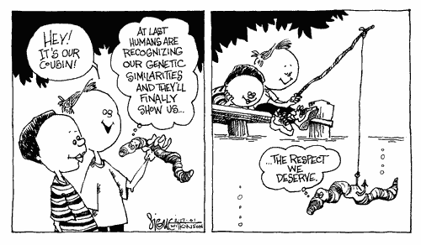
Questions?

Slide 18
Sequence Alignment - Methods
Dot Plots
Dynamic Programming
Heuristic (Approx. but Fast) Local Alignment – FASTA and BLAST
Multiple Sequence Alignment

Slide 19
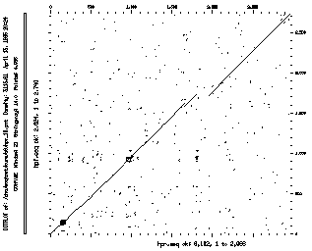
Dot Plots

Slide 20
Dot Plots
“Invented” in 1970 by Gibbs & McIntyre
Good for quick graphical overview – any size of sequence
Simplest method for sequence comparison
Inter-sequence comparison
Intra-sequence comparison
Identifies internal repeats
Identifies domains or “modules”

Slide 21
Dot Plot Algorithm
Take two sequences (A & B), write sequence A out as a row (length=m) and sequence B as a column (length =n)
Create a table or “matrix” of “m” columns and “n” rows
Compare each letter of sequence A with every letter in sequence B. If there’s a match mark it with a dot, if not, leave blank

Slide 22
Dot Plots & Internal Repeats

Slide 23
Dot Plot Algorithm Direct repeats
A C D A C D G H
A
C
D
E
F
G
H

Slide 24
Dot Plot Algorithm and Inverted Repeats
A C D E F G H G F
A
C
D
E
F
G
H
G
F

Slide 25
Dot Plots
The most popular freeware package is Dotter http://sonnhammer.sbc.su.se/Dotter.html
Dotlet - web-based http://myhits.isb-sib.ch/cgi-bin/dotlet

Slide 26
Dynamic Programming
G
E
N
E
T
I
C
S
G
E
N
E
T
I
C
S
G
10
0
0
0
0
0
0
0
G
60
40
30
20
20
0
10
0
E
0
10
0
10
0
0
0
0
E
40
50
30
30
20
0
10
0
N
0
0
10
0
0
0
0
0
N
30
30
40
20
20
0
10
0
E
0
0
0
10
0
0
0
0
E
20
20
20
30
20
10
10
0
S
0
0
0
0
0
0
0
10
S
20
20
20
20
20
0
10
10
I
0
0
0
0
0
10
0
0
I
10
10
10
10
10
20
10
0
S
0
0
0
0
0
0
0
10
S
0
0
0
0
0
0
0
10

Slide 27
Dynamic Programming
Developed by Needleman & Wunsch (1970)
Refined by Smith & Waterman (1981) (improvements by Gotoh, Altschul & Erickson, Pearson…)
Ideal for quantitative assessment
Guaranteed to be mathematically optimal
Slow N² algorithm
Performed in 2 stages
Prepare a scoring matrix using recursive function
Scan matrix diagonally using traceback protocol

Slide 28
The Recursive Function (ACK!)
Si-1,j-1 or
max Si-x,j-1 + wx-1 or
max Si-1,j-y + wy-1
Sij = sij + max
2<x<i
2<y<i
W = gap penalty
S = alignment score
Note: This is a classic, simple Smith-Waterman implementation. For dynamic programming you will also see other implementations on the web such as Needleman & Wunsch and more advanced implementations of Smith-Waterman

Slide 29
An Example... What is the Matrix?
Sij = sij + max
Si-1,j-1 or
max Si-x,j-1 + wx-1 or
max Si-1,j-y + wy-1
X X X X X
X - - - - -
X - - - - -
X - - - - -
X - - - ? -
W = gap penalty
S = alignment score
2<x<i
2<y<i
A A T V D
A 1
V
V
D
A A T V D
A 1 1
V
V
D
A A T V D
A 1 1 0 0 0
V
V
D
A A T V D
A 1 1 0 0 0
V 0
V
D
A A T V D
A 1 1 0 0 0
V 0 1 1
V
D
A A T V D
A 1 1 0 0 0
V 0 1 1 2 1
V
D

Slide 30
An Example... Filling in the Matrix… Traceback through the Matrix…
A A T V D
A 1 1 0 0 0
V 0 1 1 2 1
V
D
A A T V D
A 1 1 0 0 0
V 0 1 1 2 1
V 0 1 1 2 2
D 0 1 1 1 3
A A T V D
A 1 1 0 0 0
V 0 1 1 2 1
V 0 1 1 2 2
D 0 1 1 1 3
A A T V D
| | |
A V - V D

Slide 31
Could We Do Better?
Dynamic Programming always gives the mathematically correct answer
Dynamic Programming does not always give the biologically correct answer
Key to the performance of Dynamic Programming is the scoring function – The Scoring Matrix

Slide 32
Identity Scoring Matrix (S_{ij})
A
R
N
D
C
Q
E
G
H
I
L
K
M
F
P
S
T
W
Y
V
A
1
R
0
1
N
0
0
1
D
0
0
0
1
C
0
0
0
0
1
Q
0
0
0
0
0
1
E
0
0
0
0
0
0
1
G
0
0
0
0
0
0
0
1
H
0
0
0
0
0
0
0
0
1
I
0
0
0
0
0
0
0
0
0
1
L
0
0
0
0
0
0
0
0
0
0
1
K
0
0
0
0
0
0
0
0
0
0
0
1
M
0
0
0
0
0
0
0
0
0
0
0
0
1
F
0
0
0
0
0
0
0
0
0
0
0
0
0
1
P
0
0
0
0
0
0
0
0
0
0
0
0
0
0
1
S
0
0
0
0
0
0
0
0
0
0
0
0
0
0
0
1
T
0
0
0
0
0
0
0
0
0
0
0
0
0
0
0
0
1
W
0
0
0
0
0
0
0
0
0
0
0
0
0
0
0
0
0
1
Y
0
0
0
0
0
0
0
0
0
0
0
0
0
0
0
0
0
0
1
V
0
0
0
0
0
0
0
0
0
0
0
0
0
0
0
0
0
0
0
1

Slide 33
Scoring Matrices
An empirical model of evolution, biology and chemistry all wrapped up in a 20 X 20 table of integers
Structurally or chemically similar residues, or residues that otherwise reflect some degree of similarity should ideally have high scores

Slide 34
A Better Matrix - PAM250
Dayhoff (1978) or Point-accepted-mutation 250 matrix):
Counted the number of substitutions in related proteins across different species. Large scores are given to identities and substitutions which are found frequently.
1PAM is a unit of evolutionary divergence in which 1% of the amino acids have been changed. PAM 250 is an extrapolation to 250 mutations per 100 residues

Slide 35
Using PAM250...
A T V D
A 2
T 1 3
V 0 0 4
D 0 0-2 4
A mini version of the PAM 250,
showing only relevant residues:
Gap
Penalty = -1
A A T V D
A 2
V
V
D
A A T V D
A 2 1
V
V
D
A A T V D
A 2 1 0 -1 -1
V
V
D

Slide 36
Even better: BLOSUM Matricies
BLOSUM 90 - BLOcks SUbstitution Matrix,from BLOCKS of sequences with >90% sequence ID best for short alignments with high similarity
BLOSUM 62 - prepared from BLOCKS of sequences with >62% sequence ID best for general alignment (default)
BLOSUM 30 - prepared from BLOCKS of sequences with >30% sequence ID best for detecting weak local alignments

Slide 37
BLOSUM62

Slide 38
Dynamic Programming Algorithms
Great for doing pairwise global alignments
Produces a quantitative alignment “score”
"Problems" if one tries to do alignments with very large sequences/databases (memory requirement and run time grows as N² or as N x M)
SSEARCH is one great implementation (by Pearson) that can work, can do local alignments, and is guaranteed to find the optimal alignment, but it is sloooowww
Need an alternative for searching large databases of sequences like Genbank…..

Slide 39
Fast Local (and Heuristic) Alignment Methods
Developed by Lipman & Pearson (1985/88)
Refined by Altschul et al. (1990/97)
Ideal for large database comparisons
Uses heuristics & statistical simplification so not guaranteed to find all optimal sequence alignments
Fast N-type algorithm (similar to Dot Plot)

Slide 40
FASTA
Cuts sequences into short words (k-tuples)
Uses “Hash Tables” to speed comparison
Looks for clusters of nearby or locally dense “identical” k-tuples
init1 score = score for first set of k-tuples (using PAM250 matrix)
initn score = score for gapped k-tuples (i.e. after applying joining threshold – using a gap penalty)
opt score = optimized alignment score
Z-score = number of S.D. above random
expect = expected # of random matches

Slide 41
Fast Alignment Algorithm
Query: ACDEFGDEF…..
ACD CDE DEF EFG FGD GDE …
1 2 3,7 4 5 6
ACD CDE DEF EFG FGD GDE
ACE CDD NEF … … …
GCE CEE DEY … … …
GCD DDY … … …

Slide 42
Fast Alignment Algorithm
Query: ACDEFGDEF…..
ACD CDE DEF EFG FGD GDE
ACE CDD NEF … … …
GCE CEE DEY … … …
GCD DDY … … …
Database: LMRGCDDYGDEY…

Slide 43
Fast Alignment Algorithm
A C D E F G D E F...
L
M
R
G
C D
D
Y
G

Slide 44
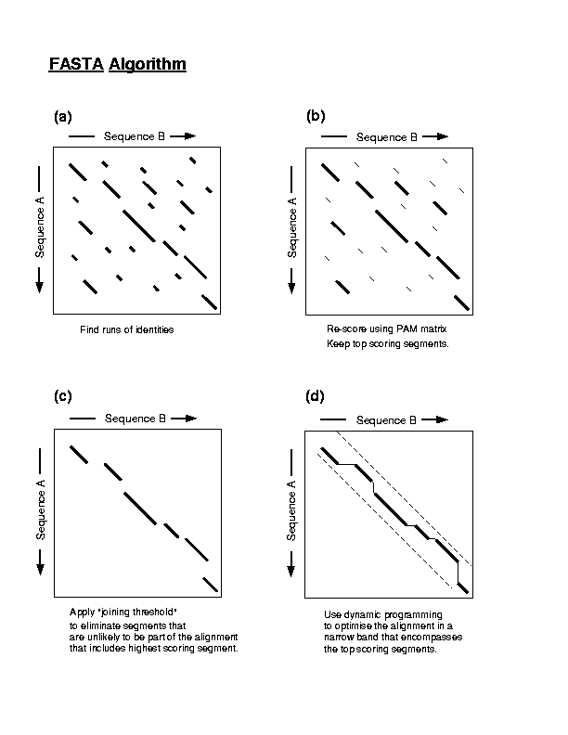
Fast Alignment Algorithm

Slide 45
Fast Alignment Algorithm
FASTA continued…

Slide 46
FASTA

Slide 47
FASTA
Note: in the end, FASTA can produce optimized alignments (based on an initial heuristic search but then using Smith-Waterman in the end) but it is not guaranteed to find all optimal “hits”/alignments in a database vs SSEARCH.
Overview of FASTA: http://en.wikipedia.org/wiki/FASTA
Web-based FASTA access:
http://www.ebi.ac.uk/Tools/fasta/

Slide 48
BLAST

Slide 49
Let’s try an experiment...
ACDEAGHNKLM...
KKDEFGHPKLM...
SCDEFCHLKLM...
Align
MCDEFGHNKLV...
ACDEFGHIKLM...
QCDEFGHAKLM...
AQQQFGHIKLPI...
WCDEFGHLKLM...
SMDEFAHVKLM...
ACDEFGFKKLM...

Slide 50
What kind of score distribution do you get?
Gaussian?
Poisson?
Other?

Slide 51
Extreme Value Distribution
-x
P(x) = 1 - e
-e

Slide 52
Why is this important?
If you can predict the usual score distribution prior to performing an alignment search then it is possible to predict which alignments and which sequences will be worth aligning
Saves time
Gives a significance value (not just a raw score) to sequence alignments

Slide 53
BLAST
Basic Local Alignment Search Tool
Developed in 1990 and 1997 (S. Altschul)
A heuristic method (Fast alignment method) for performing local alignments through searches of high scoring segment pairs (HSP’s)
1st to use statistics to predict significance of initial matches - saves on false leads
Offers both sensitivity and speed

Slide 54
BLAST
Looks for clusters of nearby or locally dense “similar or homologous” k-tuples
Uses “look-up” tables to shorten search time
Uses larger “word size” than FASTA to accelerate the search process
Can generate “domain friendly” local alignments
Fastest and most frequently used sequence alignment tool – BECAME THE STANDARD

Slide 55
What is the BLAST E-value?
Expectation value, not a probability
E-value can be greater than one
Low E-values ~ P-values (probability)
E-value = number of sequences with equal or higher score that you would expect to find in a randomized database of the same size
High E-value (>1) → bad, your alignment is not better than random
Usually you start trusting alignments with E-values <= 0.001

Slide 56
Extreme Value Distribution
Kmne^{-λS} is called Expect or E-value
In BLAST, default E cutoff = 10 so P = 0.99995
If E is small then P is small
Why does BLAST report an E-value instead of a p value?
E-values of 5 and 10 are easier to understand than P-values of 0.993 and 0.99995. (E-value = 5 means that sequence similarity is likely to occur by chance 5 times in the database.)
However, note that when E < 0.01, P-values and E-value are nearly identical.

Slide 57
Expect value
Kmne^{-λS} = Expect or E-value
What parameters does it depend on?
- λ and K are two parameters – natural scales for search space size and scoring system, respectively
λ = lnq/p and K = (q-p)²/q
p = probability of match (i.e. 0.05)
q = probability of not match (i.e. 0.95)
Then λ = 2.94 and K =0.85
p and q calculated from a “random sequence model” (Altschul, S.F. & Gish, W. (1996) "Local alignment statistics." Meth. Enzymol. 266:460-480.) based on given subst. matrix and gap costs
- m = length of sequence
- n = length of database
- S = score for given HSP
So, for example, if the database doubles in size, the E-value doubles (higher chance of getting a match by chance)

Slide 58
Expect value
Example of a basic BLAST output
Score E
Sequences producing significant alignments: (Bits) Value
ref|YP_004671467.1| enoyl-[acyl-carrier-protein] reductase [N... 414 1e-147
ref|YP_004652861.1| enoyl-ACP reductase [NADH],chloroplastic ... 412 4e-147
gb|ADV16377.1| enoyl-ACP reductase 2 [Helianthus annuus] 398 3e-140
emb|CAC41367.1| enoyl-[acyl-carrier protein] reductase [Brass... 397 9e-140
pdb|1D7O|A Chain A, Crystal Structure Of Brassica Napus Enoyl... 393 1e-139
sp|P80030.2|FABI_BRANA RecName: Full=Enoyl-[acyl-carrier-prot... 396 1e-139
emb|CAC41369.1| enoyl-[acyl carrier-protein] reductase [Brass... 396 1e-139
pdb|1ENO|A Chain A, Brassica Napus Enoyl Acp ReductaseNAD BIN... 393 2e-139
emb|CAC41368.1| enoyl-[acyl-carrier protein] reductase [Brass... 396 2e-139
emb|CAC41366.1| enoyl-[acyl-carrier protein] reductase [Brass... 395 2e-139
gb|ACF17650.1| putative enoyl-acyl-carrier-protein reductase ... 395 3e-139
pdb|1CWU|A Chain A, Brassica Napus Enoyl Acp Reductase A138g ... 392 4e-139
emb|CAA05879.1| enoyl-ACP reductase [Petunia x hybrida] 395 4e-139

Slide 59
Bit Score
Expect value an intuitive value but…
Expect value changes as database changes
Expect value becomes zero quickly
Alternative: bit score
S' (bits) = [lambda * S (raw) - ln K] / ln 2
Independent of scoring system used - normalized
Larger value for more similar sequences, therefore useful in analyses of very similar sequences

Slide 60
Bit Score verus Expect value
Score E
Sequences producing significant alignments: (Bits) Value
gb|AAX37027.1| actin alpha 1 [synthetic construct] 790 0.0
ref|NP_001091.1| actin, alpha skeletal muscle [Homo sapiens] ... 790 0.0
ref|XP_003308856.1| PREDICTED: actin, alpha skeletal muscle [... 788 0.0
gb|AAI34666.1| Actin, alpha 1, skeletal muscle [Bos taurus] 788 0.0
ref|XP_003340224.1| PREDICTED: LOW QUALITY PROTEIN: actin, al... 788 0.0
ref|NP_776650.1| actin, alpha skeletal muscle [Bos taurus] >g... 787 0.0
ref|NP_001079664.1| similar to actin alpha [Xenopus laevis] >... 787 0.0
sp|Q90X97.1|ACTS_ATRMM RecName: Full=Actin, alpha skeletal mu... 787 0.0
ref|XP_002722940.1| PREDICTED: cytoplasmic beta-actin [Orycto... 787 0.0
ref|NP_001006709.1| actin, alpha 1, skeletal muscle [Xenopus ... 786 0.0
pdb|1EQY|A Chain A, Complex Between Rabbit Muscle Alpha-Actin... 786 0.0
ref|NP_001002066.1| cardiac muscle alpha actin 1 [Danio rerio... 786 0.0
ref|NP_001090226.1| actin, alpha skeletal muscle 2 [Xenopus l... 785 0.0
ref|NP_989355.1| actin, alpha cardiac muscle 2 [Xenopus (Silu... 785 0.0
gb|AAR04426.1| skeletal muscle actin mutant [Cyprinus carpio] 785 0.0
gb|AAO38846.1| actin [Danio rerio] >emb|CAQ15402.1| actin, al... 785 0.0
ref|NP_001001409.2| actin, alpha, cardiac muscle 1a [Danio re... 785 0.0
gb|AAP74383.1| skeletal muscle actin [Cyprinus carpio] 784 0.0

Slide 61
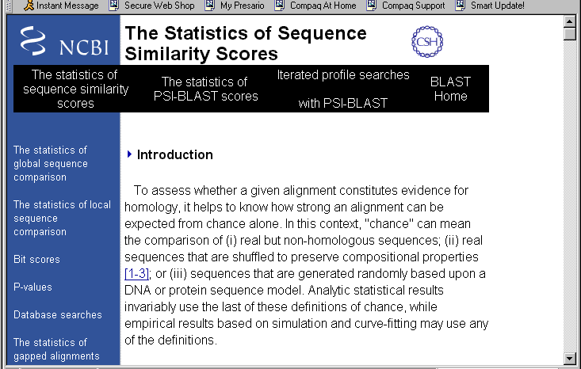
More about BLAST statistics…
http://www.ncbi.nlm.nih.gov/BLAST/tutorial/Altschul-1.html

Slide 62
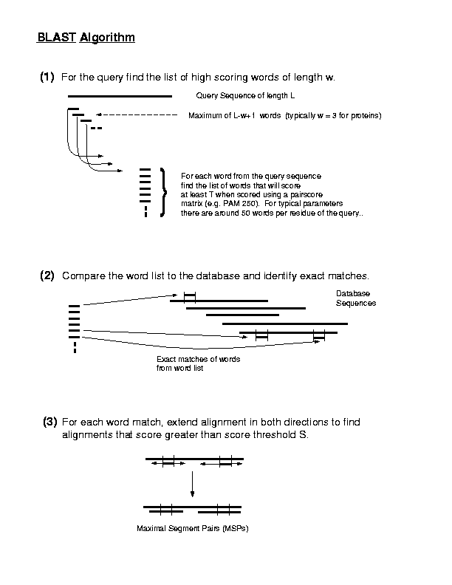

Slide 63
Connecting HSP’s

Slide 64
Segment Pairs
How are scores calculated?
Add up values from scoring matrix
Example:
If 3 letter word PQG occurs in the query sequence, then score is the sum of the log odds score of a P-P match (7), plus that for a Q-Q match (5), plus that for a G-G match (6) = 7 + 5 + 6 = 18.
Similarly, matches of PQG to PEG would score 15 (7+2+6), to PRG 14, to PSG 13 and to PQA 12.

Slide 65
Segment Pairs
L P P Q G L L QUERY SEQUENCE M P P E G L L DATABASE SEQUENCE
<WORD> THREE LETTER WORD FOUND INITIALLY 7 2 6 Blosum62 scores, word score = 15
<--- ---> EXTENSION TO LEFT AND RIGHT
2 7 7 2 6 4 4 < HSP > SCORE 9 + 15 + 8 = 32

Slide 66
Segment Pairs
How are scores calculated?
Add up values from scoring matrix
Try another example.
What is the score of the following segment pair?
S E A R C H E R S
| | | | | |
S E A R C H I N G
4 +5 +4 +5 +9 +8 -3 +0 +0 = 32

Slide 67
BLAST verses FASTA
BLAST generates local alignments as the final output – FASTA can also produce global alignments
Related to above: BLAST – multiple alignments possible for one sequence. FASTA – one Smith-Waterman alignment can be produced when global alignment produced.
FASTA initially searches for identical words, BLAST searches for similar words

Slide 68
BLAST Parameters
Identities - No. & % exact residue matches
Positives - No. and % similar & ID matches
Gaps - No. & % gaps introduced
Score - Summed HSP score (S)
Bit Score - a normalized score (S’)
Expect (E) - Expected # of chance HSP aligns
P - Probability of getting a score > X
T - Minimum word or k-tuple score (Threshold)

Slide 69
BLAST Options
Composition-based statistics (Yes)
Sequence Complexity Filter (Yes)
Expect (E) value (10)
Word Size (3)
Substitution or Scoring Matrix (Blosum62)
Gap Insertion Penalty (11)
Gap Extension Penalty (1)

Slide 70
Composition Statistics
Recent addition to BLAST algorithm
Permits calculated E (Expect) values to account for amino acid composition of queries and database hits
Improves accuracy and reduces false positives
Effectively conducts a different scoring procedure for each sequence in database

Slide 71
LCR’s (low complexity regions)
Looks for…
transmembrane or signal peptide regions
coil-coil regions
short amino acid repeats (collagen, elastin)
homopolymeric repeats
BLAST uses SEG to mask amino acids
BLAST uses DUST to mask bases
Filtered sequences marked with NNNN's (nucleotide) or XXXX’s (protein) in filtered regions – not considered in the analysis
Run searches both with and without it!

Slide 72
Choosing a matrix: More about PAM versus BLOSUM
First useful scoring matrix for protein
Assumed a Markov Model of evolution (i.e. all sites equally mutable and independent)
Derived from small, closely related proteins with ~15% divergence
Much later entry to matrix “sweepstakes”
No evolutionary model is assumed
Built from PROSITE derived sequence blocks
Uses much larger, more diverse set of protein sequences (30% - 90% ID)

Slide 73
PAM versus BLOSUM
Higher PAM numbers → detect more remote sequence similarities
1 PAM ~ 1 million years of divergence
Errors in PAM 1 are scaled 250X in PAM 250
Lower BLOSUM numbers → detect more remote sequence similarities
Sensitive to structural and functional substitution
Errors in BLOSUM arise from errors in alignment

Slide 74
BLAST Access
NCBI BLAST
http://www.ncbi.nlm.nih.gov/BLAST/
European Bioinformatics Institute BLAST / WU-BLAST
http://www.ebi.ac.uk/Tools/sss/

Slide 75
Different Flavours of BLAST
BLASTP - protein query against protein DB
BLASTN - DNA/RNA query against GenBank (DNA)
BLASTX - 6 frame translation of DNA query against protein DB
TBLASTN - protein query against 6 frame GB translation
TBLASTX - 6 frame DNA query to 6 frame GB translation
PSI-BLAST - protein ‘profile’ query against protein DB

Slide 76
Other BLAST Services
PHI-BLAST - protein pattern against protein DB
MEGABLAST - for comparison of large sets of long DNA sequences
RPS-BLAST - Conserved Domain Detection
BLAST 2 Sequences - for performing pairwise alignments for 2 chosen sequences
Genomic BLAST - for alignments against select human, microbial or malarial genomes
VecScreen - for detecting cloning vector contamination in sequenced data

Slide 77
Locally installed BLAST
Customize as you want
Run and analyze batches of sequences easily
Incorporate in a program to do BLAST analysis as part of a larger bioinformatics analysis
Not dependent on internet access
Faster, especially for large numbers of query sequences

Slide 78
Key References
Altschul, S.F., Gish, W., Miller, W., Myers, E.W. & Lipman, D.J. (1990) "Basic local alignment search tool." J. Mol. Biol. 215:403-410.
Altschul, S.F., Madden, T.L., Schäffer, A.A., Zhang, J., Zhang, Z., Miller, W. & Lipman, D.J. (1997)"Gapped BLAST and PSI-BLAST: a new generation of protein database search programs." Nucleic Acids Res. 25:3389-3402.

Slide 79
Summary
BLAST is the most widely used program in bioinformatics
BLAST is based on relatively sound statistical principles (key to its speed and sensitivity)
A basic understanding of its principles is key for using/interpreting BLAST output
Locally run BLAST can allow you to perform bigger, more complex, or more customized analyses better/faster

Slide 80
Difference BLAST and FASTA
Both BLAST and FASTA are local alignment search heuristics with slightly different algorithms
Historically, FASTA reported only one (the best) local alignment, BLAST all significant ones (HSPs)
Latest FASTA version can also output multiple HSPs
BLAST is faster than FASTA, but less sensitive - BLAST might miss more alignments with low similarity
FASTA tries harder to align low-similarity regions and thus can produce a single alignment with gaps in case where BLAST reports multiple (adjacent) HSPs
Use both programs if you want to make sure not to miss similar sequences in a database

Slide 81
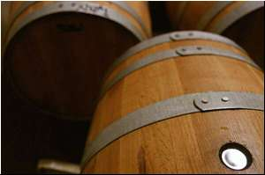
Scraping the Bottom of the Barrel with PSI-BLAST

Slide 82
PSI-BLAST Algorithm
Perform initial alignment with BLAST using BLOSUM 62 substitution matrix
Construct a multiple alignment from matches
Prepare position specific scoring matrix (PSSM)
Use PSSM profile as the scoring matrix for a second BLAST run against database
Repeat steps 3-5 until convergence

Slide 83
Position Specific Scoring Matrix (PSSM)
QUERY VLVAPGDS
LPVTPGEP
VSVALGQT
GLVEPGSS
WLVKAGSS
HSPs from database (aligned to query)
Rows: Sequence positions
Columns: All possible amino acids with scores of each variation in that position

Slide 84
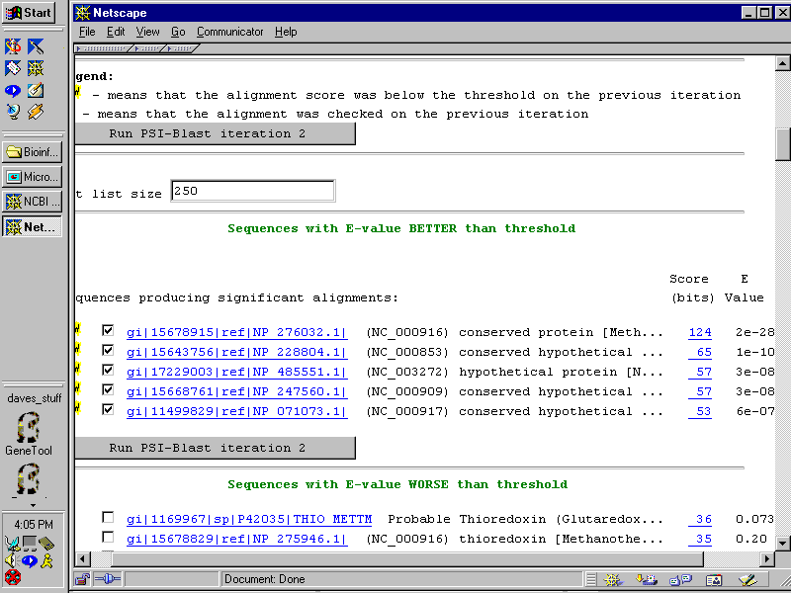
PSI-BLAST

Slide 85
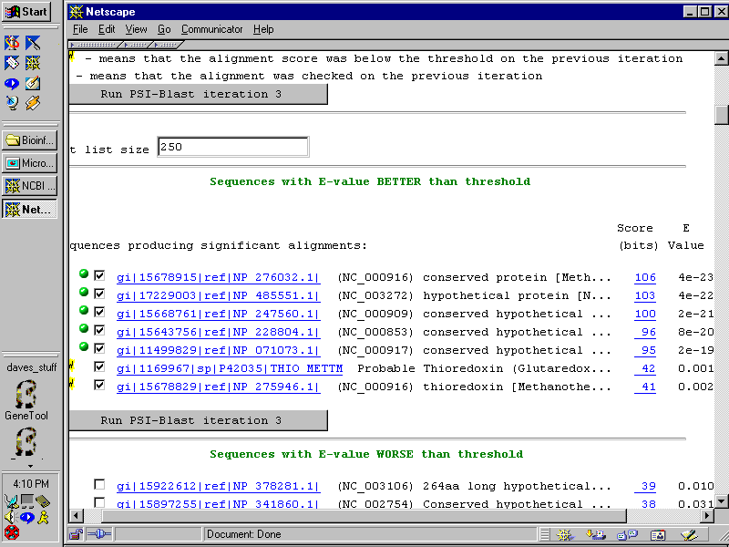
PSI-BLAST

Slide 86
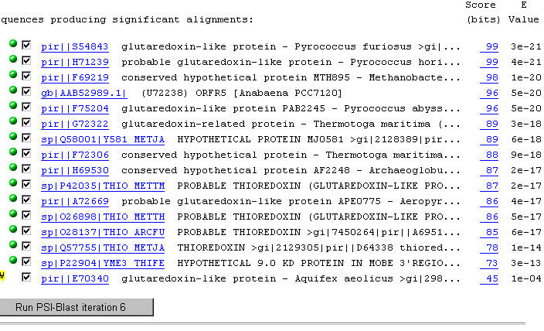
PSI-BLAST

Slide 87
PSI-BLAST
For Protein Sequences ONLY
Much more sensitive than BLAST
Slower (iterative process)
Often yields results that are as good as many common threading methods
Can be a powerful tool when analyzing a new sequence, if interpreted conservatively

Slide 88
PSI-BLAST
Watch out for sequence regions of highly biased composition that SEG doesn’t filter (because of its potential importance)
Do a COILS analysis
Run locally with more stringent SEG settings
Manual analysis with critical review of each iteration and only select sequences you feel are appropriate for the next iteration
PSI-Blast can beat Blastp if Blastp finds some reliable alignments to database sequences. (Moderately distant matches are particularly useful.)

Slide 89
What to use?
… if you wish to detect similarities between fairly distantly related sequences for a given protein-coding gene?
Analyze the deduced protein sequence!
PSI-BLAST
FASTA with ktuple=1 and appropriate scoring matrix (i.e. BLOSUM 30 or generate own matrix from multiple alignment of homologs)
BLAST with appropriate scoring matrix
Smith-Waterman alignment
Protein structure analyses and motif-based analyses
Amino acid composition analysis

