Slide 1
Stat 223 Introduction to the Theory of Statistics

Slide 2
Chapter 1
1.1 Sampling Distribution from notes
1.2 Central Limit Theorem from notes

Slide 3
Proof:

Slide 5
Examples on the weak low of large number

Slide 7
1.3 Order Statistic (p251-p254)

Slide 10
1.4 Exponential Family (p312-p314) one parameter exponential family:

Slide 11
k parameter exponential family:

Slide 12
The joint distribution of the exponential family

Slide 13
Exponential Family (p312-p314)
Example 1:
Example 2:

Slide 14
Example 3:

Slide 15
Homework: Does the following density function belong to the exponential family?

Slide 16
Chapter 2
Point Estimation

Slide 17
2. 1 Introduction
Statistical inference
estimation
Tests of hypotheses
Point estimation
Interval istimation

Slide 18
2.2 METHOD OF FINDING ESTIMATORS

Slide 19
Notes:

Slide 20
2.2.1 Method of Moments

Slide 24
Homework

Slide 25
Note:

Slide 26
2.2.2 Maximum Likelihood

Slide 27
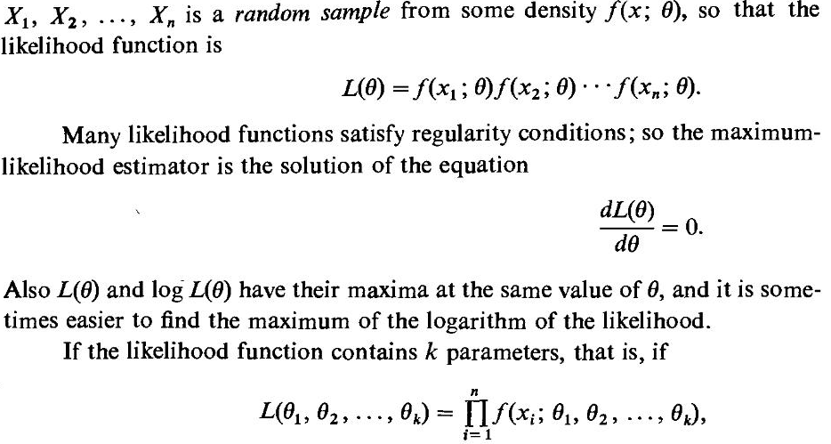

Slide 31
Note: ln = log

Slide 33
Clarification of the above example

Slide 34
2.3 Properties of Point Estimator 2.3.1mean Squared Error

Slide 35
