Slide 1
Imaging of esophagus and stomach
Radiology department
Dr. A. Alhawas

Slide 2
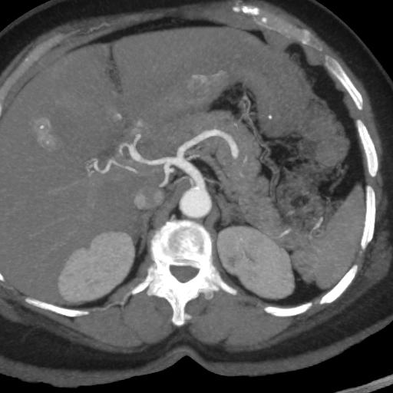
3
1
2
4
Splenic artery
Abdominal aorta
Common hepatic artery
Gastro-duodenal artery

Slide 4
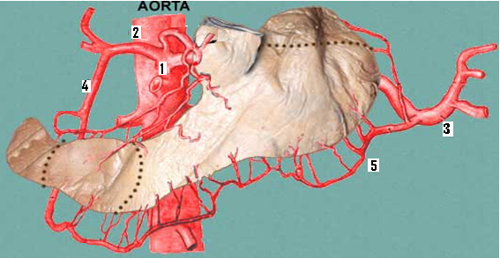
Abdominal aorta.
Common hepatic artery.
Splenic artery.
Gasto-duodenal artery.
Left gasto-epiploic artery.

Slide 5
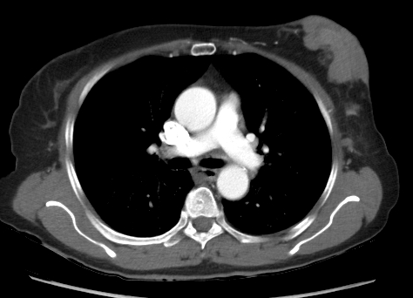
4
1
5
2
6
3
Left main pulmonary artery.
Esophagus.
Thoracic arota.
Right main pulmonary artery.
Left main bronchus.
Azygous vien.

Slide 6
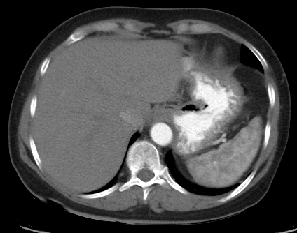
3
1
4
2
5
Stomach
Splenic artery / short gastric artery.
Gastro-esophageal junction.
Inferior vena cava.
Aorta.

Slide 7
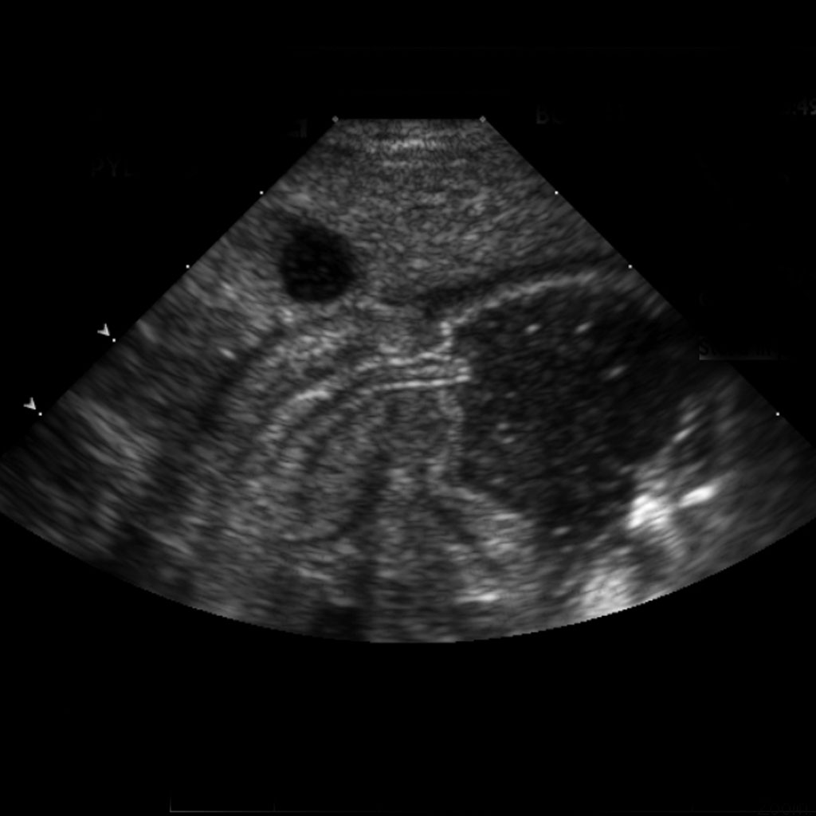
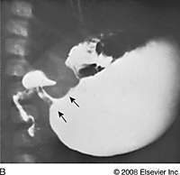

Slide 8
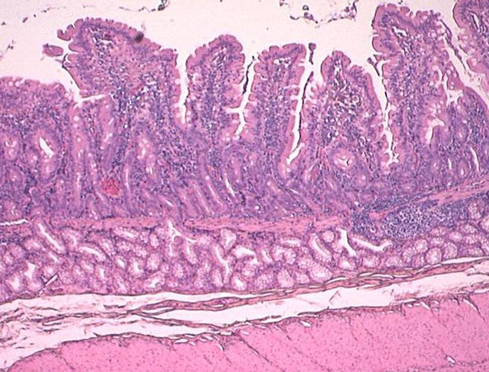
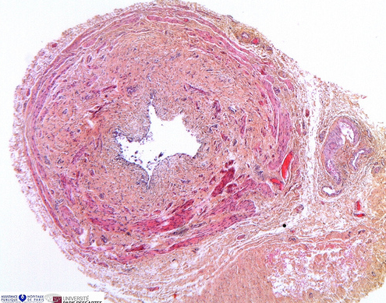
State which layers are pathologically changed in pyloric stenosis.
both circular and longitudinal layers .
State the name of arteries supplying the pylorus and the first part of the duodenum.
State four (4) structures forming the stomach bed:
Pancreas ( body and tail ).
Spleen.
Left kidney.
Left adrenal gland.
Left crus of the diaphragm.
Splenic artery
Transverse mesocolon.

