Slide 1


Exercise 1
Find the step response for a system whose transfer function is:
Solution
the step response for a system whose transfer function is:
Input: unit step
$$R\left(s\right)=\frac{1}{s}$$
$$C\left(s\right)=R\left(s\right)G\left(s\right)=\frac{1}{s}\frac{s}{\begin{aligned}&\left(s+4\right)\left(s+8\right) \\ &\end{aligned}}=\frac{1}{\left(s+4)(s+8\right)}$$
Output (System Response):
$$A={\left.(s+4)C\left(s\right)\right|}_{s=−4}={\left.\frac{1}{\begin{aligned}\left(s+8\right) \\ &\end{aligned}}\right|}_{s=−4}=\frac{1}{4}$$
Using Partial fraction:
$$C\left(s\right)=\frac{A}{s+4}+\frac{B}{s+8}$$
$$C\left(s\right)=\frac{\frac{1}{4}}{s+4}−\frac{\frac{1}{4}}{s+8}$$
Using Inverse Laplace Transform:
$$B={\left.(s+8)C\left(s\right)\right|}_{s=−8}={\left.\frac{1}{\begin{aligned}\left(s+4\right) \\ &\end{aligned}}\right|}_{s=−8}=−\frac{1}{4}$$
$$c\left(t\right)=\frac{1}{4}\left(e^{−4t}−e^{−8t}\right)$$
The time response of the system:

Slide 2
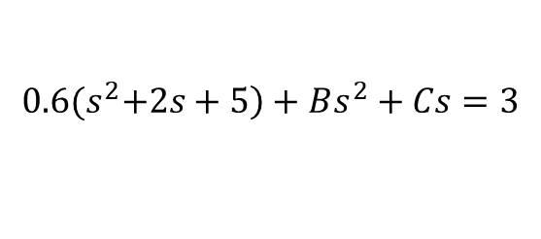

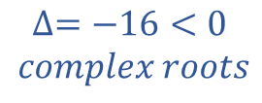
Exercise 2
For the following differential equation, find the solution c(t) if r(t) is a unit step function. Assume all initial conditions are zeros.
$$\frac{\left.d^{2}c(t\right)}{{dt}^{2}}+2\frac{\left.dc(t\right)}{dt}+5c\left(t\right)=3r(t)$$
Solution
Using Laplace Transform:
$$s^{2}C\left(s\right)+2 s C\left(s\right)+5C\left(s\right)=3R(s)$$
$$(s^{2}+2 s+5)C\left(s\right)=3R(s)$$
$$\frac{C\left(s\right)}{R\left(s\right)}=\frac{3}{s^{2}+2s+5}$$
$$C\left(s\right)=\frac{3}{s^{2}+2s+5} \left.R(s\right)$$
$$R\left(s\right)=\frac{1}{s}$$
$$C\left(s\right)=\frac{3}{\left.{s(s}^{2}+2s+5\right)}$$
$$∆=−16<0$$
$$complex roots$$
Input: unit step
Output (System Response):
$$C\left(s\right)=\frac{A}{s}+\frac{Bs+C}{{(s}^{2}+2s+5)}$$
Using Partial fraction:
$$A=0.6$$
$$B=0.6$$
$$C=1.2$$
$$\left.{s(s}^{2}+2s+5\right)C\left(s\right)=A\left.{(s}^{2}+2s+5\right)+Bs^{2}+Cs=3$$
$$s^{2}+2s+5={(s+1)}^{2}+{(2)}^{2}$$
$$a=1 and ω=2$$
$$B+0.6=0$$
$$0.6\left.{(s}^{2}+2s+5\right)+Bs^{2}+Cs=3$$
$$s+2=D\left(s+a\right)+Eω$$
$$D=1 and E=0.5$$
$$C+1.2=0$$
$$0.6 \frac{s+2}{{(s}^{2}+2s+5)}=0.6\frac{D\left(s+a\right)+Eω}{{(s+a)}^{2}+{(ω)}^{2}}$$
ILT:
$$0.6(Ae^{−at}cosωt+Be^{−at}sinωt)$$
The time response of the system:
$$\left.c\left(t\right)=\left[0.6−0.6e^{−t}\left(cos2t+0.5sin2t\right)\right]u(t\right)$$

Slide 3
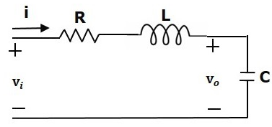
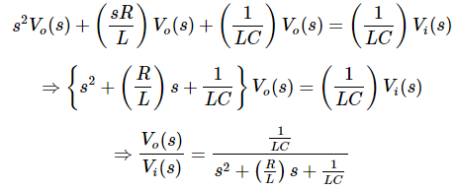
Exercise 3
Consider the following electrical system,
Find the transfer function $G\left(s\right)=\frac{V_{0}(s)}{V_{i}(s)}$
Solution
Mesh equation for this circuit is
Substitute, the current passing through capacitor
in the above equation.
Apply Laplace transform on both sides.

Slide 4
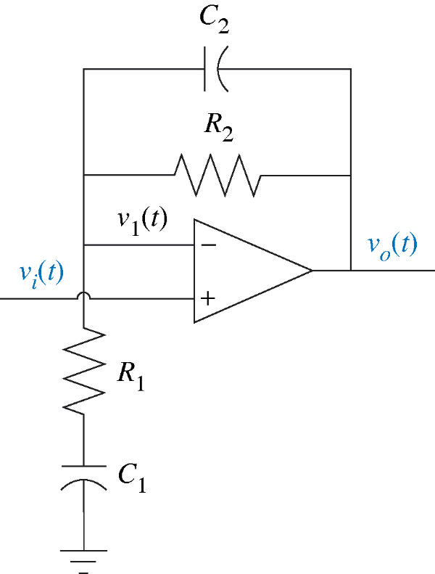

Exercise 4
Consider the inverting amplifier, Find the transfer function $\frac{v_{o}}{v_{i}}$
$R_{1}=1MΩ, C_{1}=1μ$F, $R_{2}=10MΩ, C_{1}=0.1μ$F,
Solution
the transfer function
$$Z_{1}=R_{1}+\frac{1}{C_{1}s}=\frac{R_{1}C_{1}s+1}{C_{1}s}=\frac{s+1}{{10}^{−6}s}$$
$$\frac{V_{0}(s) }{V_{1}(s)}=\frac{Z_{1}+Z_{2}}{Z_{1}}$$
$$Z_{2}=\frac{R_{2}}{R_{2}C_{2}s+1}=\frac{{10}^{7}}{s+1}$$
$$\frac{V_{0}(s) }{V_{1}(s)}=\frac{Z_{1}+Z_{2}}{Z_{1}}=\frac{\frac{s+1}{{10}^{−6}s}+\frac{{10}^{7}}{s+1}}{\frac{s+1}{{10}^{−6}s}}=1+\frac{s}{({s+1)}^{2}}=\frac{s^{2}+3s+1}{({s+1)}^{2}}$$

Slide 5
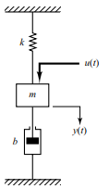
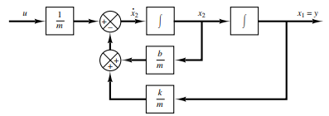
Exercise 5
Consider the mechanical system shown in Figure, find:
1. Block diagram of the mechanical system ($u\left(t\right):input, y(t):output)$.
2. State space representation of the system (state variables: $x_{1}=y\left(t\right),x_{2}=\dot{y}\left(t\right))$
Solution
From the diagram, the system equation (SISO) is:
This system is of second order, state variables:
$$x_{1}=y\left(t\right) and x_{2}=\dot{y}\left(t\right)=\dot{x_{1}}$$
$$and$$
The output equation is
the outputs of the integrators are state variables.
Block diagram of the mechanical system

Slide 6
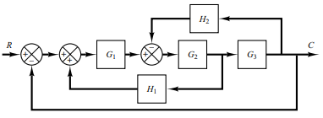
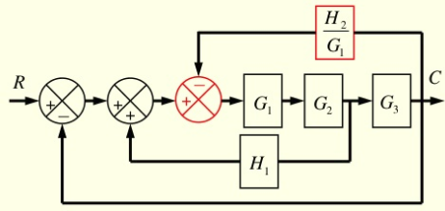
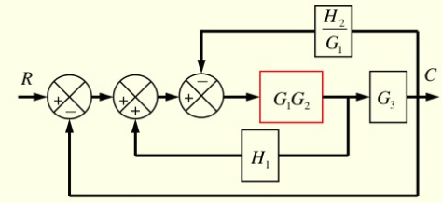
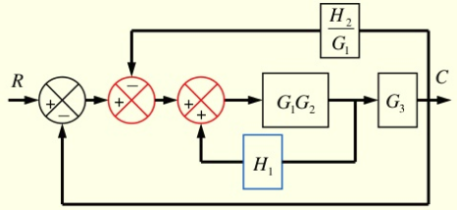
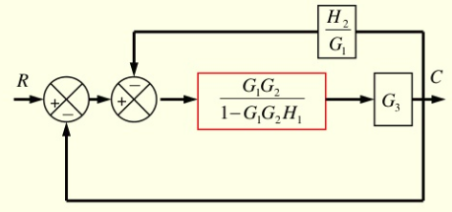
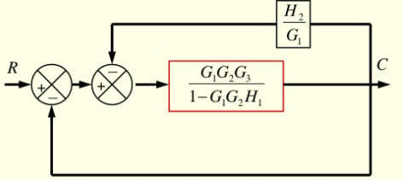
Exercise 6
Consider the system shown in Figure.
Simplify this diagram
Solution

