Slide 1
Table of Contents
2014 BasmahAlQadheeb

Slide 2
What is a report?
A report is a clearly structured document that presents information as clearly as possible.
Reports should be easy to read and professional in presentation.
2014 BasmahAlQadheeb

Slide 3
How to write a report?
Title page
This page should include:
the report title, which states the report’s purpose ,
your name and the name of the person receiving the report (place in the bottom right-hand corner) and the submission date.
Executive summary
An executive summary is a paragraph that provides the reader with a quick overview of the entire report, including its purpose, context, methods, major findings, conclusions and recommendations. It is often easier to write the executive summary once the report has been completed.
This is placed on a separate page between the title page and the table of contents. This may often be the only part of the report that is actually read.
2014 BasmahAlQadheeb

Slide 4
Table of Contents
The table of contents lists the main sections (headings) of the report, and the page on which each begins. If your report includes tables, diagrams or illustrations, these are listed separately on the page after the table of contents.
Introduction
The introduction should:
Discuss the importance or significance of the research or problem to be reported .
Define the purpose of the report.
Outline the issues to be discussed (scope) .
Inform the reader of any limitations to the report, or any assumptions made.
2014 BasmahAlQadheeb

Slide 5
Discussion or body
This contains the main substance of the report, organized into sections with headings and subheadings rather than paragraphs.
Conclusion
This summarizes the key findings from the discussion section and may be numbered here for clarity. Relate your conclusion to the objectives of the report and arrange your points logically so that major conclusions are presented first.
Recommendations
These are subjective opinions about what action you think could be followed. They must be realistic, achievable and clearly relate to the conclusion of the report.
2014 BasmahAlQadheeb

Slide 6
Reference list
This must contain all the material cited in the report. It must be accurate and consistent with a standard referencing style.
Appendices
They contain detailed information, such as questionnaires, tables, graphs and diagrams.
Appendices should be clearly set out and numbered in the order they are mentioned in the text.
2014 BasmahAlQadheeb

Slide 7
Table of Contents
The Table of Contents provides a map for whatever you're reading, because it outlines exactly where the paper is going, what will be discussed, and where to go to find specific information.
2014 BasmahAlQadheeb

Slide 8
Example
2014 BasmahAlQadheeb

Slide 9
Creating a Table of Contents
Creating a Table of Contents in a Microsoft Word document is a two-step process.
2014 BasmahAlQadheeb

Slide 10
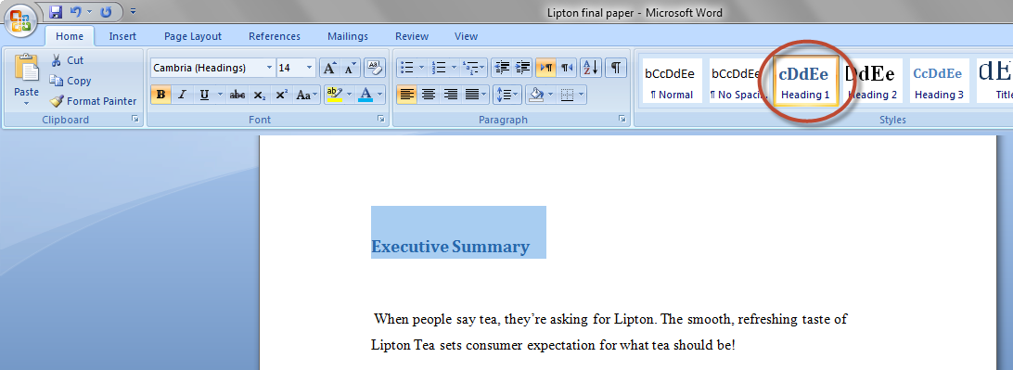
1.Identify the text that you want to appear in the Table of Contents
In your document, click within the first major heading that you want to appear in the Table of Contents. Apply the Heading 1 style to that paragraph.
(on the Home tab, in the Styles group, click the Heading 1 thumbnail)
In the same way, apply the Heading 1 style to other major headings in your document. Apply the Heading 2 style to sub-headings, Heading 3 style to sub-sub-headings etc.
2014 BasmahAlQadheeb

Slide 11
Note
If you don't like the way the heading styles look (eg. you want a different font or font size or color), don't format the text directly. Instead, modify the heading styles.
2014 BasmahAlQadheeb

Slide 12
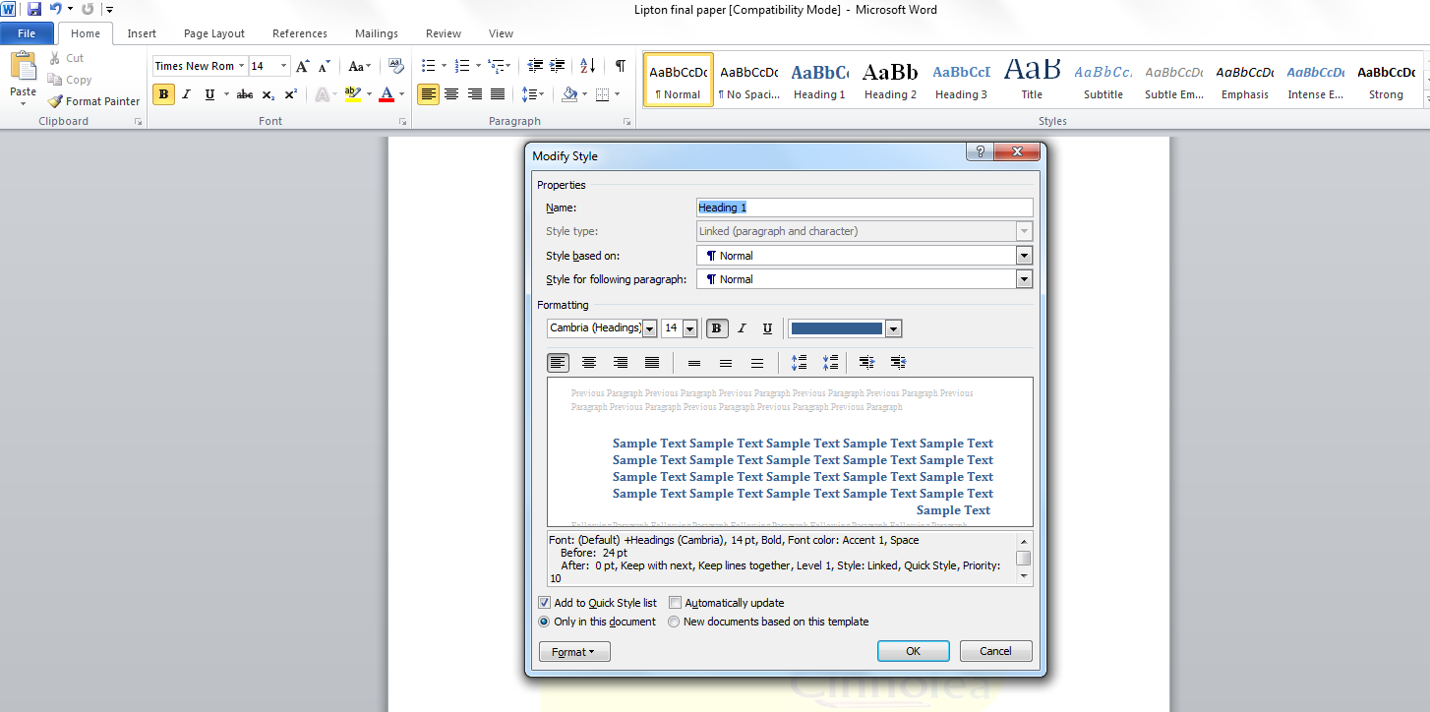
Modify Heading style
On the Home tab, in the Styles gallery, right-click the thumbnail for the style you want to modify and choose Modify. You're now at the Modify Style dialog.
2014 BasmahAlQadheeb

Slide 13
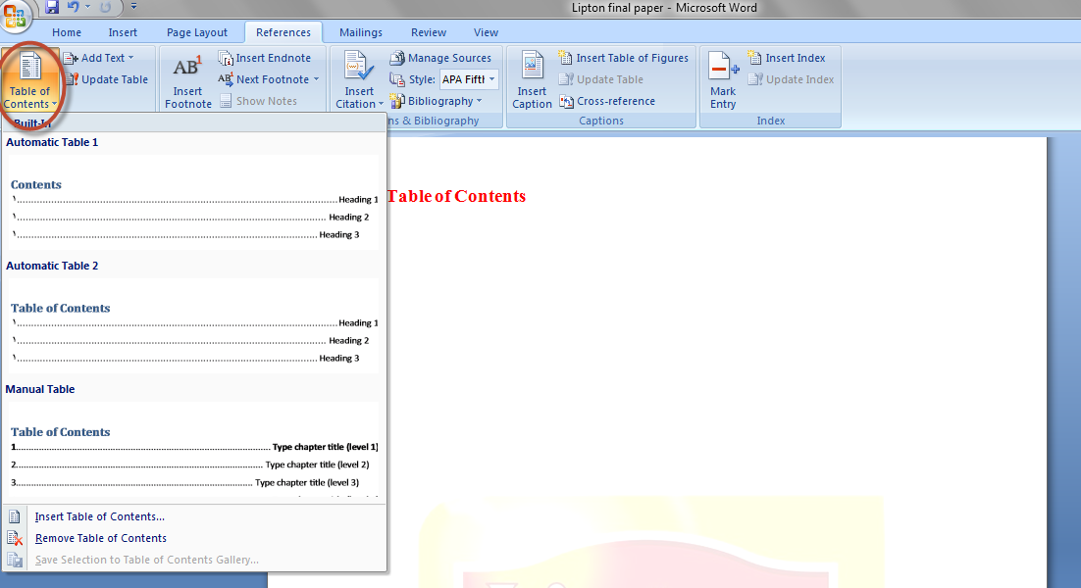
2.Create the Table of Contents
2.1 Create a Table of Contents from the gallery
Click where you want to insert the Table of Contents, usually at the beginning of a document.
On the References tab, in the Table of Contents group, click Table of Contents, and then click the table of contents style that you want.
2014 BasmahAlQadheeb

Slide 14
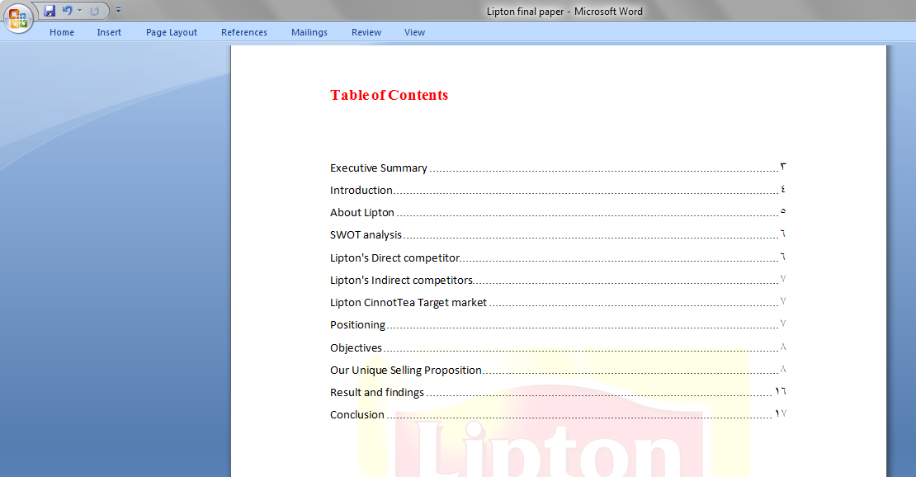
Microsoft Word searches for headings and then inserts the table of contents into your document.
2014 BasmahAlQadheeb

Slide 15
2.2 Create a custom Table of Contents
On the References tab, in the Table of Contents group, click Table of Contents, and then click Insert Table of Contents.
In the Table of Contents dialog box, do any of the following:
To change how many heading levels are displayed in the table of contents, enter the number that you want in the box next to Show levels, under General.
To change the overall look of your table of contents, click a different format in the Formats list. You can see what your choice looks like in the Print Preview and Web Preview areas.
To change the type of line that appears between the entry text and the page number, click an option in the Tab leader list.
2014 BasmahAlQadheeb

Slide 16
2014 BasmahAlQadheeb

Slide 17
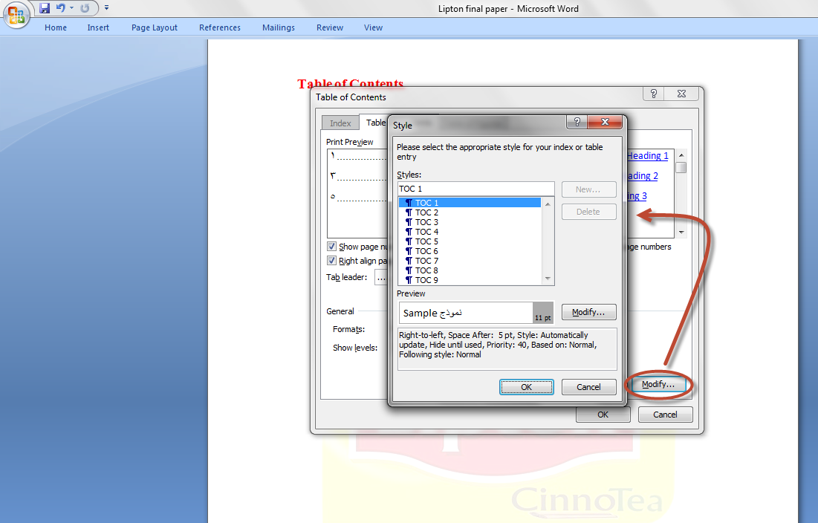
To change the way heading levels are displayed in the table of contents, click Modify. In the Style dialog box, click the level that you want to change, and then click Modify. In the Modify Style dialog box, you can change the font, the size, and the amount of indentation.
2014 BasmahAlQadheeb

Slide 18
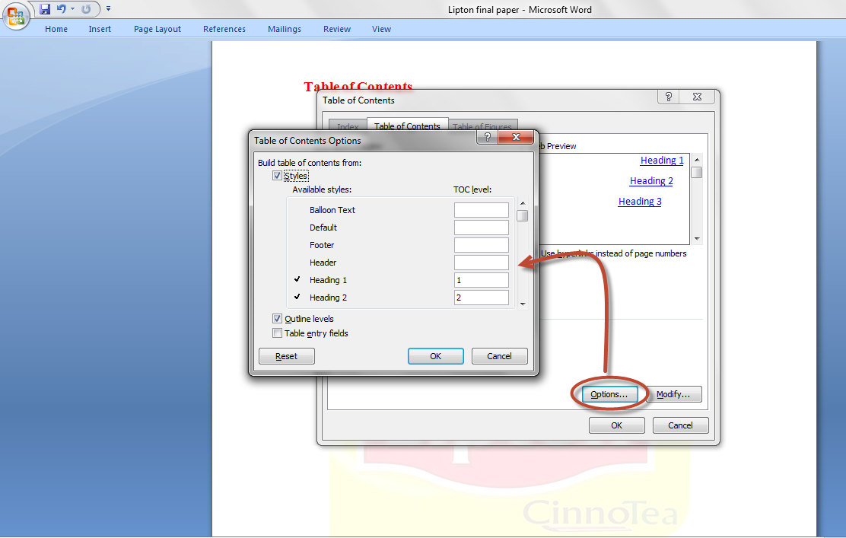
To use Custom styles in the table of contents, click Options, and then do the following:
Under Available styles, find the style that you applied to the headings in your document.
Under TOC level, next to the style name, type a number from 1 to 9 to indicate the level that you want the heading style to represent.
Click OK.
2014 BasmahAlQadheeb

Slide 19
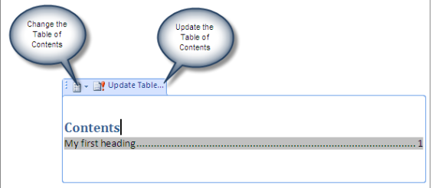
Update the Table of Contents
Tables of Contents don't update automatically when you add a new heading to your document. This is because a ToC is a field.
To update a Table of Contents, you can use the content control to update the ToC.
2014 BasmahAlQadheeb

Slide 20
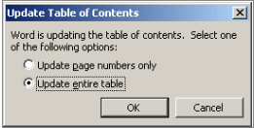
When you update your Table of Contents, always choose to update the entire table .
2014 BasmahAlQadheeb

Slide 21
Delete a Table of Contents
On the References tab, in the Table of Contents group, click Table of Contents.
Click Remove Table of Contents
2014 BasmahAlQadheeb

Slide 22
Table of Figures and Table of Tables
What if you’ve got figures and/or tables and you want to show those in the contents pages, too?
2014 BasmahAlQadheeb

Slide 23
Why do I need a Table of Figures and Tables?
It’s often useful to provide a list of the figures and tables in your document, especially if it’s a long one, like a dissertation or thesis.
They should be separate from the main table of contents, and listed below.
The tricky thing is creating two lists, one of tables and one of figures.
2014 BasmahAlQadheeb

Slide 24
Example
2014 BasmahAlQadheeb

Slide 25
How to apply a Table Caption
Let’s start off with a table caption. Remember, we want to mark a difference between tables and figures so that Word can create automatic lists.
2014 BasmahAlQadheeb

Slide 26
Put your cursor below the table and click on the References tab. Find the Captions section, Click on the Insert Caption button.
2014 BasmahAlQadheeb

Slide 27
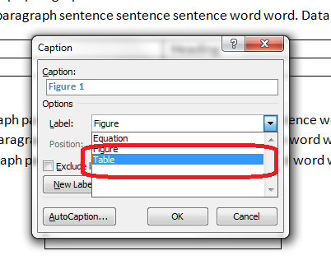
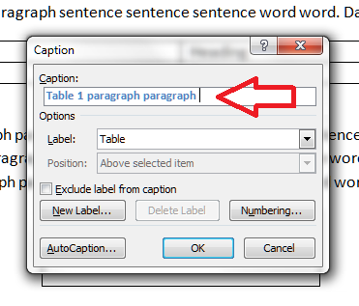
Click on the arrow on the right to drop down the list and choose Table. Once you’ve clicked, the Caption section above it will also change to read Table 1.
Now you can type the caption text straight into this box.
2014 BasmahAlQadheeb

Slide 28
It will be like this
2014 BasmahAlQadheeb

Slide 29
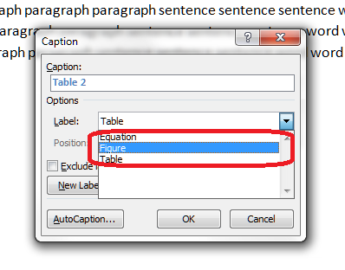
How to apply a Figure Caption
Put your cursor below the figure and click on the same Insert Caption button. This time, choose Figure rather than Table.
2014 BasmahAlQadheeb

Slide 30
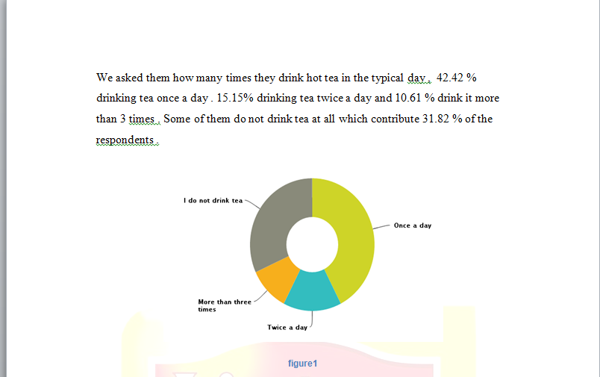
2014 BasmahAlQadheeb

Slide 31
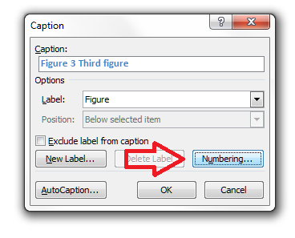
Modifying and formatting caption numbering
You can modify your captions, especially their numbering. When you’re adding a caption, click the Numbering button
2014 BasmahAlQadheeb

Slide 32
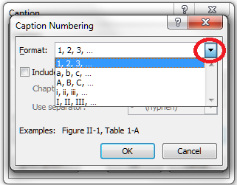
You will now get options for changing the numbering from 1, 2, 3 to a, b, c, etc.
2014 BasmahAlQadheeb

Slide 33
Creating a Table of Figures and a Table of Tables
Once you’ve labeled all of your captions correctly ,you can create your table of figures and table of tables.
2014 BasmahAlQadheeb

Slide 34
Create a blank page where you want your table of figures to go, or click just below your Table of Contents if you’ve already created that.
Click on the Reference tab, click on Insert Table of Figures.
2014 BasmahAlQadheeb

Slide 35
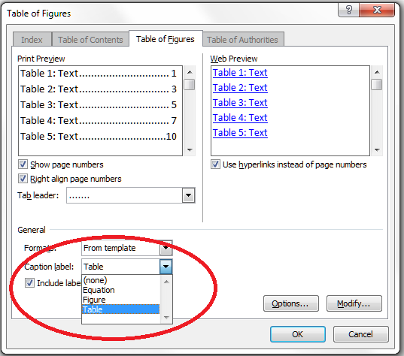
You will now get some options, and this is where we choose whether we want the figures or tables to be listed. We’re adding the figures first… and do the same to insert a Table of Tables.
2014 BasmahAlQadheeb

Slide 36
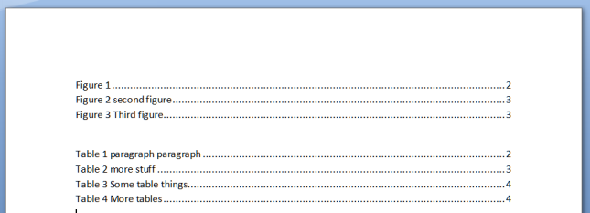
2014 BasmahAlQadheeb

Slide 37
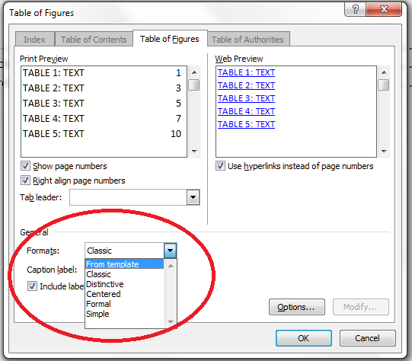
Customizing your Table of Figures and Table of Tables
You can customize them in the same way that you can customize a Table of Contents, choosing from a range of styles and specifying how they are laid out:
2014 BasmahAlQadheeb

Slide 38
The End
2014 BasmahAlQadheeb

