Slide 1
Introduction to Management Science
Thirteenth Edition, Global Edition
Chapter 7
Network Flow Models
Copyright © 2019 Pearson Education, Ltd. All Rights Reserved
Notes:
If this PowerPoint presentation contains mathematical equations, you may need to check that your computer has the following installed:
1) MathType Plugin
2) Math Player (free versions available)
3) NVDA Reader (free versions available)

Slide 2
Learning Objectives
7.1 Network Components
7.2 The Shortest Route Problem
7.3 The Minimal Spanning Tree Problem
7.4 The Maximal Flow Problem

Slide 3
Learning Objective 7.1
Network Components

Slide 4
Network Components (1 of 3)
A network is an arrangement of paths (branches) connected at various points (nodes) through which one or more items move from one point to another.
The network is drawn as a diagram providing a picture of the system, thus enabling visual representation and enhanced understanding.
A large number of real-life systems can be modeled as networks which are relatively easy to conceive and construct.

Slide 5
Network Components (2 of 3)
Network diagrams consist of nodes and branches.
Nodes (circles), represent junction points, or locations.
Branches (lines), connect nodes and represent flow.

Slide 6
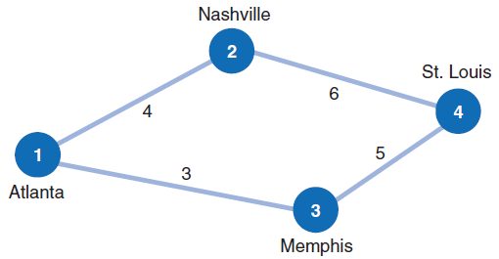
Network Components (3 of 3)
Four nodes, four branches in figure.
“Atlanta”, node 1, termed the origin; any of others, destination.
Branches identified by beginning and ending node numbers.
Value assigned to each branch (distance, time, cost, etc.).
Figure 7.1 Network of railroad routes

Slide 7
Learning Objective 7.2
The Shortest Route Problem

Slide 8
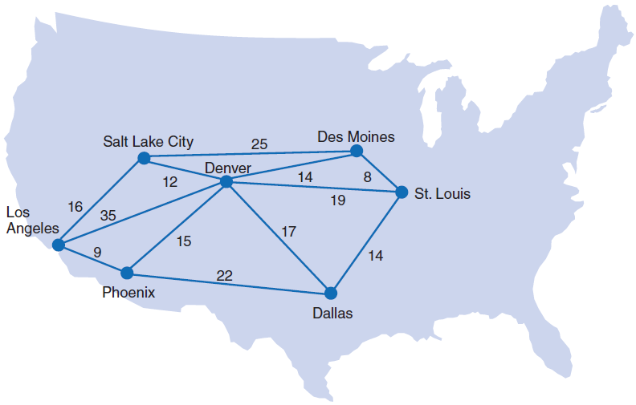
Definition and Example Problem Data 1 (1 of 2)
Problem: Determine the shortest routes from the origin to all destinations.
Figure 7.2 Shipping routes from Los Angeles

Slide 9
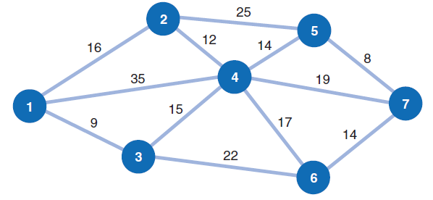
Definition and Example Problem Data 1 (2 of 2)
Figure 7.3 Network representation of shortest route problem

Slide 10
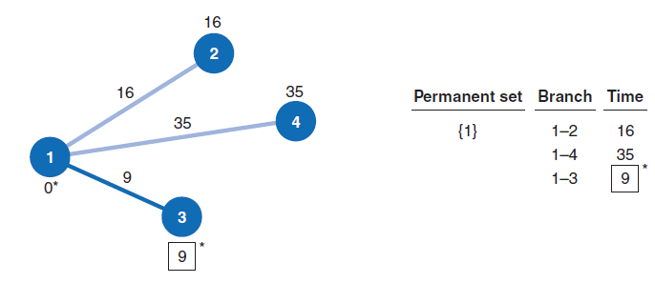
Solution Approach 1 (1 of 8)
Determine the initial shortest route from the origin (node 1) to the closest node (3).
The permanent set indicates the nodes for which the shortest route to has been found.
Figure 7.4 Network with node 1 in the permanent set

Slide 11
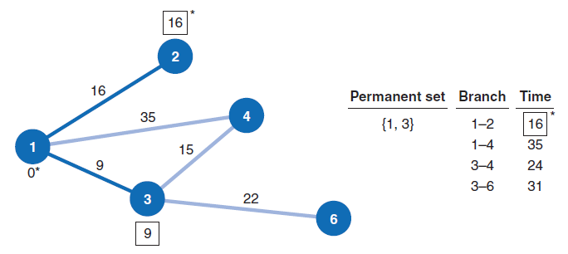
Solution Approach 1 (2 of 8)
Determine all nodes directly connected to the permanent set.
Figure 7.5 Network with nodes 1 and 3 in the permanent set

Slide 12
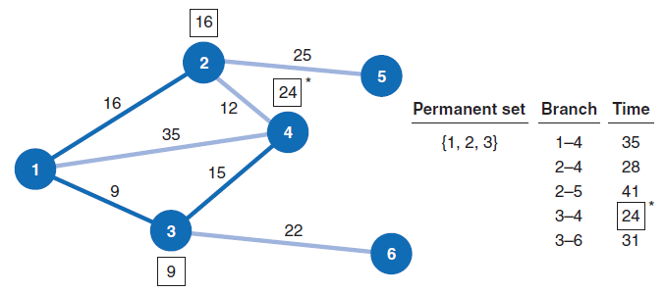
Solution Approach 1 (3 of 8)
Redefine the permanent set.
Figure 7.6 Network with nodes 1, 2, and 3 in the permanent set

Slide 13
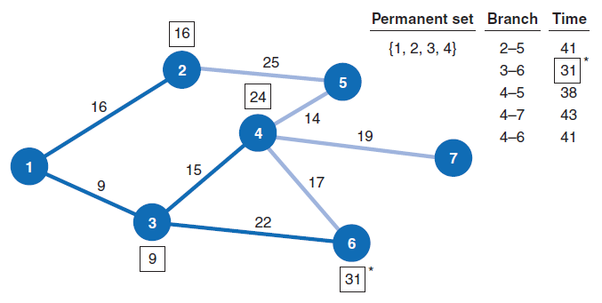
Solution Approach 1 (4 of 8)
Figure 7.7 Network with nodes 1, 2, 3, and 4 in the permanent set

Slide 14
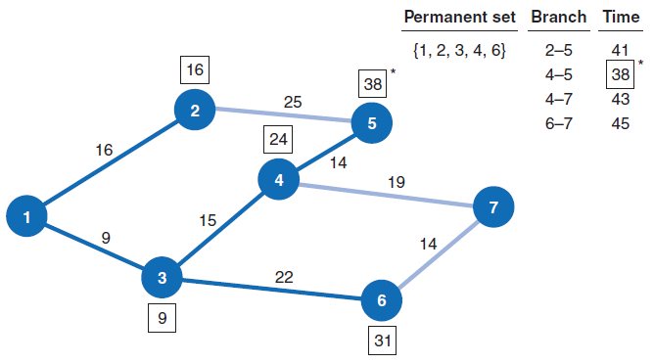
Solution Approach 1 (5 of 8)
Figure 7.8 Network with nodes 1, 2, 3, 4, & 6 in the permanent set

Slide 15
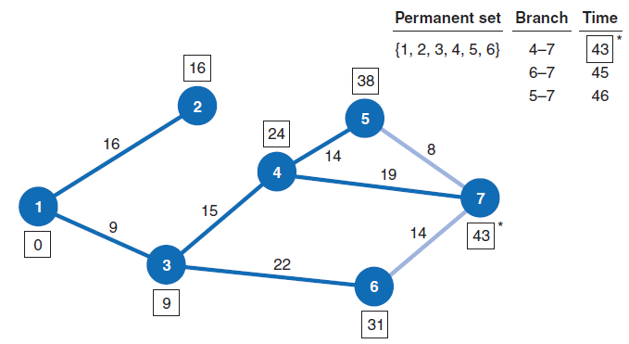
Solution Approach 1 (6 of 8)
Figure 7.9 Network with nodes 1, 2, 3, 4, 5 & 6 in the permanent set

Slide 16
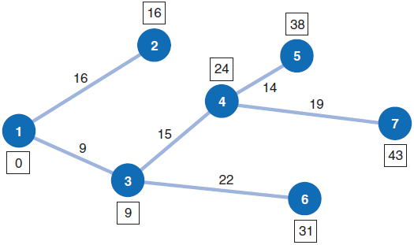
Solution Approach 1 (7 of 8)
Figure 7.10 Network with optimal routes from L A to all destinations

Slide 17
Solution Approach 1 (8 of 8)
Table 7.1 Shortest travel time from origin to each destination
From Los Angeles to: | Route | Total Hours
Salt Lake City (node 2) | 1–2 | 16
Phoenix (node 3) | 1–3 | 9
Denver (node 4) | 1–3–4 | 24
Des Moines (node 5) | 1–3–4–5 | 38
Dallas (node 6) | 1–3–6 | 31
St. Louis (node 7) | 1–3–4–7 | 43

Slide 18
Solution Method Summary 1
Select the node with the shortest direct route from the origin.
Establish a permanent set with the origin node and the node that was selected in step 1.
Determine all nodes directly connected to the permanent set nodes.
Select the node with the shortest route from the group of nodes directly connected to the permanent set nodes.
Repeat steps 3 & 4 until all nodes have joined the permanent set.

Slide 19
Computer Solution with Q M for Windows 1 (1 of 2)
Exhibit 7.1

Slide 20
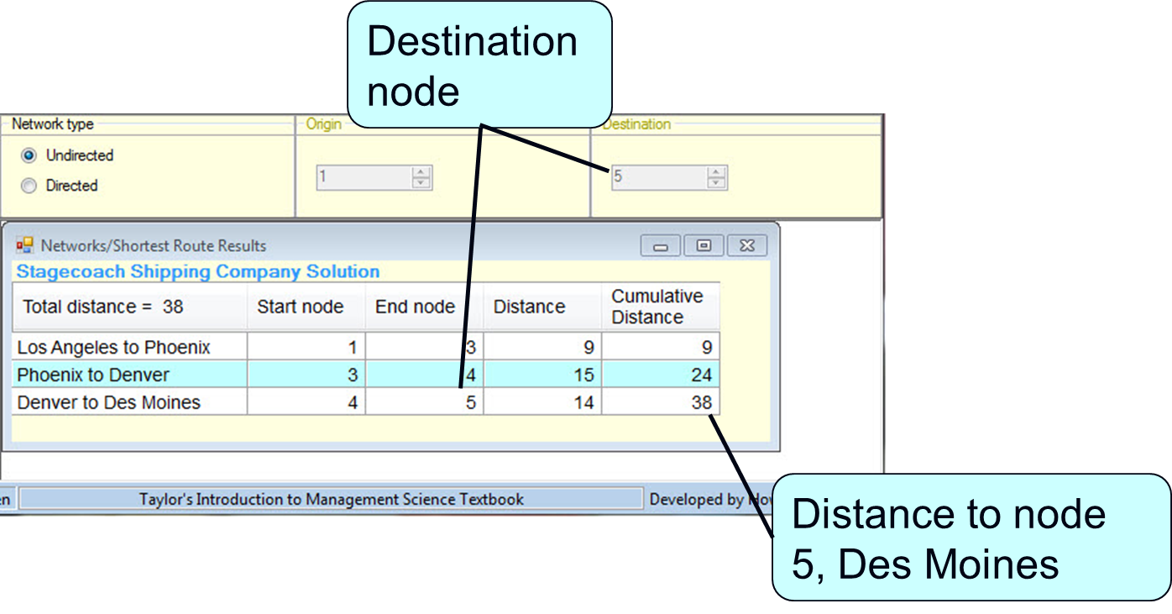
Computer Solution with Q M for Windows 1 (2 of 2)
Exhibit 7.2

Slide 21
Computer Solution with Excel 1 (1 of 4)
Formulation as a 0–1 integer linear programming problem.
if branch i–j is not selected as part of the shortest
route and 1 if it is selected.

Slide 22
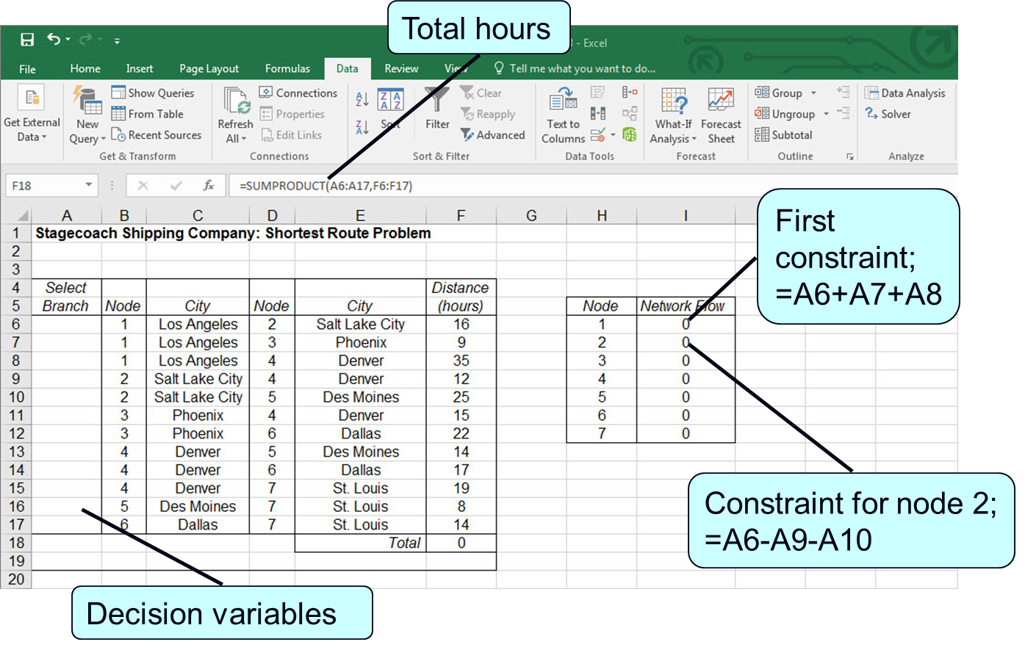
Computer Solution with Excel 1 (2 of 4)
Exhibit 7.3

Slide 23
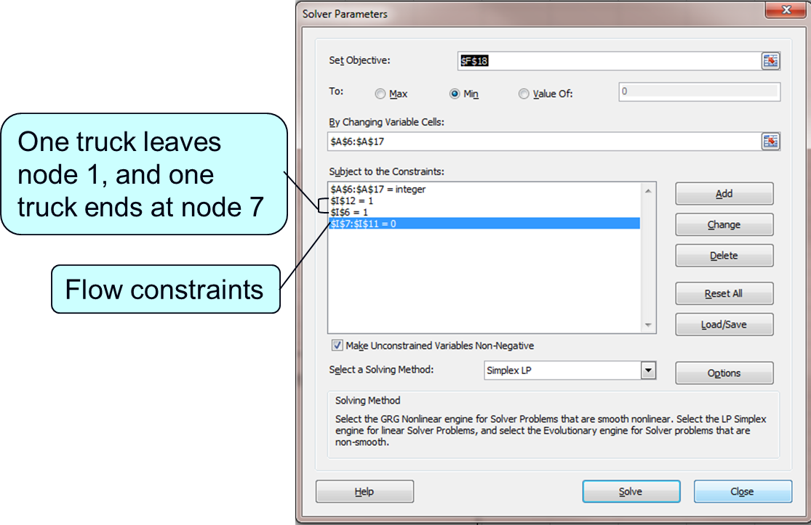
Computer Solution with Excel 1 (3 of 4)
Exhibit 7.4

Slide 24
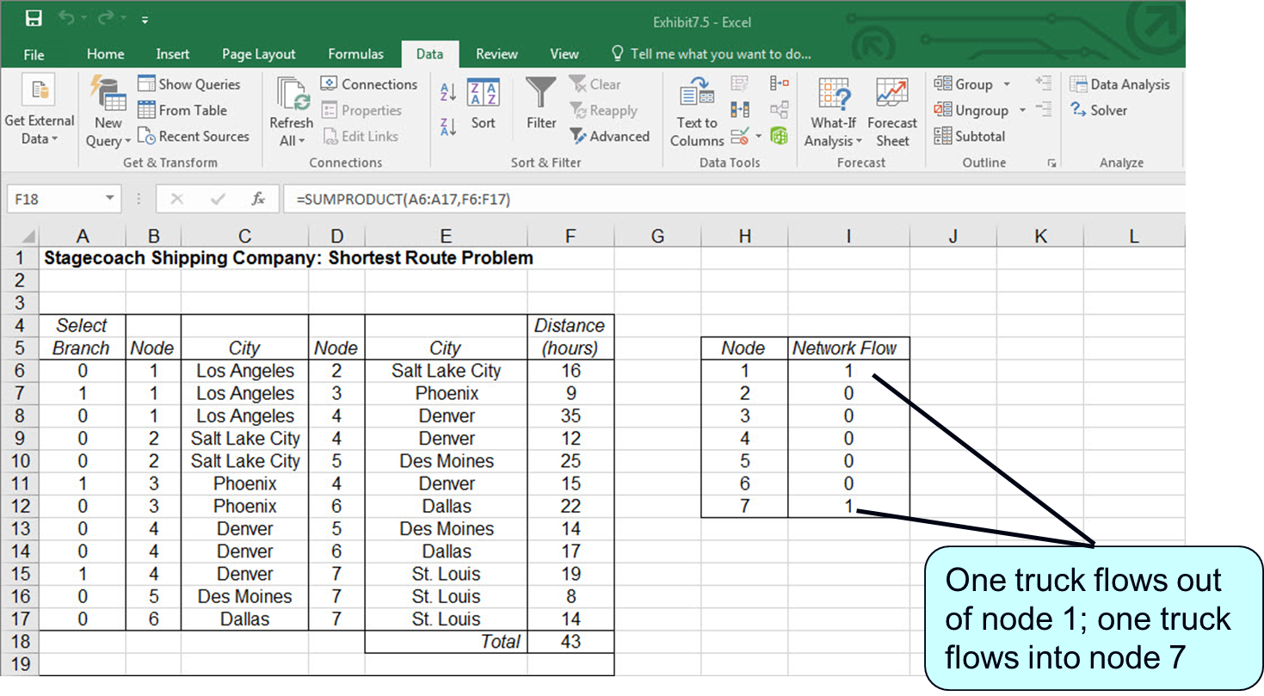
Computer Solution with Excel 1 (4 of 4)
Exhibit 7.5

Slide 25
Learning Objective 7.3
The Minimal Spanning Tree Problem

Slide 26
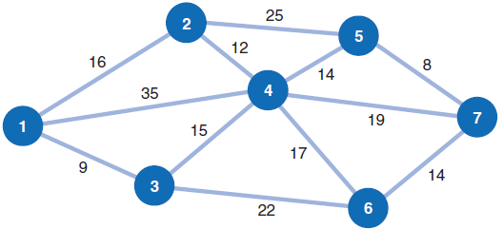
Definition and Example Problem Data 2
Problem: Connect all nodes in a network so that the total of the branch lengths are minimized.
Figure 7.11 Network of possible cable T V paths

Slide 27
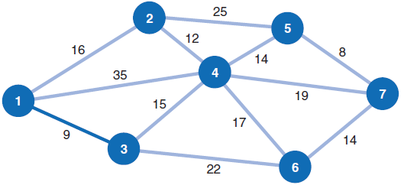
Solution Approach 2 (1 of 6)
Start with any node in the network and select the closest node to join the spanning tree.
Figure 7.12 Spanning tree with nodes 1 and 3

Slide 28
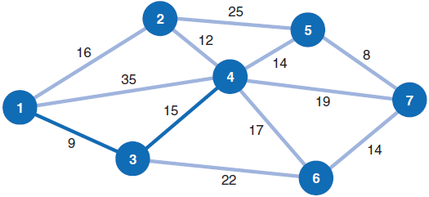
Solution Approach 2 (2 of 6)
Select the closest node not presently in the spanning area.
Figure 7.13 Spanning tree with nodes 1, 3, and 4

Slide 29
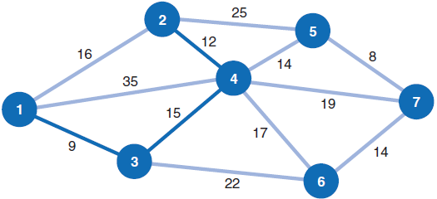
Solution Approach 2 (3 of 6)
Figure 7.14 Spanning tree with nodes 1, 2, 3, and 4

Slide 30
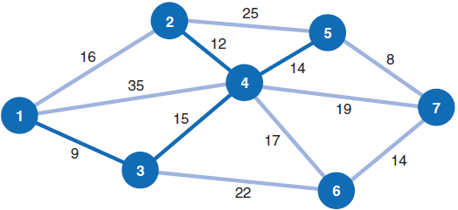
Solution Approach 2 (4 of 6)
Figure 7.15 Spanning tree with nodes 1, 2, 3, 4, and 5

Slide 31
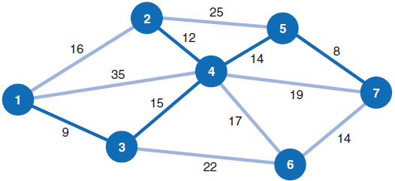
Solution Approach 2 (5 of 6)
Figure 7.16 Spanning tree with nodes 1, 2, 3, 4, 5, and 7

Slide 32
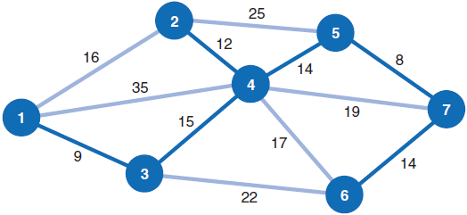
Solution Approach 2 (6 of 6)
Optimal Solution
Figure 7.17 Minimal spanning tree for cable T V network

Slide 33
Solution Method Summary 2
Select any starting node (conventionally, node 1).
Select the node closest to the starting node to join the spanning tree.
Select the closest node not currently in the spanning tree.
Repeat step 3 until all nodes have joined the spanning tree.

Slide 34
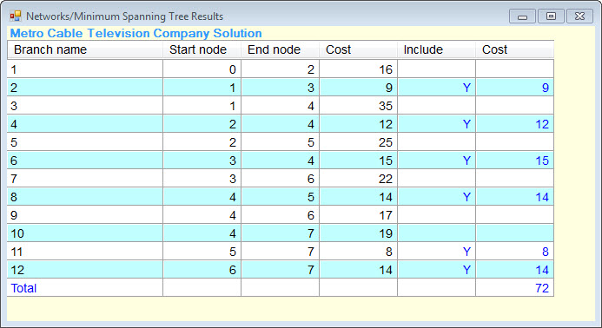
Computer Solution with Q M for Windows 2
Exhibit 7.6

Slide 35
Learning Objective 7.4
The Maximal Flow Problem

Slide 36
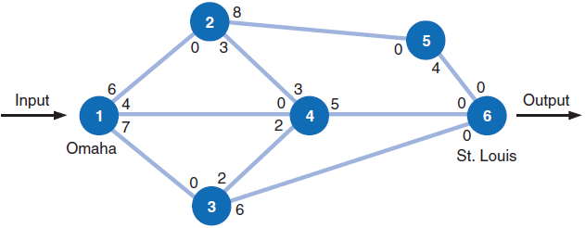
Definition and Example Problem Data 3
Problem: Maximize the amount of flow of items from an origin to a destination.
Figure 7.18 Network of railway system

Slide 37
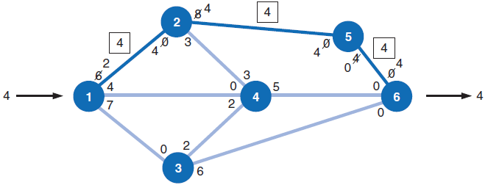
Solution Approach 3 (1 of 5)
Step 1: Arbitrarily choose any path through the network from origin to destination and ship as much as possible.
Figure 7.19 Maximal flow for path 1–2–5–6

Slide 38
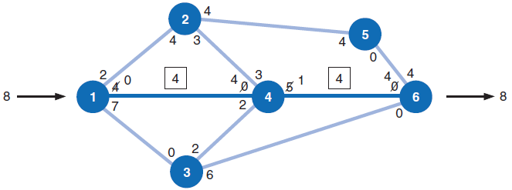
Solution Approach 3 (2 of 5)
Step 2: Re-compute branch flow in both directions
Step 3: Select other feasible paths arbitrarily and determine maximum flow along the paths until flow is no longer possible.
Figure 7.20 Maximal flow for path 1–4–6

Slide 39
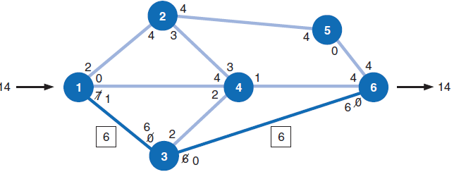
Solution Approach 3 (3 of 5)
Figure 7.21 Maximal flow for path 1–3–6

Slide 40
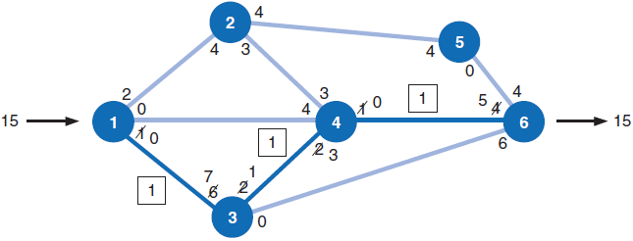
Solution Approach 3 (4 of 5)
Figure 7.22 Maximal flow for path 1–3–4–6

Slide 41
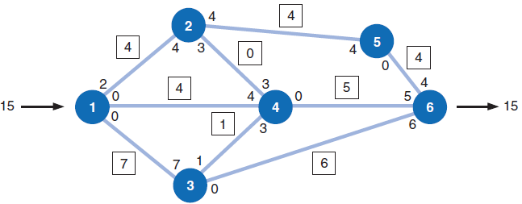
Solution Approach 3 (5 of 5)
Optimal Solution
Figure 7.23 Maximal flow for railway network

Slide 42
Solution Method Summary 3
Arbitrarily select any path in the network from the origin to the destination.
Adjust the capacities at each node by subtracting the maximal flow for the path selected in step 1.
Add the maximal flow along the path to the flow in the opposite direction at each node.
Repeat steps 1, 2, and 3 until there are no more paths with available flow capacity.

Slide 43
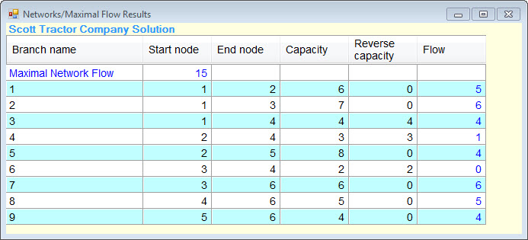
Computer Solution with Q M for Windows 3
Exhibit 7.7

Slide 44
Computer Solution with Excel 2 (1 of 4)
flow along branch i–j and integer
Maximize
subject to:

Slide 45
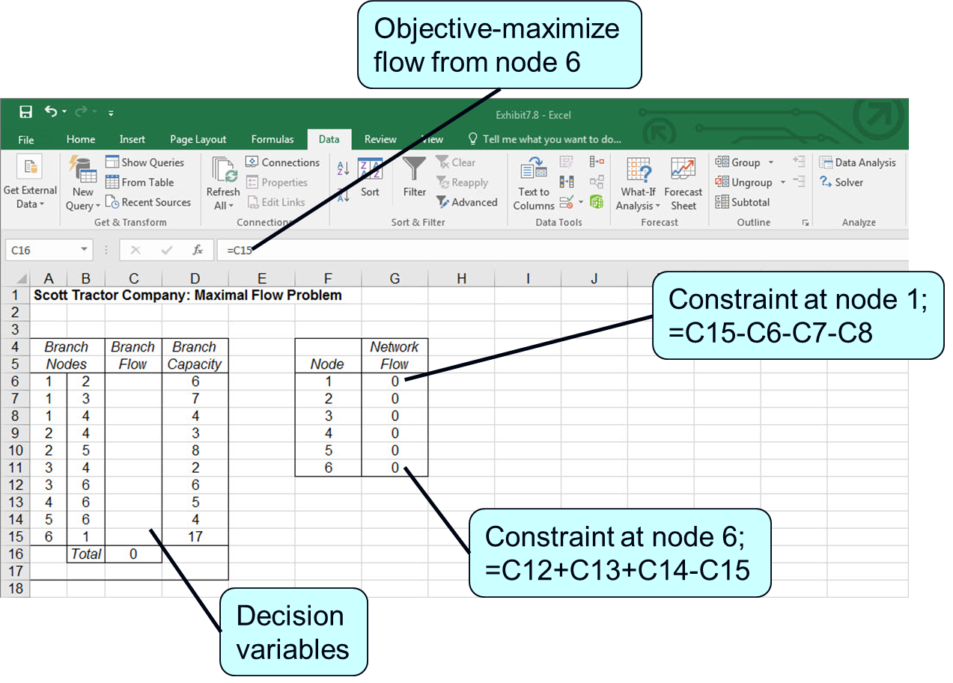
Computer Solution with Excel 2 (2 of 4)
Exhibit 7.8

Slide 46
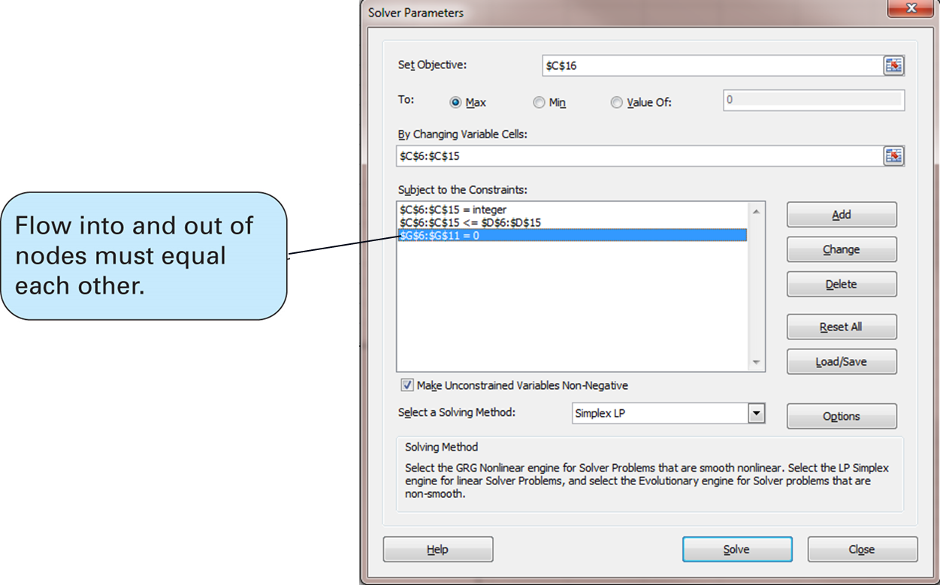
Computer Solution with Excel 2 (3 of 4)
Exhibit 7.9

Slide 47
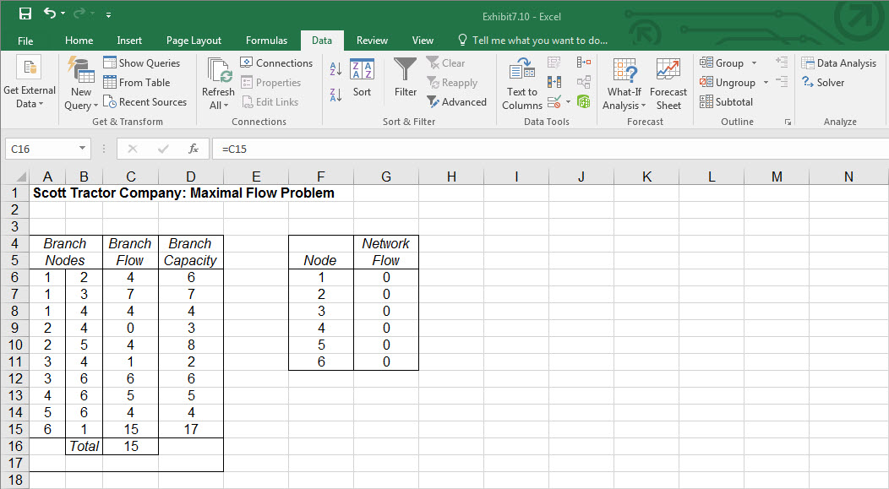
Computer Solution with Excel 2 (4 of 4)
Exhibit 7.10

Slide 48
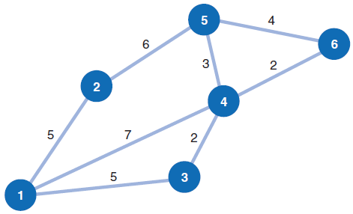
Example Problem Statement and Data
Determine the shortest route from Atlanta (node 1) to each of the other five nodes (branches show travel time between nodes).
Assuming the branches show distance (instead of travel time) between the nodes, develop a minimal spanning tree.

Slide 49
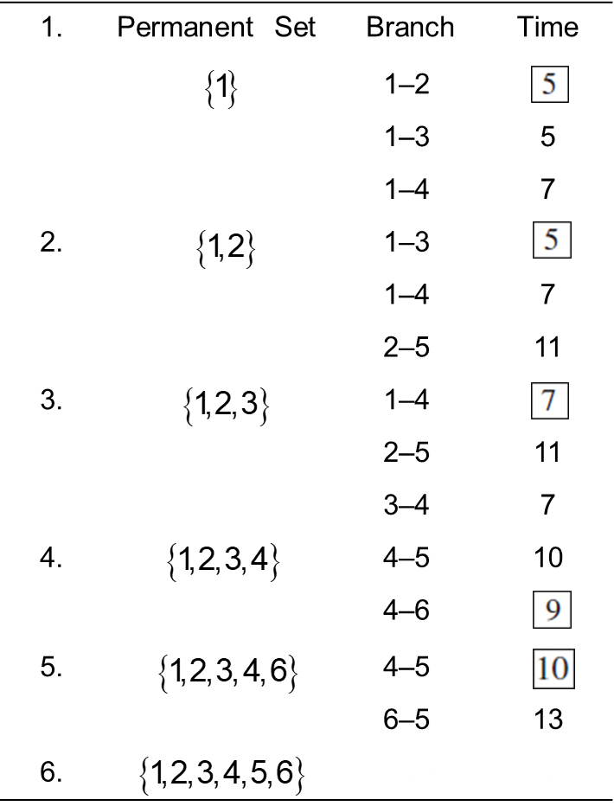
Example Problem, Shortest Route Solution (1 of 2)
Step 1 (part A): Determine the Shortest Route Solution

Slide 50
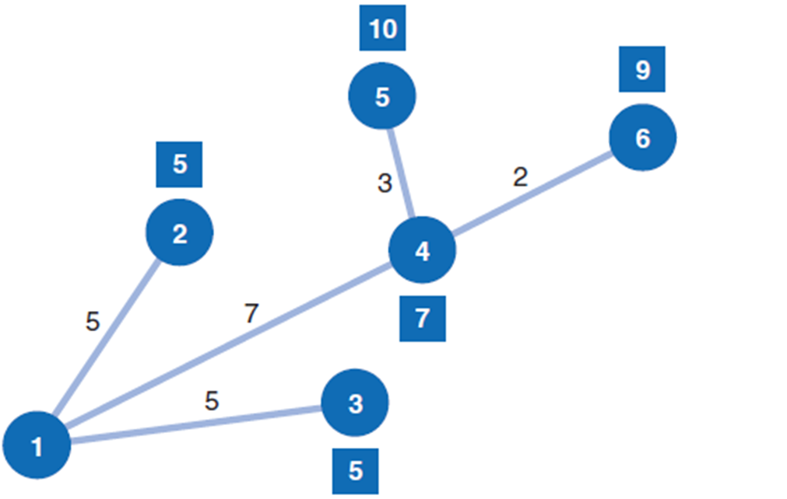
Example Problem, Shortest Route Solution (2 of 2)
Shortest route network

Slide 51
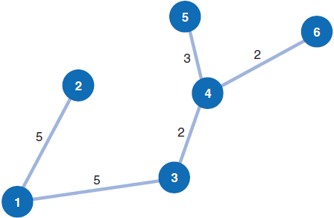
Example Problem, Minimal Spanning Tree
The closest unconnected node to node 1 is node 2.
The closest to 1 and 2 is node 3.
The closest to 1, 2, and 3 is node 4.
The closest to 1, 2, 3, and 4 is node 6.
The closest to 1, 2, 3, 4 and 6 is 5.
The shortest total distance is 17 miles.

