Slide 1
The roles and opportunities of Actuaries in Saudi Insurance Market
Fahad Almansoor ( Actuarial analyst)
11th of April 2018

Slide 2
Outlines
Roles of appointed actuary
Opportunities
Who is the actuary
Pricing the products
Reserving&Solvency
SAMA Functions

Slide 3
SAMA’s Functions

Slide 4
SAMA’s Funactions
SAMA Functions
Saudi Arabian Monetary Authority (SAMA), the central bank of the Kingdom of Saudi Arabia, was established in 1372H (1952). It has been entrusted with performing many functions pursuant to several laws and regulations. The most important functions are the following:
To deal with the banking affairs of the Government
Minting and printing the national currency (the Saudi Riyal), strengthening the Saudi currency and stabilizing its external and internal value, in addition to strengthening the currency’s cover;
Managing the Kingdom’s foreign exchange reserves;
Managing the monetary policy for maintaining the stability of prices and exchange rate;
Promoting the growth of the financial system and ensuring its soundness;
Supervising commercial banks and exchange dealers;
Supervising cooperative insurance companies and the self-employment professions relating to the insurance activity;
Supervising finance companies;
Supervising credit information companies.

Slide 5
Organizational structure

Slide 6
GDIC Structure

Slide 7
Who is the actuary?

Slide 8
Introduction
Who is the Actuary?
Actuary
Apply math and statistics knowledge to business and finance in order to estimate risk
Plan for the future by evaluating the likelihood of future events such as
– Retirement – Catastrophic events (earthquakes, hurricanes, etc.) – Health care, auto claims and liability
Help find ways to reduce risk and its financial impact

Slide 9
Introduction
Career Paths Of An Actuary
Once you graduate from college there are different options for career paths:
Retirement
Health
Reserving
Pricing
Insurance companies (60% of all actuaries are employed by Health insurance (SOA))
Life Insurance (SOA)
Property and Casualty including auto, homeowners, etc (CAS)

Slide 10
Introduction
An Example of Actuarial Work
Present Value: If you have a retirement plan that pays you $1,000 a month for as long as you live, how much is that worth today? – You have to account for interest rates (Time Value of Money) – Also factor in the probability of surviving (Statistics)

Slide 11
Introduction
Benefits Of Being An Actuary
Actuary has consistently been ranked one of the best careers in America – It is ranked 1st according to CareerCast.com's 2015 Jobs Rated Report Based on environment, income, physical demands, hiring outlook, and stress

Slide 12
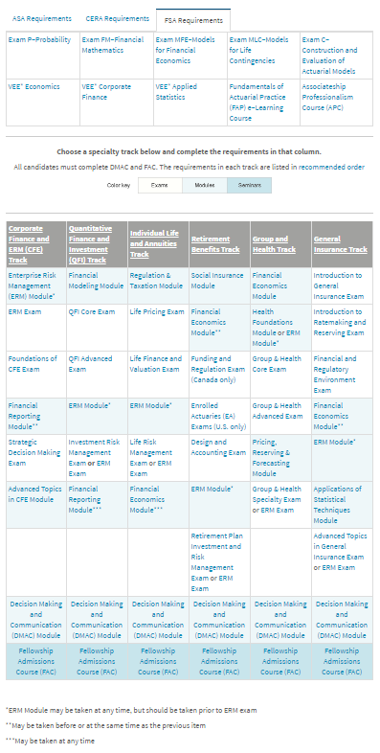
Professional Designations
Actuarial Exams
In order to achieve professional designations, there are series of exams to pass – Exams test subjects related to the actuarial profession such as: • Probability • Financial Mathematics • Investments • Life insurance

Slide 13
Professional Designations
Where To Get More Information
www.BeAnActuary.org – Great resource for high school students – Offers a lot of information
www.soa.org – Official site for the Society of Actuaries – Has a list of colleges with actuarial programs (see the education section)
www.casact.org – Official site for the Casualty Actuarial Society

Slide 14
Roles of appointed actuary

Slide 15
Implementing Regulations
Actuary:
Person who conducts various statistical and probability theories whereby services are priced; liabilities are assessed and provisions calculated
Solvency Margin:
Minimum standard of financial health for an insurance or reinsurance company, where assets exceed liabilities.

Slide 16
Implementing Regulations
Article Twenty
First: The Company shall appoint an Actuary who should be a Fellow to undertake the following duties:
Obtain all required information and particulars from the previous Actuary
Examine the Company’s financial position
Evaluate the Company’s ability to meet its future obligations
Determine adequate risk retention level
Price the Company’s insurance product
Determine and approve the Company’s technical provisions
Provide advice and recommendations related to the Company’s investment policy
Any other actuarial recommendations

Slide 17
Implementing Regulations
Article Twenty
Second: The Actuary is professionally liable for his/her advice and technical services provided to the Company. According to the Company’s request, the Actuary should furnish to the Company’s management with the following particulars and documents:
Sound actuarial information and statements about the company’s present and future financial position.
Annual report, within sixty days from the expiry date of the company’s fiscal year reflecting the adequacy of the Company’s technical provisions.
Annual report, within sixty days from the expiry date of the Company’s fiscal year reflecting the pricing adequacy of the insurance products.
Company’s investment returns analysis.
Insurance portfolio development analysis.
Cost Analysis
Report reflecting the adequacy of matching assets with liabilities.
Positive and adverse underwriting policy development status.
The Company shall ensure compliance with all required actuarial duties and reports. Otherwise, the Agency shall appoint an actuary at the company’s expense to undertake these actuarial duties.

Slide 18
Implementing Regulations
Article Twenty
Third: An external auditor shall review actuarial reports that present immediate or future risks facing the Company, and the Agency shall be provided with copies of these reports in a timely manner. The Company’s Actuary shall, in the presence of immediate or future risks facing the Company, submit a report on an urgent basis directly to the company’s Board of Directors. The Board of Directors shall examine the report and recommend corrective actions, and forward all related information to the Agency within fifteen days from receiving the report.

Slide 19
Pricing
Terms & Definitions
Gross Written Premium
Net Written Premium
Retention Rate (Net Written Premium/Grows Written Premium)
Net Earned Written Premium
Gross Written
Net Written
Net Earned

Slide 20
Pricing
Loss, Expenses and Companied ratios
$$Net Loss Ratio=\frac{Net Incurred Claims (Including any Claims Costs)}{Net Earend Premium}$$
$$Expenses Ratio=\frac{Total Expenses}{Net Earend Premium}$$
$$Combined Ratio=Net Loss Ratio+Expenses Ratio$$

Slide 21
Pricing the products

Slide 22
Pricing
Rating Factors
Medical:
Age
Gender
Status
Benefit level
Motor (TPL):
Vehicle type (Sedan, Jeep, … etc)
Age of Main Driver
Address of Policyholder where the Vehicle is kept, subdivided by Province at least.
Nationality of vehicle manufacturer.
Age of vehicle.

Slide 23
Pricing
Pricing Methodology
Office Rate
Book Rate
Total Loadings
Fees
Adjustment Factor
Expenses
Commission
Final Risk Rate
Margins

Slide 24
Reserving& Solvency

Slide 25
Financial Condition Report
Why Technical Provisions Are Important?
It reflects the actual financial position of the company
The technical provision will cover the arising future claims
The companies do not like the technical provisions because they will hit the bottom line of the company(net profit) since it is a liability.

Slide 26
Financial Condition Report
Why SAMA Concerns About The Technical Provisions?
Since SAMA is mostly protecting the policyholders, the company should book adequate technical provisions to cover its arising future claims
SAMA has issued the Financial Condition Report (FCR) instructions letter to the insurance companies

Slide 27
Financial Condition Report
The FCR is mainly about the financial position of the company
The FCR has to be prepared by the Appointed Actuary of the company
The FCR is in annual basis

Slide 28
Technical Provisions
In the actuarial context the reserve word is used to the technical provisions
Types of actuarial reserves in the FCR
Data deficiency reserve
Outstanding reserve
Incurred but not reported yet (IBNR)
Incurred but not enough reported (IBNER)
Premium Deficiency Reserve (PDR)
Unearned premium reserve (UPR)
Unexpired risk reserve (URR)

Slide 29
Solvency
The solvency margin is an indicator for the company that will be able to meet its obligations
SAMA wants the company to be solvent which means the solvency margin above 100%
The method to calculate the solvency margin:
$$Solvency Margin= \frac{Net admissible asset }{Maximum\left( A, B, C \right)+D}$$
A: Minimum capital requirement (100M for insurance company and 200M for reinsurance company)
B: Total required margin on premium basis
C: Total required margin on claims basis
D: The mathematical reserve for protection and saving

Slide 30
Opportuiinties

Slide 31
Opportunities
There are only three licensed actuarial service companies (Manar Sigma, Actu-Scope and Alkhwarizmi). We have other global actuarial service companies that are appointed actuary to the insurance companies(Lux, Sidat Hyder, … etc)
It can be considered as major opportunities for the new Saudi Fellows
The Penetration of the non mandatory insurance still considered as in low point, thus increase it will open more opportunities
There is only one Saudi Fellow who have got the designation, Mr. Ahmad Al-Quraishi
All of the insurance companies will have to develop their technical expertise of their human resources and some regulations may request employing Actuarial students

Slide 32
References
www.soa.org
www.casact.org
www.BeAnActuary.org
www.SAMA.Gov.SA
Law on supervision of cooperative insurance companies
Implementing Regulation
Actuarial Work Regulation

Slide 33
Conclusion

