Slide 1
PROJECT TIME PLANNING
Process and Bar Chart Technique

Slide 2
Definition of Planning
Planning is the process of thinking systematically about the future in order to decide
  what our goals are, and
  how we are going to achieve them.
Planning means looking ahead, making preparations, and deciding the best course of action.

Slide 3
Dimensions of Planning
Planning can be viewed from following points:
Subject:- Time Planning, Quality Planning, Financial Planning, Risk Planning, Product Planning, Organizational Planning, …….
Organization:- Strategic Planning, Corporate Planning, Project Planning, …
Time:- Long-Rang Planning, Short-Range Planning, Weekly Planning, ….

Slide 4
Why is Time Planning necessary?
The increasing importance of timely completion.
The continuous complexity and growth in the size of the project generates the necessity for specialization. Specialization may lead to a breakdown of communications. Time planning must be found to facilitate communications.
Planning is essential for resource management
Planning is important for the efficient and maximum utilization of resources.

Slide 5
Why is Time Planning necessary?
Planning is basis for evaluating progress, controlling the work and making decisions.
For achieving an increase in production.
Financiers require a workable plan.
Essential in projects when their is transfer of personnel.
Minimum risk of the problems occurring.

Slide 6
Who Needs Time Planning?
Customer/ Client/ Owner
Designer/ Consultant
Project management team (Manager, Engineers)
Cost estimating department
Planning and controlling department
Supervisors, foremen, labors
Supplier
Financiers

Slide 7
Processes of Time Planning
Visualize and define the activities. (WBS =Work breakdown Structure))
Sequence the activities (Job Logic).
Estimate the activity duration.
Schedule the project or phase.
Allocate and balance resources.

Slide 8
Processes of Time Planning
Visualize and define the activities. (WBS =Work breakdown Structure))
Sequence the activities (Job Logic).
Estimate the activity duration.
Schedule the project or phase.
Allocate and balance resources.

Slide 9
1a) Visualize and define the activities
An activity is a single work step (element) that has a recognizable beginning and end and requires time for its accomplishment.
  Activity definition involves identifying and documenting the specific activities that must be performed to produce the deliverables and sub-deliverables.

Slide 10
1b) Visualize and define the activities
The technique of decomposition (Work Breakdown) may be used in defining activities. Decomposition involves subdividing project work packages into smaller, more manageable components to provide better management control.
The output from activity definition is the activity list.
The Level of detail of the plan should be considered in this phase.

Slide 11
1-Visualize and define the activities
Work Breakdown Structure (WBS)
WBS divides the project into recognizable work packages (tasks and activities) at different levels
Level
Project
Major tasks in the project
Subtasks in the major tasks
Activities (work packages) to be completed

Slide 12
1-Visualize and define the activities
Work Breakdown Structure (WBS)
Level 1
Develop Windows 7 Operating System
1.0
Level 2
Software Design
1.1
Project Management
1.2
System Testing
1.3
Level 3
Develop GUIs
1.1.1
Planning
1.2.1
Module Testing
1.3.1
Ensure Compatibility with Earlier Versions
1.1.2
Cost/Schedule Management
1.2.2
Defect Testing
1.3.2
Level 4
Compatible with Windows ME
1.1.2.1
(Work packages)
Compatible with Windows Vista
1.1.2.2
(From Heizer/Render: operation Management Figure 3.3 )
Compatible with Windows XP
1.1.2.3

Slide 13
1c) Visualize and define the activities
Case Study: Install a new machine
Activity Code | Activity Description | Depends on | Level | Duration (day)
 | Inspect the machine after installation
 | Hire the operator
 | Install the new machine
 | Inspect and store the machine after delivery
 | Hire labor to install the new machine
 | Train the operator
 | Order and deliver the new machine

Slide 14
Processes of Time Planning
Visualize and define the activities. (WBS =Work breakdown Structure))
Sequence the activities (Job Logic).
Estimate the activity duration.
Schedule the project or phase.
Allocate and balance resources.

Slide 15
2a) Sequence the activities
Sequence the activities or job logic refers to identifying and documenting interactivity logical relationships,
  i.e. determined order in which the activities are to be accomplished in the project.

Slide 16
2b) Sequence the activities
Job plan must reflect the practical restraints or limitations that apply to most job activities. The types of restraints are:
    Mandatory dependencies or hard logic (natural dependency),
    Preferred logic (Discretionary dependencies),
    External dependencies,
    Resource restraints and
    Safety restraints.
  Predecessor activities mean coming before, while successor activities mean coming after.
  Overlap the activities to reduce the project time.

Slide 17
2c) Sequence the activities
Case Study: Install a new machine
Activity Code | Activity Description | Depends on | Level | Duration (day)
100 | Inspect the machine after installation | 300 | 4
200 | Hire the operator | None | 1
300 | Install the new machine | 500, 400 | 3
400 | Inspect and store the machine after delivery | 700 | 2
500 | Hire labor to install the new machine | None | 1
600 | Train the operator | 200, 300 | 4
700 | Order and deliver the new machine | None | 1

Slide 18
Processes of Time Planning
Visualize and define the activities. (WBS =Work breakdown Structure))
Sequence the activities (Job Logic).
Estimate the activity duration.
Schedule the project or phase.
Allocate and balance resources.

Slide 19
3a) Estimate the activity duration
Select the time unit (week, day,..) to be used.
Use one of the following tools and techniques for estimating the activity duration:
  Expert judgment
  Quantitatively based durations
    Duration of activity (D) = Quantity of work / [Production rate of a crew or equipment * No. of crews].
    Where ‘production rate = Quantity produced in unit of time’
    Duration of activity (D) = Quantity of work * Unit rate productivity of a crew or equipment
    Where ‘unit rate productivity = Time needs to produce one unit of output’

Slide 20
3b) Estimate the activity duration
Case Study: Install a new machine
Activity Code | Activity Description | Depends on | Level | Duration (day)
100 | Inspect the machine after installation | 300 | 4 | 1
200 | Hire the operator | None | 1 | 25
300 | Install the new machine | 500, 400 | 3 | 2
400 | Inspect and store the machine after delivery | 700 | 2 | 1
500 | Hire labor to install the new machine | None | 1 | 20
600 | Train the operator | 200, 300 | 4 | 3
700 | Order and deliver the new machine | None | 1 | 30

Slide 21
Processes of Time Planning
Visualize and define the activities. (WBS =Work breakdown Structure))
Sequence the activities (Job Logic).
Estimate the activity duration.
Schedule the project or phase.
Allocate and balance resources.

Slide 22
4a) Schedule the Project or Phase
Scheduling Defined
It is process showing relationship of activities and determining of the project duration time and the project activities starting and finishing timings.

Slide 23
4a) Schedule the Project or Phase
Purpose of Scheduling
  Ensure that all activities are planned for
  Their order of performance is accounted for
  The activity time estimates are recorded
  The overall project time is developed
In scheduling we consider the following questions:
  How long the project is expected to take?
  When each activity may be scheduled (started and ended)?
  How resources can be used more proper?
  What are the critical bottlenecks in the project?

Slide 24
4b) Schedule the Project or Phase
Project Scheduling principles
  Project scheduling is carried out before a project begins.
  It involves (1) identifying tasks, (2) estimating duration and (3) allocating
  resources.
  The revision is done by creating milestones.
  Once the project is underway, the schedule may need to be
  revised based on initial progress. This ensures (1) cost estimates
  and (2) time constraints are maintained at a specific level of quality and
  scope.

Slide 25
Time Planning Techniques
  To schedule the project, the planner needs a Time Planning Technique.
  Bar Charts and Linked Bar Charts;
  Network Model (Analysis), either
    Activity on arrow (AOA),
    Activity on node (AON),
    Precedence Diagram
  Line of Balance;
  Time-location Diagram.

Slide 26
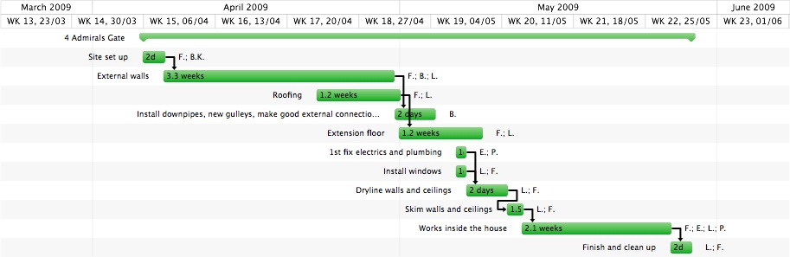
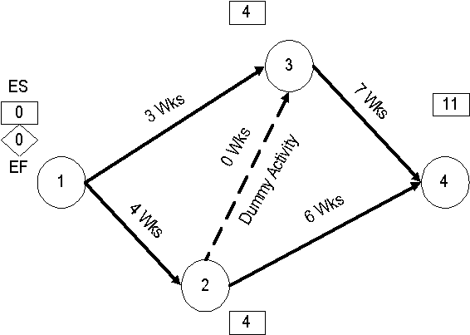
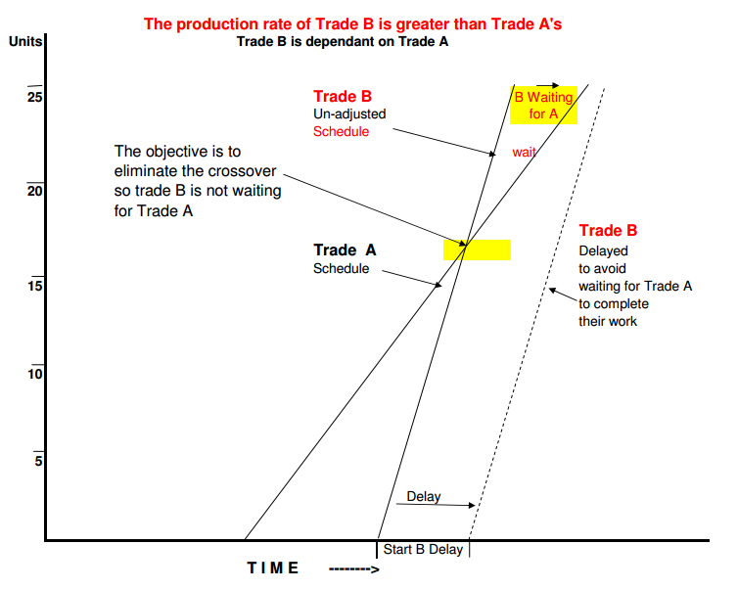
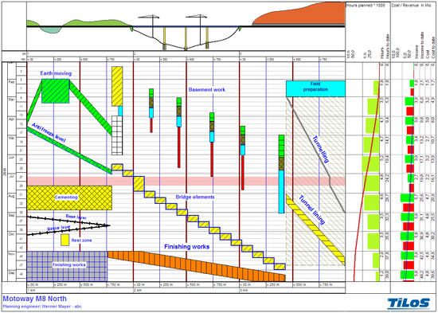

Slide 27
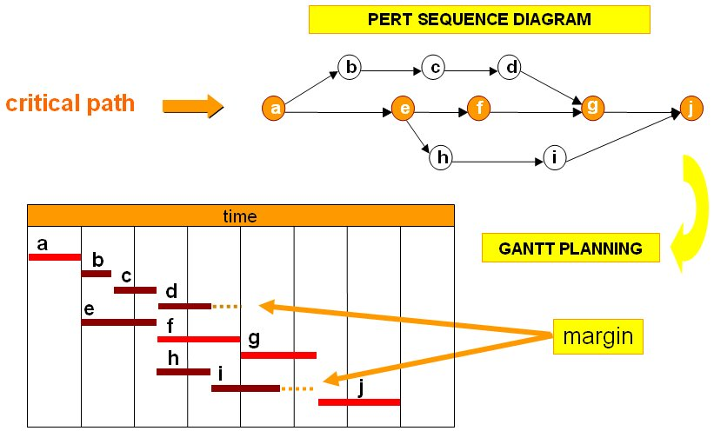
Project Scheduling (Process &Time)

Slide 28
BAR CHART
During World War 1, Henry Gantt developed the Bar chart planning technique.
A bar chart graphically describes a project consisting of well-defined activities, the completion of which marks its end.
An activity is a task whose performance contributes to completion of the overall project.

Slide 29
BAR CHART
All activities are listed in a column at the left side of the diagram.
A horizontal time scale extends to the right of the list.
A bar presenting each activity is drawn between its corresponding scheduled start and finish times.

Slide 30
Case study: Install a new machine
Activity Code | 1 | 2 | 3 | 4 | 5 | 6 | 7 | 8 | 9 | 10 | 11 | 12 | 13 | 14 | 15 | 16 | 17 | 18 | 19 | 20 | 21 | 22 | 23 | 24 | 25 | 26 | 27 | 28 | 29 | 30 | 31 | 32 | 33 | 34 | 35 | 36
200
500
700
400
300
100
600

Slide 31
Case study: Install a new machine
Activity Code | 1 | 2 | 3 | 4 | 5 | 6 | 7 | 8 | 9 | 10 | 11 | 12 | 13 | 14 | 15 | 16 | 17 | 18 | 19 | 20 | 21 | 22 | 23 | 24 | 25 | 26 | 27 | 28 | 29 | 30 | 31 | 32 | 33 | 34 | 35 | 36
200
500
700
400
300
100
600

Slide 32
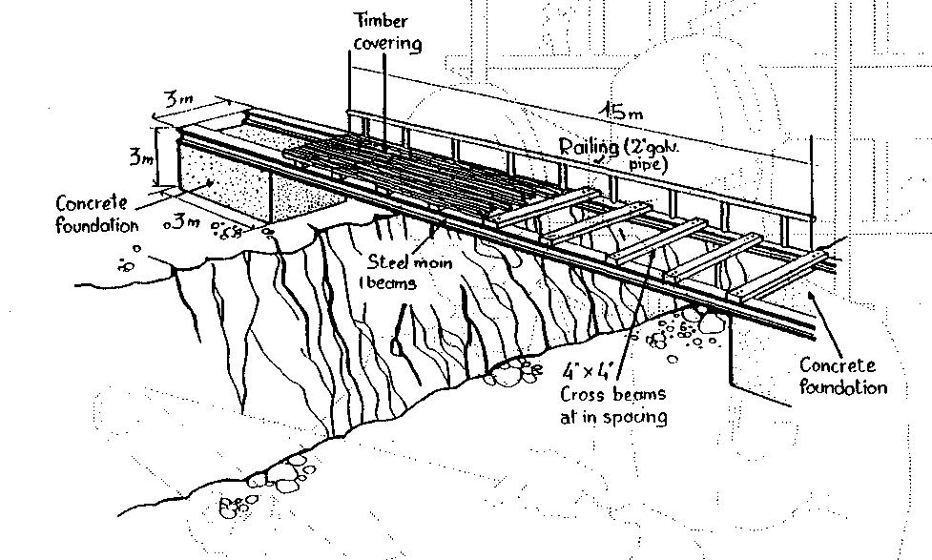
Case study: Building A bridge

Slide 33
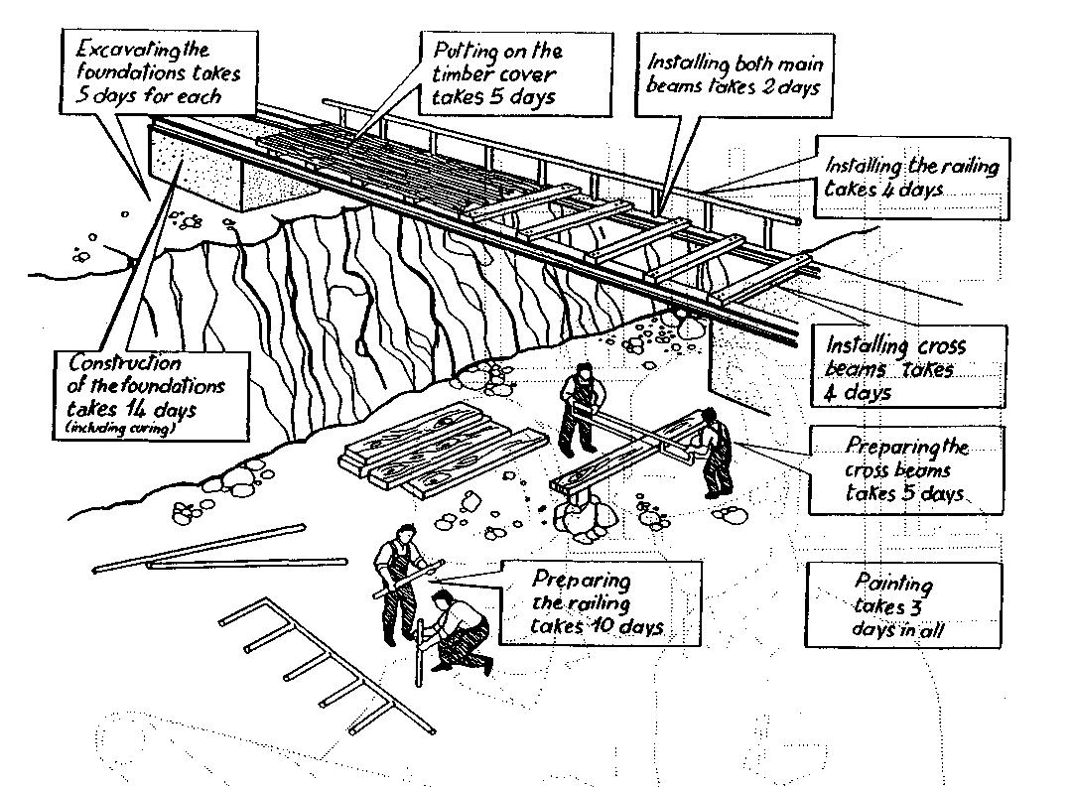
Case study: Building a bridge

Slide 34
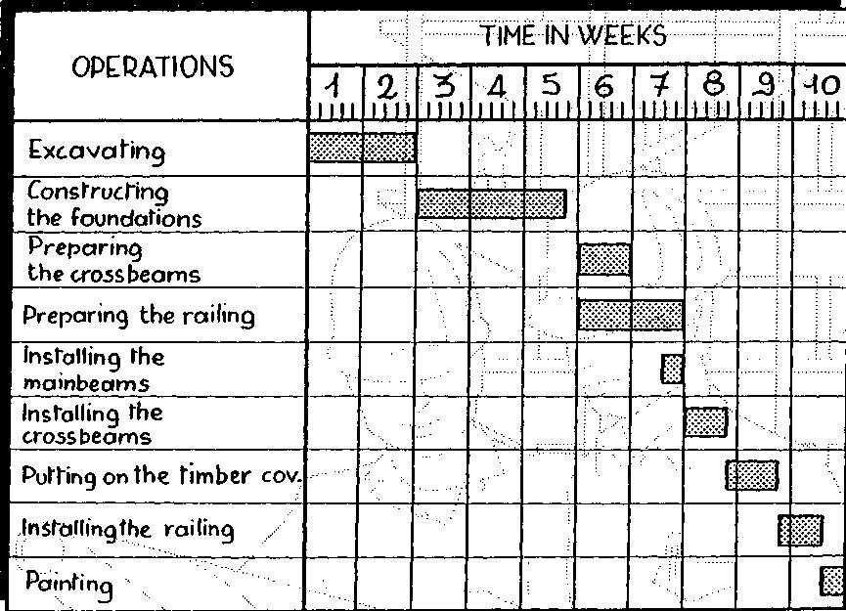
Preparing a Bar Chart

Slide 35
Gantt chart for Service For A Delta Jet
Passengers
Baggage
Fueling
Cargo and mail
Galley servicing
Lavatory servicing
Drinking water
Cabin cleaning
Cargo and mail
Flight services
Operating crew
Baggage
Passengers
Deplaning
Baggage claim
Container offload
Pumping
Engine injection water
Container offload
Main cabin door
Aft cabin door
Aft, center, forward
Loading
First-class section
Economy section
Container/bulk loading
Galley/cabin check
Receive passengers
Aircraft check
Loading
Boarding
0 10 20 30 40
Time, Minutes
Figure 3.4 (From Heizer/Render; Operation Management

Slide 36
Uses of Bar Chart Planning Technique
Showing the order of the different activities
Showing when operations should start and finish
Checking what labor or equipment are needed and when
Checking out delivery dates for materials
Explaining to everyone concerned what and when is due to happen
Forecasting cash flow
During execution, the chart used to control the work

Slide 37
Advantages of Bar Chart
Simple graphical form
Easy understood for all levels of management
Good form of communication.

Slide 38
Limitations of Bar Chart
Very cumbersome as the number of activities increases
Logic is not expressed in the diagram (at the initial stage of developing GS)
Difficult to use it for forecasting the effects of changes, it is therefore limited as a control tool
No indication where management attention should be focused
Ineffective for project shortening

Slide 39
Planning a custom-written computer project
Step 1. List all activities in the plan
Task | Earliest start | Length | Type | Dependent on...
A. High level analysis | Week 0 | 1 week | Sequential
B. Selection of hardware platform | Week 1 | 1 day | Sequential | A
C. Installation and commissioning of hardware | Week 1.2 | 2 weeks | Parallel | B
D. Detailed analysis of core modules | Week 1 | 2 weeks | Sequential | A
E. Detailed analysis of supporting modules | Week 3 | 2 weeks | Sequential | D
F. Programming of core modules | Week 3 | 2 weeks | Sequential | D
G. Programming of supporting modules | Week 5 | 3 weeks | Sequential | E
H. Quality assurance of core modules | Week 5 | 1 week | Sequential | F
I. Quality assurance of supporting modules | Week 8 | 1 week | Sequential | G
J. Core module training | Week 6 | 1 day | Parallel | C,H
K. Development and QA of accounting reporting | Week 5 | 1 week | Parallel | E
L. Development and QA of management reporting | Week 5 | 1 week | Parallel | E
M. Development of Management Information System | Week 6 | 1 week | Sequential | L
N. Detailed training | Week 9 | 1 week | Sequential | I, J, K, M

Slide 40
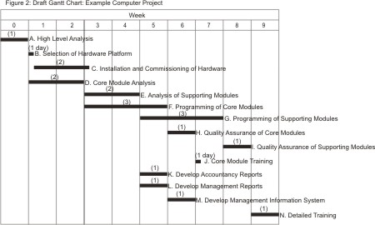
Planning a custom-written computer project
Step 2. Plot the tasks onto the graph paper

Slide 41
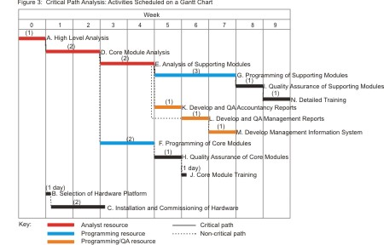
Planning a custom-written computer project
Step 3. Presenting the analysis

Slide 42
Planning a custom-written computer project
Step 4. Discuss the result
By drawing this example Gantt Chart, you can see that:
If all goes well, the project can be completed in 10 weeks.
If you want to complete the task as rapidly as possible, you need:
  1 analyst for the first 5 weeks.
  1 programmer for 5 weeks starting from week 4.
  1 programmer/QA expert for 3 weeks starting from week 6. Note: Activities L and M have been moved back a week. This does not affect the critical path, but it does mean that a single programming/ QA resource can carry out all three of activities K, L and M.
Analysis, development and testing of supporting modules are essential activities that must be completed on time.
Hardware installation and commissioning is not time-critical as long as it is completed before the Core Module Training starts.

Slide 43
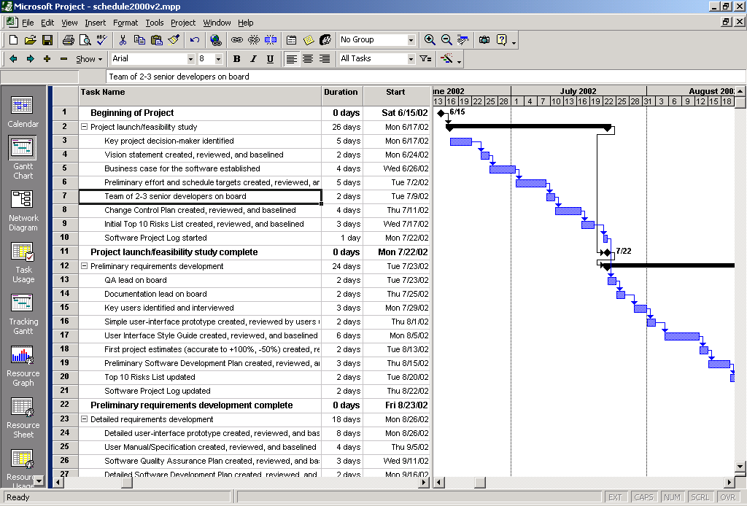
Example: output of a software program

Slide 44
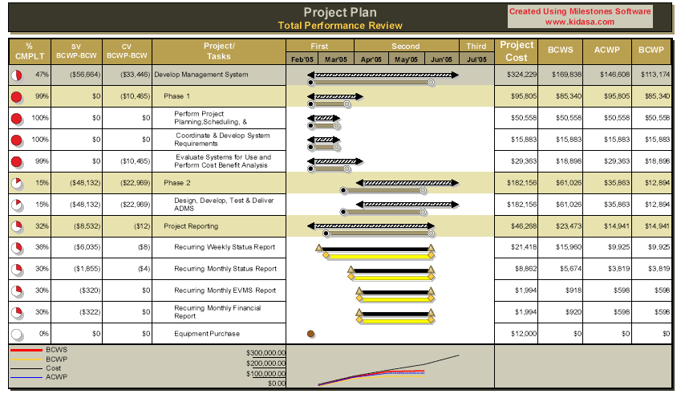
Example: output of a software program

