Slide 1
Project Cash Flow

Slide 2
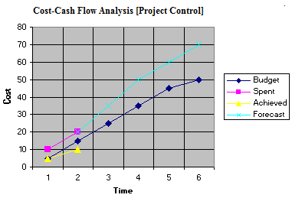
Cash Flow Forecasting
In order to make a workable project plan, the resources needed for the project and their availability must be checked.
Money is one of the most important resources.
Cash flow forecasting is required to determine whether or not the funds to execute the plan are available.
Cash flow forecasting is the forecasting of both cash in and cash out of the project.

Slide 3
Cash in
Engineering project contracts typically provide that the owner shall make progress payments of the contract amount to the prime contractor as the work progresses.
Cash in = Cash receipt = Income
Principal components of cash in
Value of work actually performed in the field. The total value of work done to date is obtained in different ways, depending on the type of contract, and
Material stored on the site, but not yet incorporated into work, as well as any prefabrication or preassembly work that the contractor may have done at some location other than the job site.
A step curve is used to represent contract cash income.

Slide 4
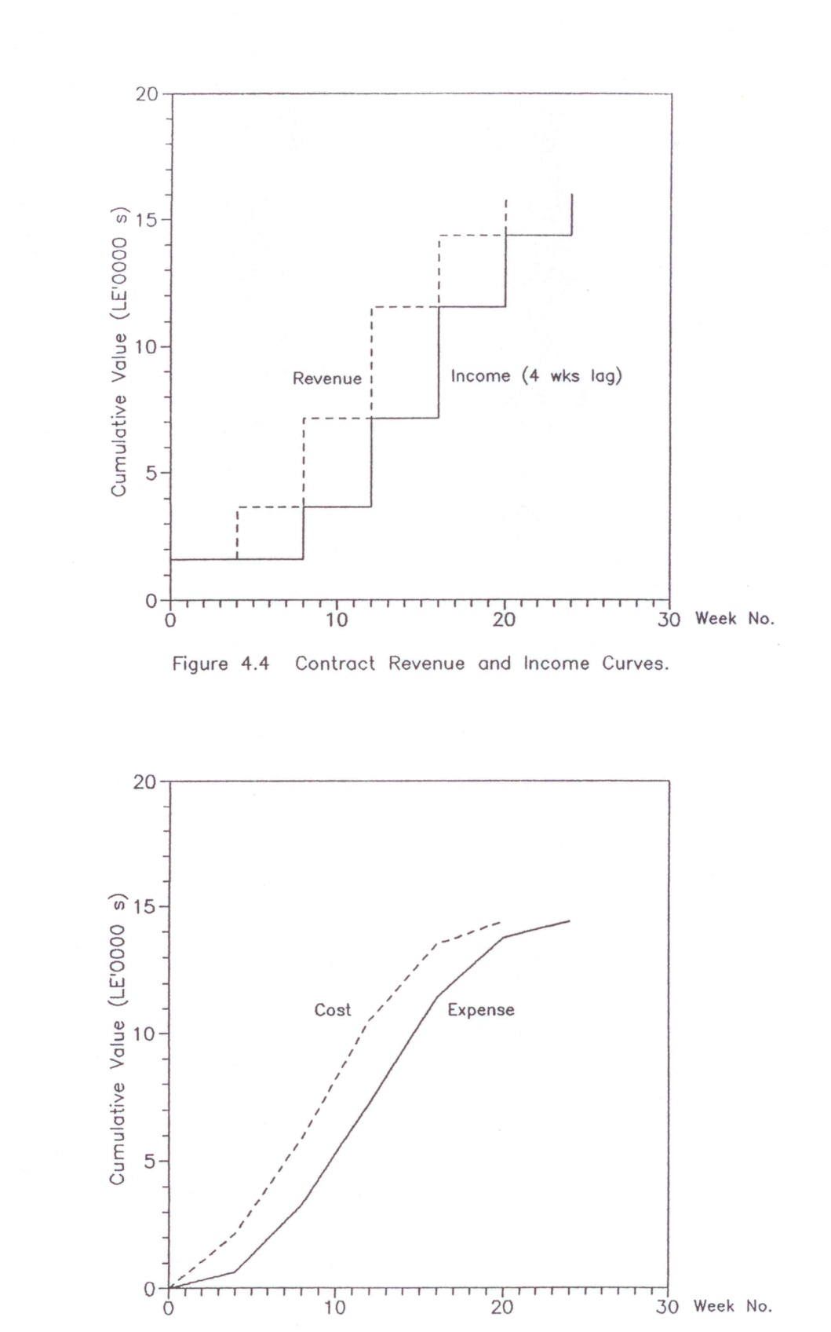
Cash in (Receipt or Income) and Revenue
An income is the actual receipt of revenue. It takes into account the delays between incurring a commitment and making a money transaction.
Contract revenue and income curves

Slide 5
Payment Request for Unit Price Contract
  The quantities of work done on unit-price contracts are determined by actual field measurement of the bid items put into place.
  The total quantity accomplished to date on each bid item is multiplied by its corresponding contract unit price.
  All of the bid items are totaled and the value of materials stored on the site as well as any prefabrication or preassembly work that the contractor may have done at some location other than the job site is then added.
  The prescribed retainage is subtracted from this total.
  The resulting figure represents the entire amount due the contractor for his work to date. The sum of all prior progress payments that have already been paid is then subtracted, this yielding the net amount of money payable to the contractor for his work that month.

Slide 6
Payment Request for Lump Sum Contract
  Under lump sum contract, the project is divided (for payment purposes) into relatively small work classifications, most of which are extensive and often extend over considerable portions of the construction period. Contracts progress is customarily measured in terms of estimated percentages of completion of work classifications (major job components).
  The contractor estimates the percentage completed and in place.
  The total value of each work classification is multiplied by its percent completion.
  To the total of completed work is added the value of all materials stored on the site. From this total is subtracted the retainage. This gives the total amount of money due the contractor up to the date of the pay request.
  From this is subtracted the amount of progress payments already made. The resulting figure gives the net amount now payable to the contractor.

Slide 7
Payment Request for Negotiated Contract
  Negotiated contracts of the cost-plus variety usually provide for the contractor's submission of payment vouchers to the owner at specified intervals during the life of the contract.
  The contractor must make periodic accountings to the owner for the cost of the work, either to receive direct payment from the owner or to obtain further advances of funds.
  A common provision is weekly reimbursement of payrolls and monthly reimbursement of all other costs, including a proportion of the contractor's fee.

Slide 8
Contract Provision that Impact Cash in
Advanced payment
Progress payment
Materials stored on the site
Final Payment
Retention
…………

Slide 9
Retainage = Retention
A prescribed percentage of each progress payment is usually retained by the owner in accordance with the terms of the contract.
The retainage may be held by the owner until the work receives final certification by the A/E, the owner accepts the project.
Final payment is then made to the contractor, including the accumulated retainage.

Slide 10
Final Payment
After the work has been finalized and all deficiencies remedied, the owner makes formal written acceptance of the project and the contractor presents his application for final payment.
Under a lump-sum form of contract, the final payment is the final contract price less (minus) the total of all previous payment installments made.
With a unit-price contract, the final total quantities of all payment items are measured and the exact final contract price is determined. Final payment is again equal to the contract price less the sum of all progress payments previously made.
In all cases, final payment by the owner includes all retainage that has been held by him.

Slide 11
Cash out
Engineering projects can make substantial demands on a contractor's cash.
Cash out = payment of costs = expense
Principal components of cash out
"Up-front" costs = initial expenses = start-up costs are costs necessary to start the project such as costs of moving in workers and equipment; erecting field offices, storage sheds, fences; job layout; installation of temporary electricity, water, telephone, sanitary, and other services; bonds; permits and project insurance.
Payment of direct job costs. These include costs associated with payrolls, materials, equipment, and subcontractor payments.
Payments for filed overhead expense and tax.
An S-curve (a smooth curve) is used to represent contract cash out.

Slide 12
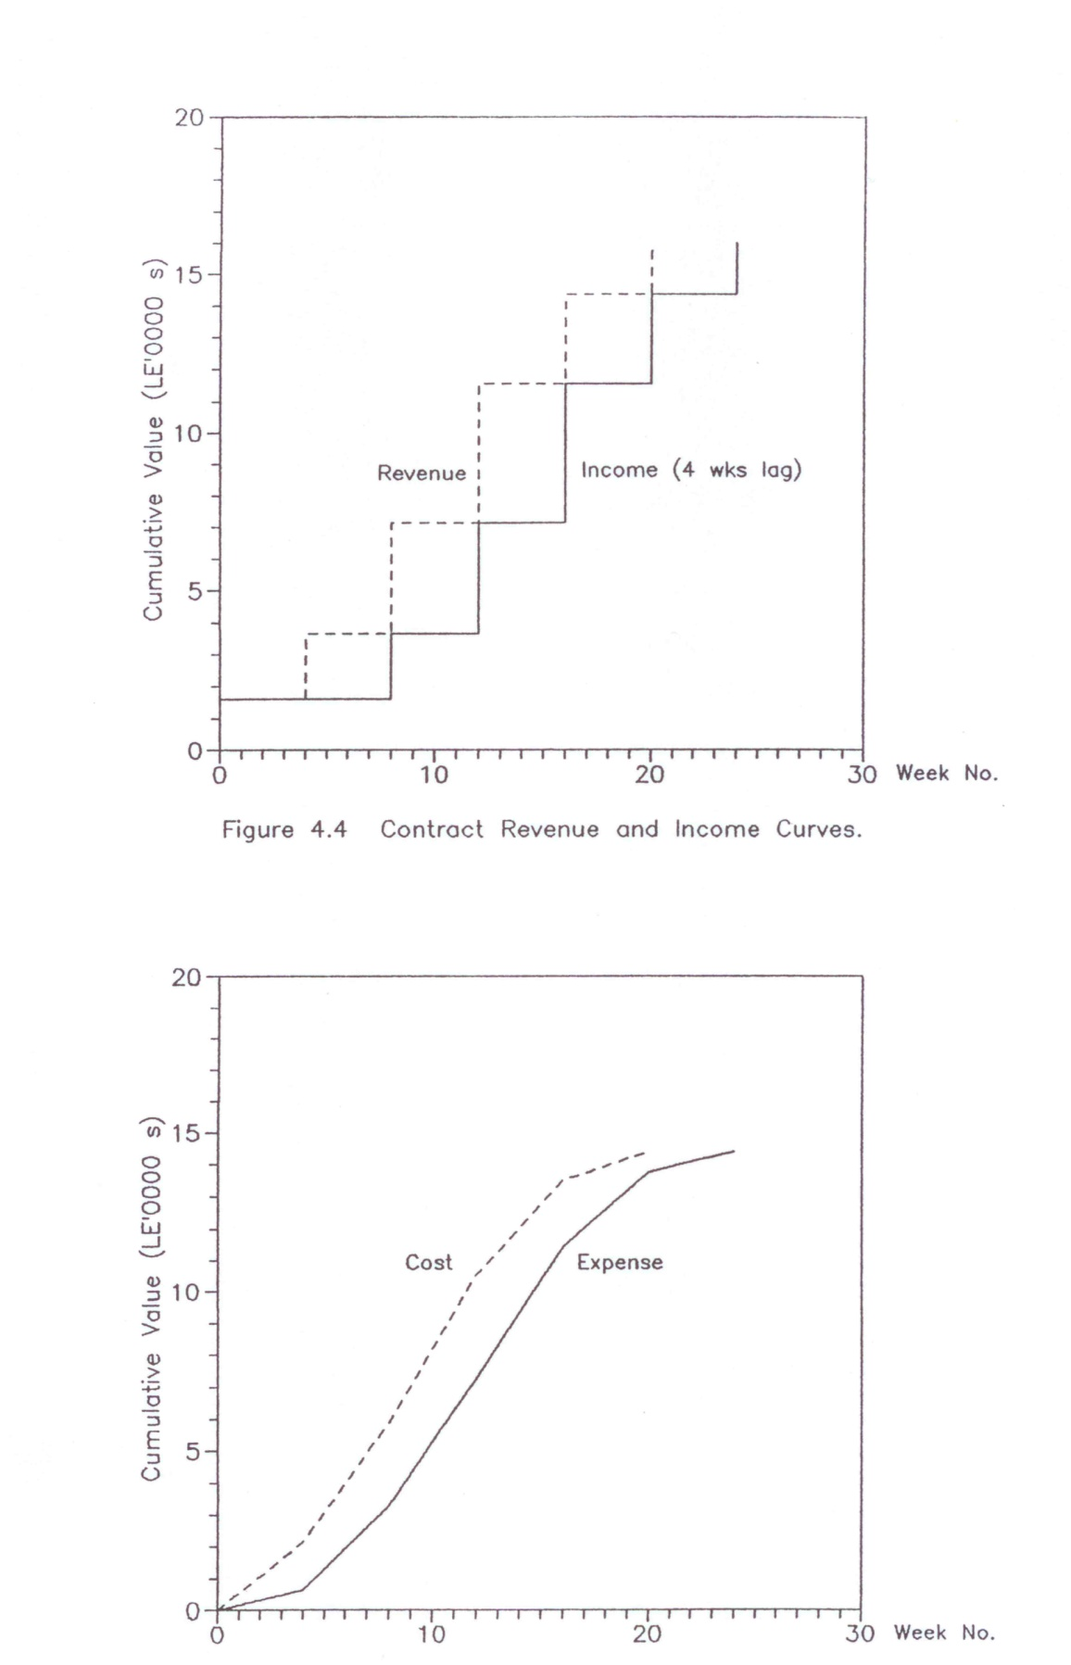
Cash out (Payment of Cost = Expense) and Cost
An expense is the actual payment of costs. It takes into account the delays between incurring a commitment and making a money transaction.
Contract cost and expense curves

Slide 13
Cash Flow
The contractor's expense on a project will typically exceed his monthly progress payment income over an appreciable part of the construction period.
The cash shortage on the project must be made up from the contractor's working capital, or money must be borrowed to provide the necessary operating funds.
"Cash flow" refers to a contractor's income and outgo of cash.

Slide 14
Net Cash Flow
The net cash flow is the difference between cash out and income at any point in time. A negative net flow means expense are exceeding income, a normal situation on even a highly profitable project during the greater part of its duration.
A determination of the future rates of cash outs and cash income together with their combined effect on the project cash balance is called a "cash flow forecast".

Slide 15
Need to Forecast Contract Cash Flow
To determine the negative cash flow and how to cover it.
To determine the positive cash flow and how to use it (the positive cash flow of one contract may be used to handle the negative cash flow of another).

Slide 16
Simplified Approach to Forecast Contract Cash Flow
Contract Revenue / Income Curve
Produce an activity schedule in bar chart or time-scaled form. If adjustments have been made to effect allocation or leveling of resources, the schedule should reflect these adjustments.
Determine the value/price of each activity per week.
Sum up the activities weekly and then the monthly revenue in case of the admeasurement contract, or sum up the activities weekly and then the periodic revenue in case of lump sum contract.
Adjust the revenue for advanced payment and retention.
Draw cumulative adjusted revenue versus time curve.
Shift the above curve by the lag between submitting payment requests and receiving revenue to get the income curve.

Slide 17
Simplified Approach to Forecast Contract Cash Flow
Contract Cost / Expense Curve
When the mark-up is uniformly spread throughout the contract, the cost/expense curve can be derived as follows:
If the mark-up; M, is expressed as a percentage of tender price, then:
Cumulative cost = cumulative revenue * (1- M)
Draw cumulative cost versus time curve.
Group cost headings that have the same payment delay between incurring the cost and making the payment.
Calculate the proportion of costs due to each group.
Shift the cumulative cost of each group by the specified amount to get its cumulative expense.
Sum up contract cumulative expenses.
Draw cumulative expense curve.

Slide 18
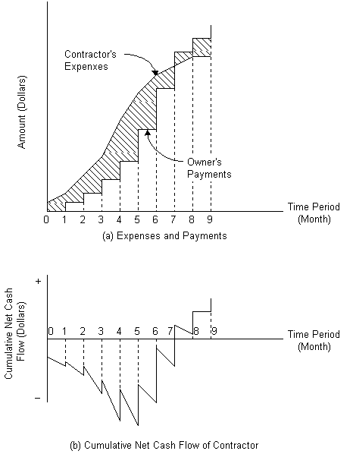
Contract Cash Flow Curves
Having determined the contract cumulative income and expense curves, one can combine them on one graph to represent the contract cumulative cash flow curves.

Slide 19
Contract Net Cash Flow
The difference between contract cumulative income and expense curves can be drawn to represent the contract cumulative net cash flow.

Slide 20
Factors That Minimize Contractor's Negative Cash Flow
Front end rate loading: earlier items in bill of quantities carry a higher mark-up than later items. This reduces negative cash flows in contract early stages.
Reduction of delays in receiving revenue.
Adjustment of work schedule to late start timing.
Coinciding the timing of delivery of large materials orders with the submittal of the contractor's monthly pay estimate.
Delay in paying labor, plant hirers, materials suppliers, and subcontractors. This would reduce negative cash flows but undermine commercial confidence in the company.
Increasing the mark-up and reducing the retentions.
Increasing advance payment.
Achievement of maximum production in the field.
Quick settlement or claims.

Slide 21
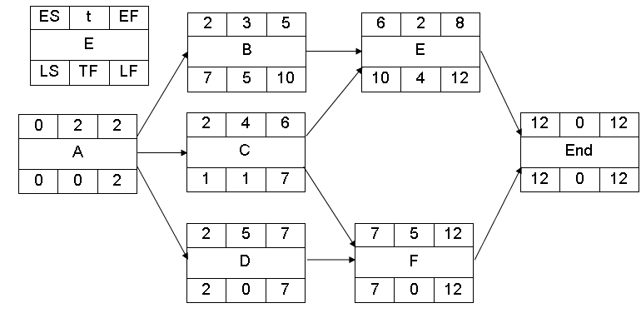
Example 1
The following network shows the activates of small project.
  The activaties’ durations are in weeks.
  The price of each activity is shown in below table.
F | E | D | C | B | A | Activity
30000 | 16000 | 30000 | 20000 | 45000 | 20000 | Price (SR)

Slide 22
Example 1
According to contract conditions,
  the contractor will receive advanced payment of 20%.
  This will be deduced from each monthly revenue.
Applications of payments will be submitted by the contractor to the client every 4 weeks and payment will be after 2 weeks from the submission of the application.
The client will deduct 10% from each payment as retention.
  All retentions will be paid to the contractor with the last payment.
The ratio between project price to project cost is 1.1 (project price /project cost = 1.1)
  there is no delay in paying the costs by the contractor.
Calculate and draw the cash flow curves (cash-in and cash-out) based on early start time.

Slide 23
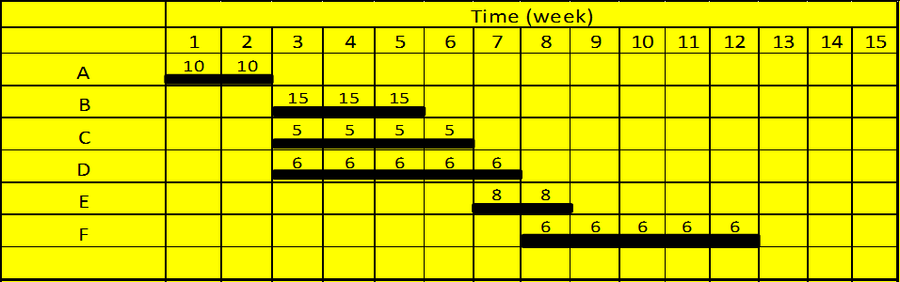

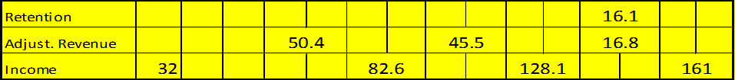
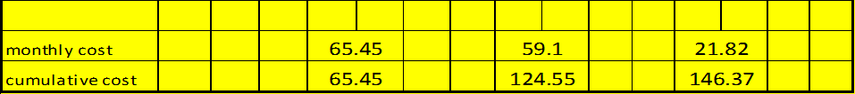
Example 1
∑ =161
32.2
20%*161
10%*161
(72-.1*72-.2*72)
32.2
(72/1.1)

Slide 24
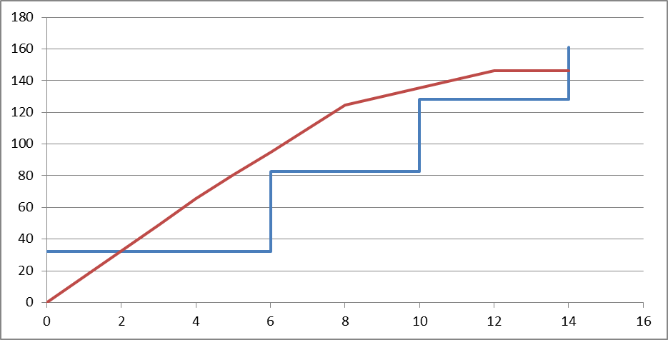
Example 1
32.2

Slide 25
Example 2
The actives involved in a small engineering project are given in table 1 the value of the work involved in each activity is listed in the table.
Activity | Duration (Week) | Preceding Activity | Value of Lag | Value (SR)
A | 5 | - |  | 30000
B | 4 | A |  | 20000
C | 5 | A | +1 | 15000
D | 5 | A |  | 15000
E | 5 | B | -2 | 25000
F | 4 | B,C |  | 16000
G | 6 | D |  | 18000
H | 4 | E | -1 | 8000
I | 3 | F,G | -2 with G | 9000
J | 2 | H,I |  | 4000

Slide 26
Example 2
The mark-up is 10% of tender value and is assumed to be uniformly distributed over the contract.
The contractor will receive an advanced payment of 10% of tender value.
  This will be deduced from each monthly revenue.
Retention is 5% and is paid on contract completion.
Labor cost is assumed to be 30% of total contract cost.
  The delay for other payment is one month.
Revenue is received after 4 weeks from submitting invoices.
Assuming all the activities are scheduled on their early start timings
derive income and expanse curve and contract cash flow curves.

Slide 27
Example 1

Slide 28
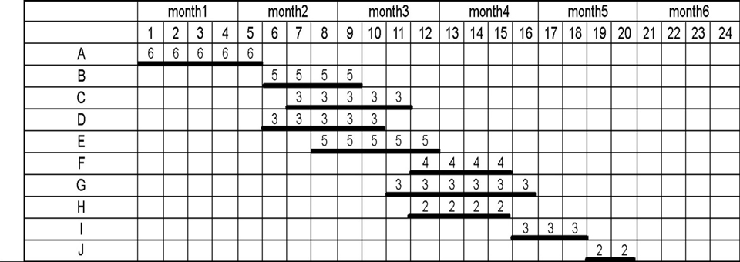
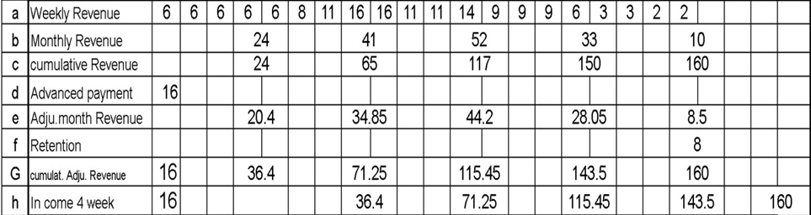
Example 2

Slide 29
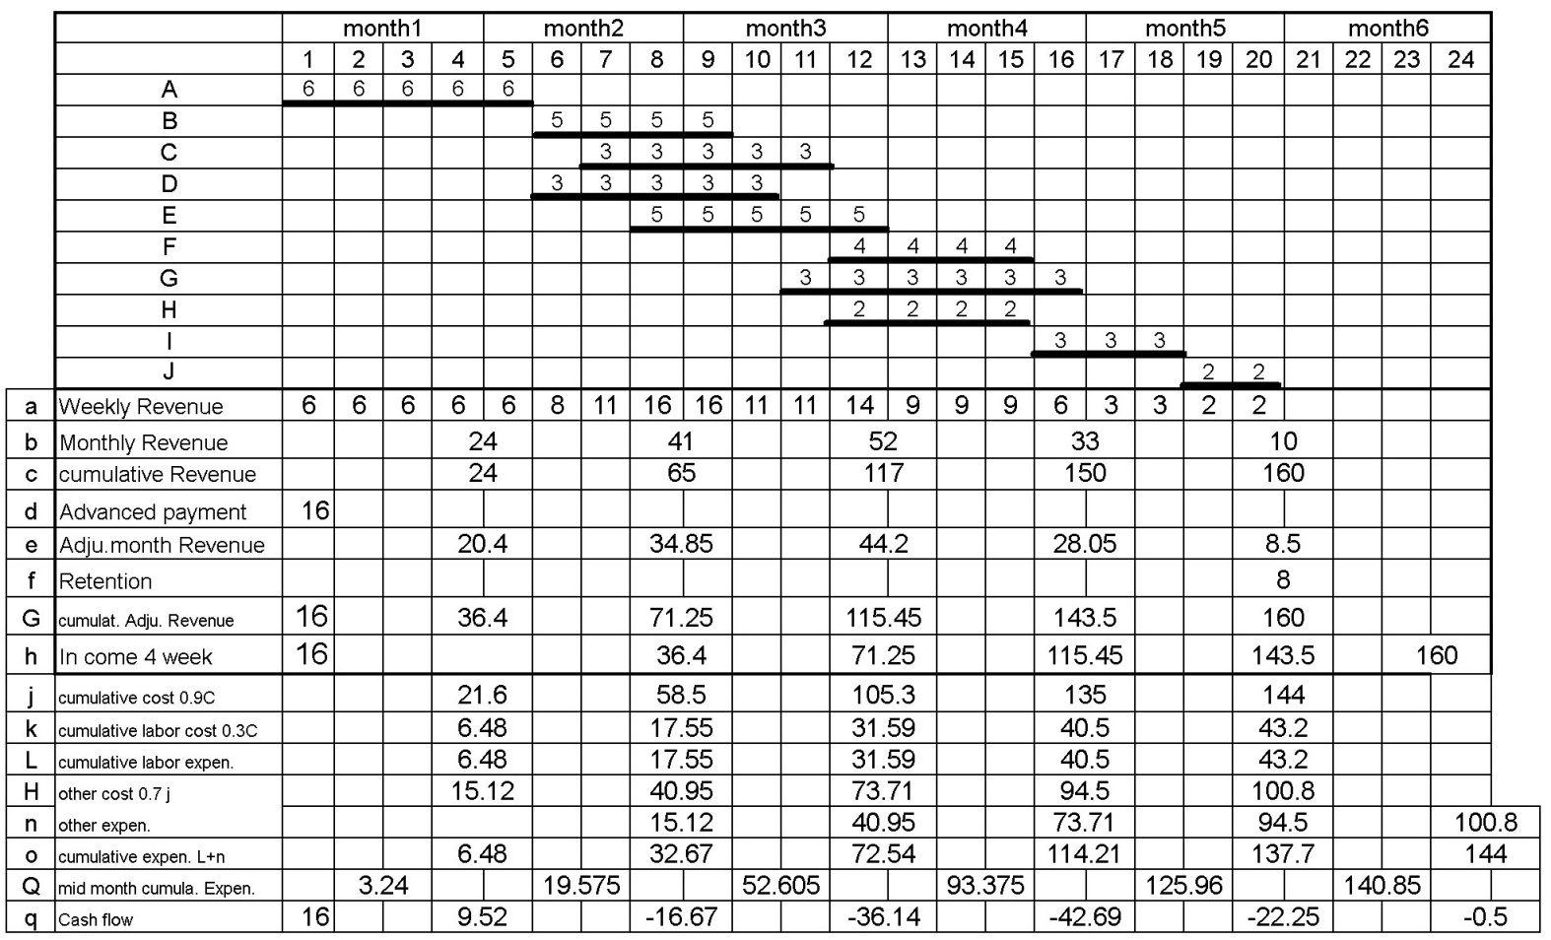
Example 2

Slide 30
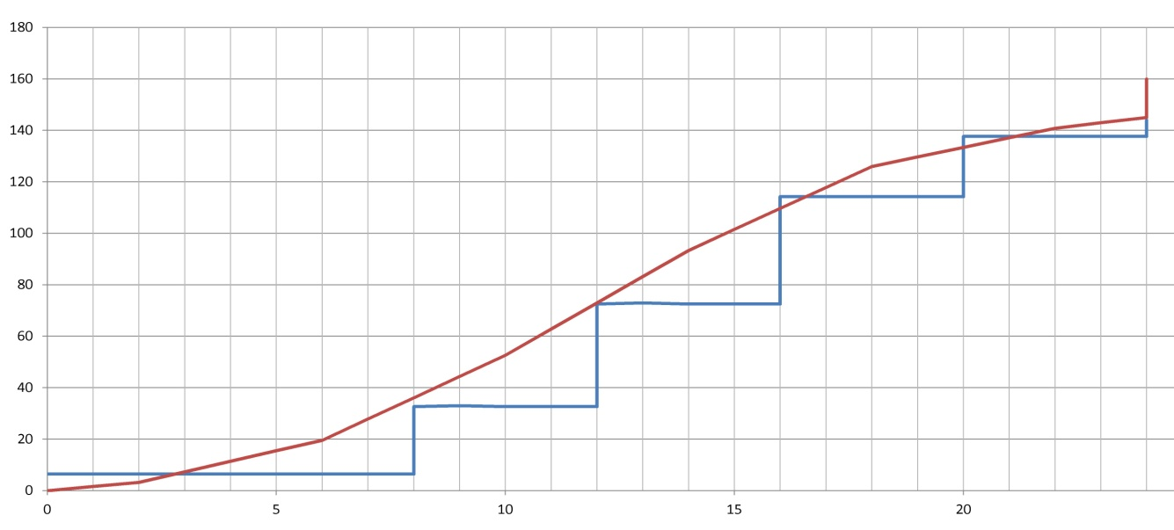
Example 2
Cash out
- ve
- ve
- ve
Cash in
+ ve
- ve

Slide 31
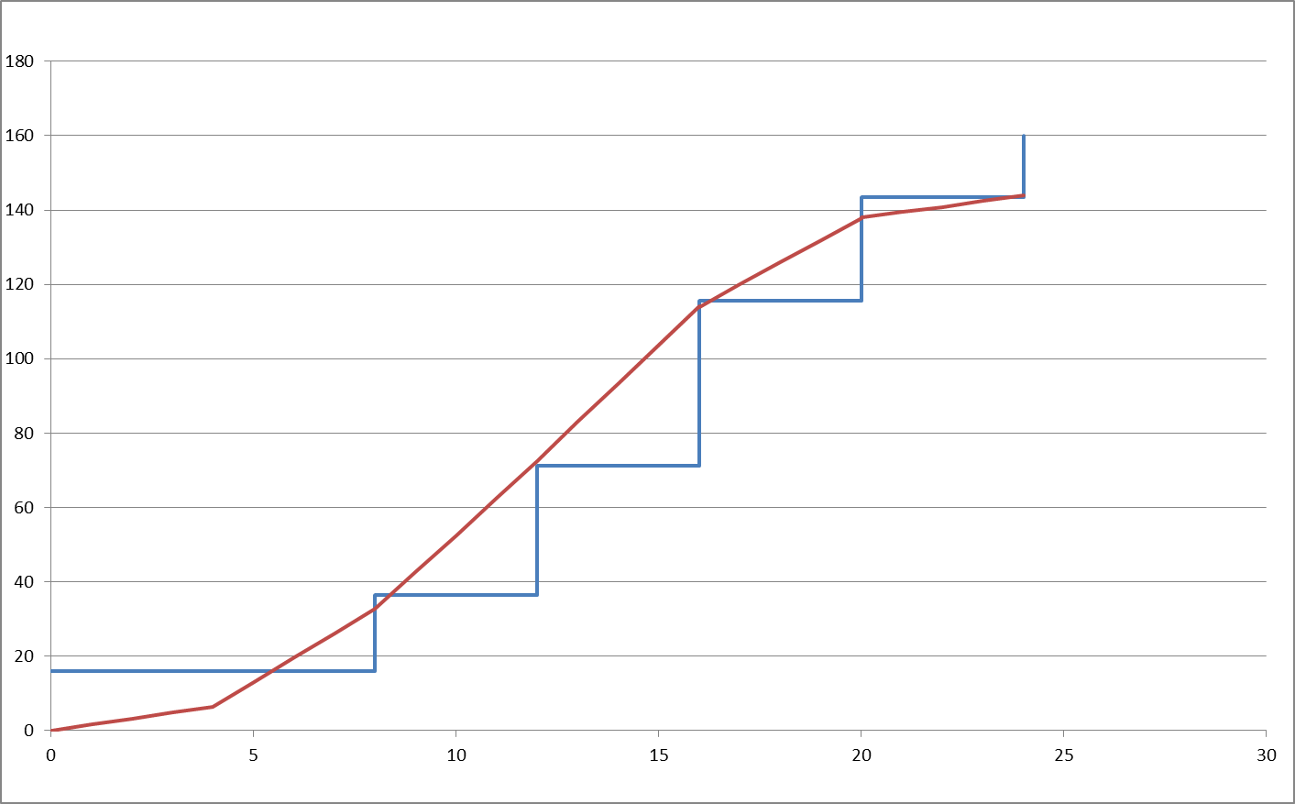
Example 2

Slide 32
Financial Charges
The cash invested in the contract is represented by the negative area between the expense and income curves.
This area, A, can be calculated in units of “SR. weeks” if the vertical scale is in Saudi Riyal and the horizontal scale in weeks.
If the rate of investment is r% per year, then the financial charges can be calculated as follows:
Financial charges = A * r / 52
It is important to point out that if the contractor borrows the negative cash with interest, then r equals the interest rate.

Slide 33
Example 3
The table below lists the cumulative monthly expenses incurred by contractors and the corresponding monthly incomes which are received from the owner of a project.
End of Month | Cumulative Expense, (1000SR) | Cumulative Income, (1000SR)
0 | 0 | 0
1 | 12 | 0
2 | 20 | 0
3 | 54 | 0
4 | 90 | 14
5 | 130 | 40
6 | 180 | 100
7 | 220 | 130
8 | 240 | 190
9 | 260 | 210
10 | 290 | 300
11 | 290 | 320
12 | 290 | 340
Calculate financial charges of this project if the chosen annual investment rate is 12%. If the owner makes all his payments one month later than anticipated in the table above, by what percentage will the financial charges increase?

Slide 34
Example 3
End of Month | 0 | 1 | 2 | 3 | 4 | 5 | 6 | 7 | 8 | 9 | 10 | 11 | 12 | Total
Cumulative Expense, (10,000SR) | 0 | 1.2 | 2 | 5.4 | 9 | 13 | 18 | 22 | 24 | 26 | 29 | 29 | 29
Cumulative Income, (10,000SR) | 0 | 0 | 0 | 0 | 1.4 | 4 | 10 | 13 | 19 | 21 | 30 | 32 | 34
Area (10,0000SR) | 0 | 0.6 | 1.6 | 3.7 | 7.2 | 9.6 | 11.5 | 10 | 10 | 6 | 6.5 | * | * | 66.7
additional Area (10,0000SR) |  |  |  |  |  | 1.4 | 2.6 | 6 | 3 | 6 | 2 | 8 |  | 29
 |  |  |  |  |  |  |  |  |  |  |  |  |  | 95.7
% increase (29/66.7) = 43.5%

