Slide 1
Types of Dictionaries

Slide 2
Types of Dictionaries in Relation to Form or Medium:
Books
CD ROMs
Internet

Slide 3
 | Books | CD-ROMs | Internet
Advantages | Familiarity Experience Looking up words in a dictionary is a great brain exercise, and an important way to improve spilling. | Fast retrieval Lots of information Light-weight Small size Some contain pronunciation files Some contain English learning materials Some contain many pictures | Free *Wild-card searching Similar advantages to the CD-ROMs More information and media for an entry, Always updated. Zero weight Sharable
Disadvantages | Large size, and heavy weight. Slow retrieval Not always updated | Computer is required. Slower retrieval with users who lack sufficient computer skills. Some are not well-designed Requires installation. Not always updated. | Access to a PC or an electronic device is necessary. Internet connection is required. Slow internet speed might affect retrieval time. Advertising is always a problem with free online dictionaries.

Slide 4
CD-ROM Dictionary
https://youtu.be/HfkADZxSc0g

Slide 5
Example of Online Dictionaries
https://www.dictionary.com/
https://www.oxfordlearnersdictionaries.com/
https://www.almaany.com/

Slide 6
Wild cards search - you can type ? if you don't know a letter, or * for a group of letters you don't know; e.g. b?t will find bat, bet, bit, & but. b*t finds babysit, backseat, bait, ballet etc.

Slide 7
Types of Dictionaries in Relation to the Dictionary Content:
General Dictionaries
These are dictionaries that give you information about the most common words in English. However, new words are often not included in these dictionaries until they become very common. Therefore you should look for new words and technical words (especially computer terms) in a dictionary of slang or informal expressions or in a technical dictionary.

Slide 8
Specialized Dictionaries
are useful for special groups of people, such as Advanced Learner's dictionaries for college students,or school dictionaries for children, etc.

Slide 9
Useful for special fields or professions (technical dictionaries). E.g.: medical, chemical, physical, literary, linguistic, computer dictionaries, etc.

Slide 10
Concentrate on one part of language. E.g.: dictionaries of idioms, collocations, phrasal verbs, abbreviations, etc.

Slide 11
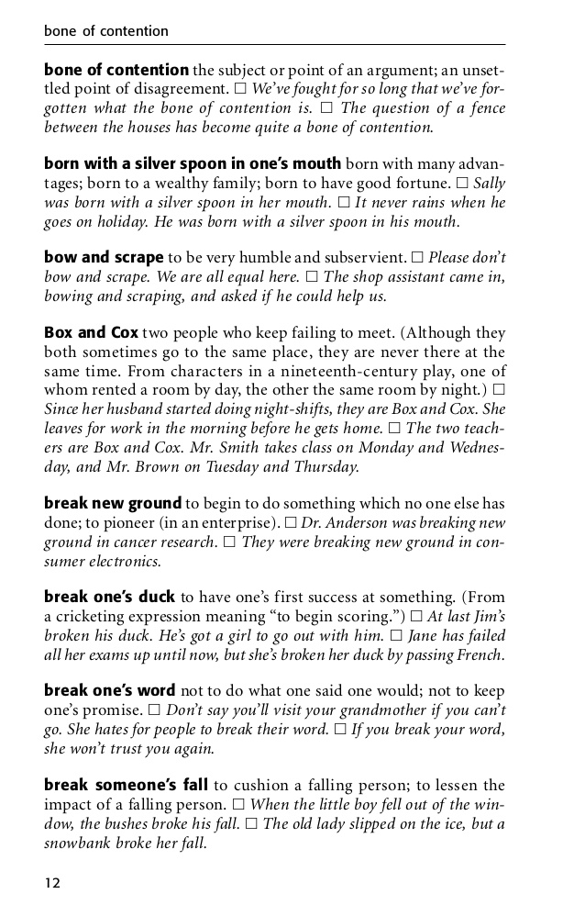

Slide 12
Focus on different varieties of a single language. E.g.: British-American dictionaries.

Slide 13
Have a special organization. e.g.: thesauri, which are dictionaries that list words with similar meanings together. This is useful for writing, where it is sometimes bad style to use the same word many times.
https://www.merriam-webster.com/thesaurus

Slide 14
Types of Dictionaries in Relation to the Dictionary language
Monolingual dictionaries: all entries come in one language.
Bilingual dictionaries: each entry has translations of words in another language.
Multilingual dictionaries: each entry has translations of words in two or more languages.

Slide 15
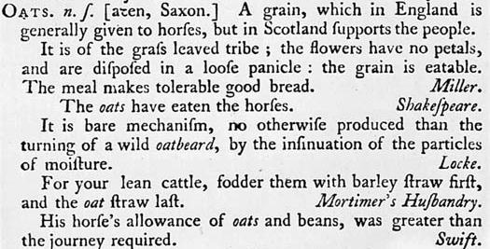

Slide 16
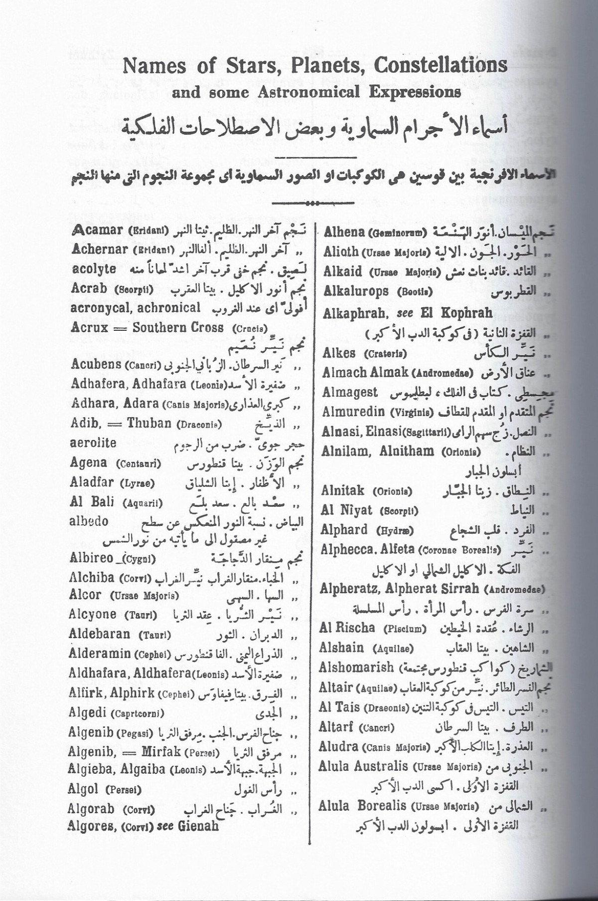

Slide 17
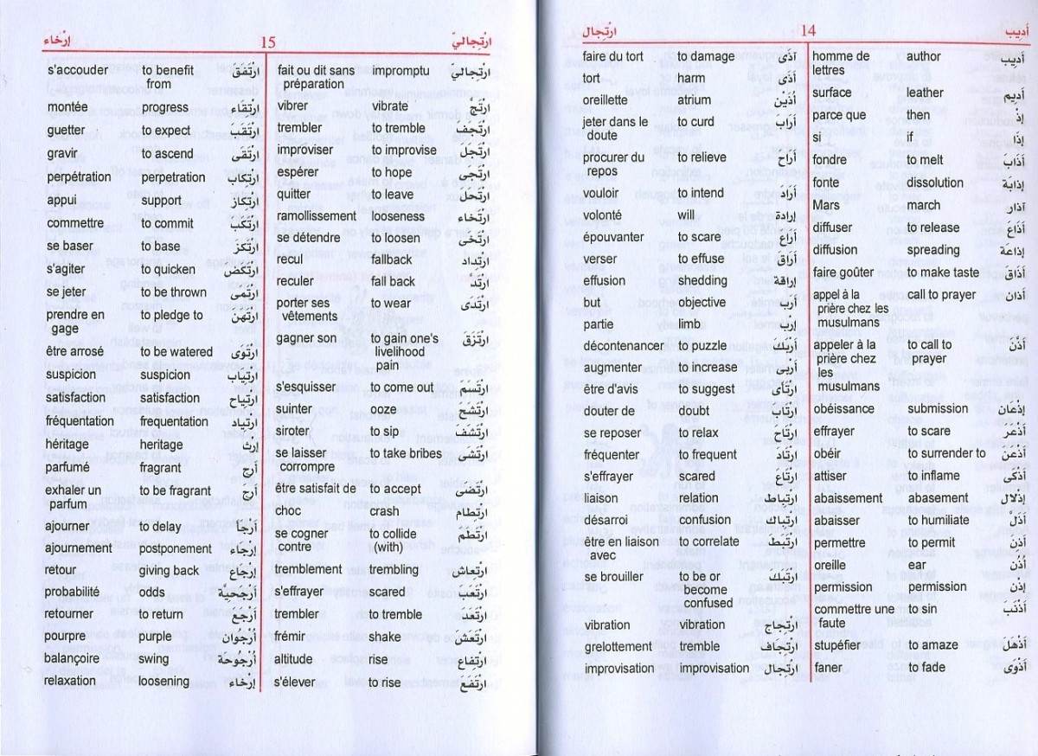

Slide 18
Class Activities

