Slide 1
Underground Water

Slide 2
Groundwater
Groundwater is contained in aquifers, porous spongelike layers of rock, sand, or gravel.
Aquifers- porous, saturated layers of sand, gravel, or bedrock through which groundwater flows
Water table = boundary between the upper zone of aeration and the lower zone of saturation, falls in dry weather, rises in wet weather

Slide 3
Aquifers
Confined or artesian aquifer = water under pressure, trapped within impermeable layers
Unconfined aquifer = water under less pressure; no overlying impermeable layer
Aquifer recharge zone = geographic area where water infiltrates soil and recharges aquifer

Slide 4
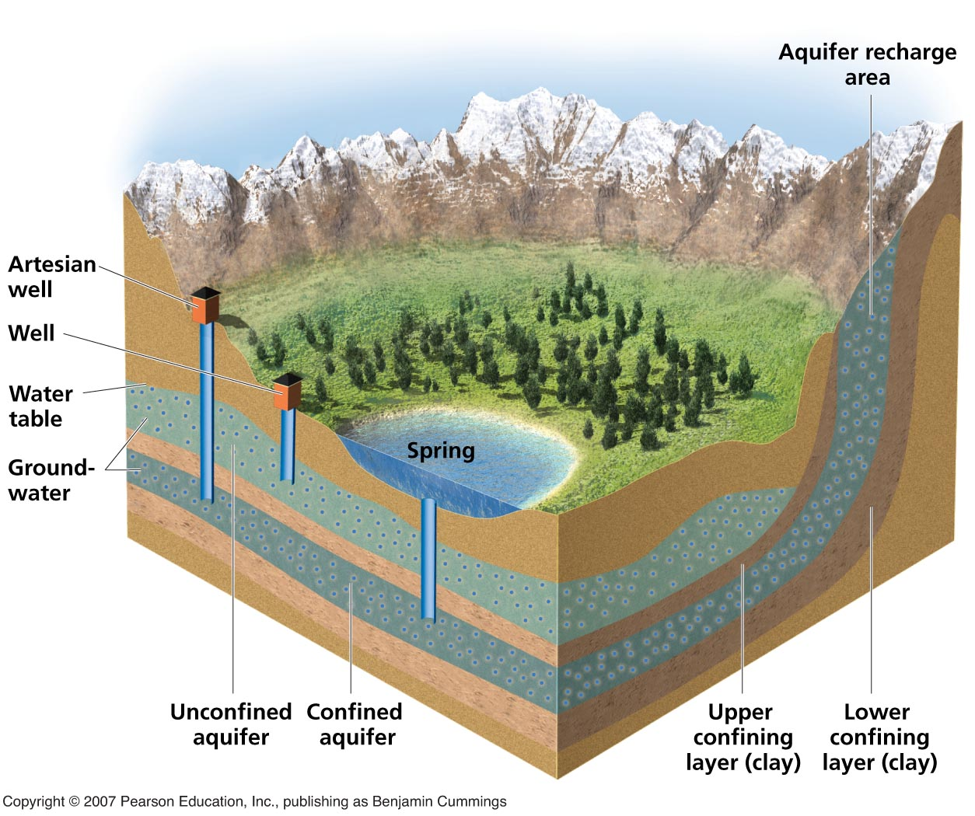
Groundwater and aquifers

Slide 5
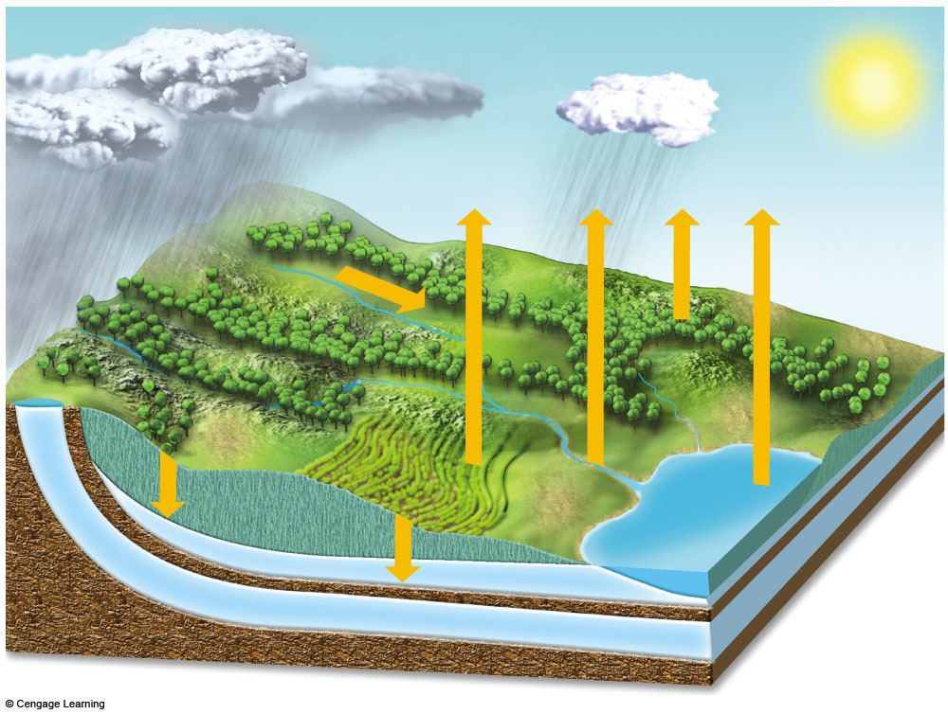
Unconfined Aquifer Recharge Area
Precipitation
Evaporation and transpiration
Evaporation
Confined
Recharge
Area
Runoff
Flowing
artesian well
Recharge Unconfined Aquifer
Stream
Well
requiring
a pump
Infiltration
Water
table
Lake
Infiltration
Unconfined aquifer
Less
permeable material such as clay
Confined aquifer
Confining impermeable rock layer
Fig. 11-2, p. 229
Notes:
Figure 11.2: Natural capital: groundwater system. An unconfined aquifer is an aquifer with a permeable water table. A confined aquifer is bounded above and below by less permeable beds of rock where the water is confined under pressure. Some aquifers are replenished by precipitation; others are not.

Slide 6
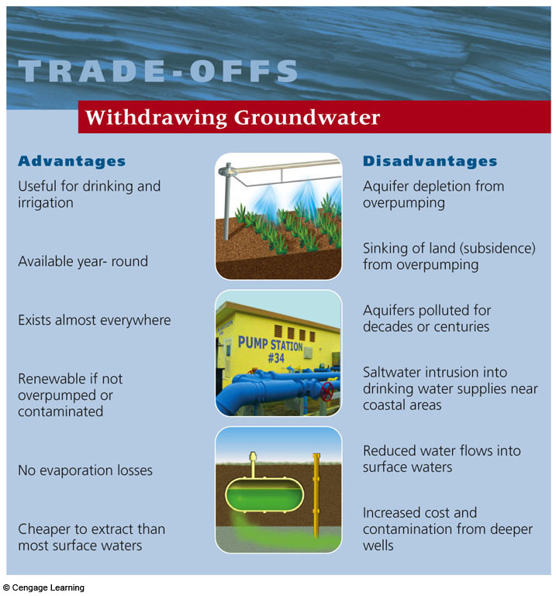
Ground water

Slide 7
Groundwater Pollution
Greater threat to humans than much of more visible surface water pollution
Much groundwater renewed slowly, such that pollution lingers for long time
Crude estimates indicate that up to 25% of usable groundwater in the U.S. contaminated
Extremely difficult to clean up contaminated groundwater; prevention more effective
Main approach: pump groundwater to surface, purifying water, and returning to aquifer; costs high
© Brooks/Cole Publishing Company / ITP Water Resources and Water Pollution by Paul Rich

Slide 8
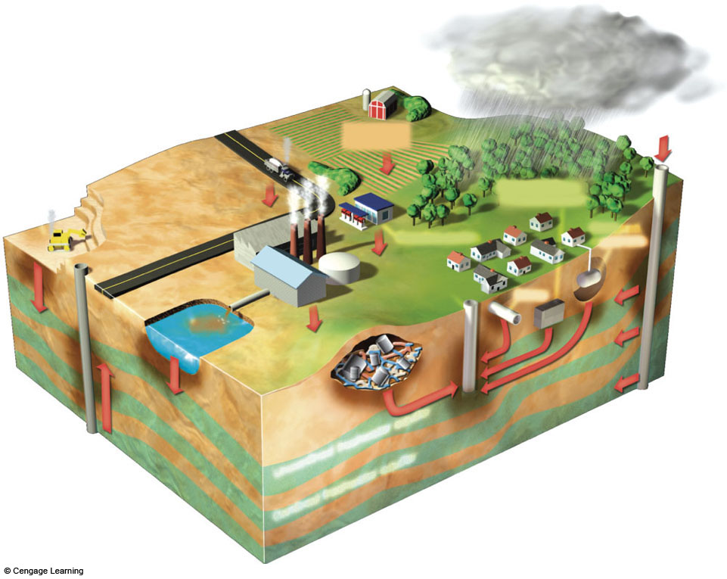
Polluted air
Pesticides
and fertilizers
Hazardous waste
injection well
Coal strip
mine runoff
Deicing
road salt
Buried gasoline
and solvent tanks
Pumping
well
Gasoline station
Cesspool,
septic tank
Water
pumping well
Waste lagoon
Sewer
Landfill
Accidental
spills
Leakage
from faulty
casing
Discharge
Unconfined freshwater aquifer
Confined
aquifer
Groundwater
flow
Confined freshwater aquifer
Fig. 11-25, p. 249
Notes:
Figure 11.25: Natural capital degradation: principal sources of groundwater contamination in the United States. Another source is saltwater intrusion from excessive groundwater withdrawal.
Question: What are three sources shown in this picture that might be affecting groundwater in the area where you live? (Figure is not drawn to scale.)

Slide 9
Groundwater pollution sources

Slide 10
Prevention
Reduce sources that feed into the aquifer;
Monitor aquifers near landfills
Require leak detection systems and liability insurance for existing and new underground tanks that store hazardous liquids;
Ban or more strictly regulate disposal of hazardous wastes in landfills;
Store hazardous liquids aboveground with more safeguards.
© Brooks/Cole Publishing Company / ITP Water Resources and Water Pollution by Paul Rich

Slide 12
Zamzam Well:
Zamzam well: is a well located 20 metres east of the Kaaba.
The Zamzam well is about 30 metres deep and 1.08 to 2.66 metres in diameter
The Saudi Geological Survey has a "Zamzam Studies and Research Centre" which analyses the technical properties of the well in detail

Slide 13
The water level is 3.23 metres (about 10.59 ft) below the surface. A pumping test at 8000 litres/second for more than a 24 hour period showed a drop in water level from 3.23 metres below surface to 12.72 metres and then to 13.39 metres, after which the water level stopped receding. When pumping stopped, the water level recovered to 3.9 metres below surface only 11 minutes later. This data shows that the aquifer feeding the well seems to recharge from rock fractures in neighbouring mountains around Mecca

