Slide 1
Unit 3

Slide 2
Different mode and types of inheritance

Slide 3
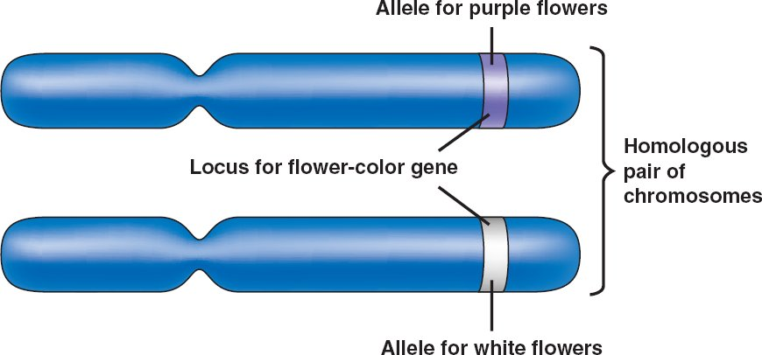
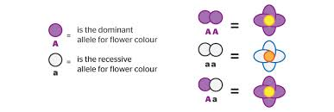
Definition
Allelle
is an alternative form of a gene (one member of a pair) that is located at a specific position on a specific chromosome.
These DNA coding determine distinct traits that can be passed on from parents to offspring.
The process by which alleles are transmitted was discovered by Gregor Mendel and formulated in what is known as Mendel’s law of segregation.
Example:
The gene for seed shape in pea plants exists in two forms, one form or allele for round seed shape (R) and the other for wrinkled seed shape (r).

Slide 4
Genotype
Is the structures of the genes
Phenotype
is the physical trait
Example:
the allele for straight hair matched with one for curly hair, usually shows up as wavy hair (a situation of incomplete dominance). That's the phenotype.
Inheritance
Genetic trait or characteristic that is passed on from a parent to the next generation of offspring
Dominant genes are most often expressed as observable characteristics.
Recessive genes are most often masked by the dominant genes, unless the offspring inherits one of the same recessive gene from each parent.

Slide 5
Homozygous means that the two alleles an individual possesses for one gene are the same i.e. AA or aa
Heterozygous means that the two alleles an individual possesses for one gene are different i.e. Aa

Slide 6
Mode of inheritance
MODE
Inheritance patterns describe how a disease is transmitted in families.
These patterns help to predict the recurrence risk for relatives.
In general, inheritance patterns for single gene disorders are classified based on whether they are autosomal or X-linked and whether they have a dominant or recessive pattern of inheritance.
These disorders are called Mendelian disorders, after the geneticist Gregor Mendel.

Slide 7
Mode and types of inheritance
Single Gene Inheritance
Autosomal dominant
Autosomal recessive
X-linked
Multifactorial Inheritance
Mitochondrial Inheritance

Slide 8
Single gene inheritance
Autosomal dominant
Autosomal recessive
Sex linked

Slide 9
Single gene inheritance
Genetic conditions caused by a mutation in a single gene follow predictable patterns of inheritance within families.
Types
Autosomal dominant
Autosomal recessive
X-linked

Slide 10
Single autosomal dominant gene - conditions that are manifest in heterozygotes (individuals with just one copy of the mutant allele).

Slide 11
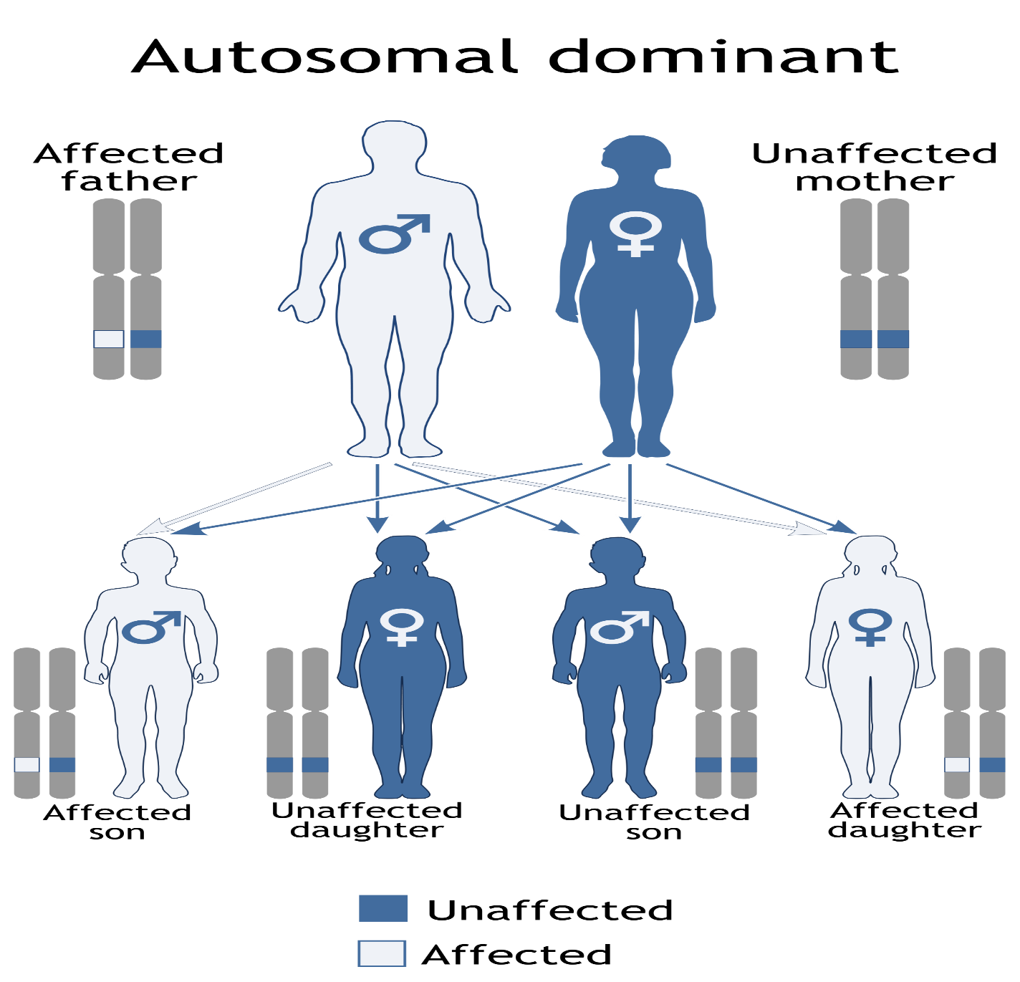

Slide 12
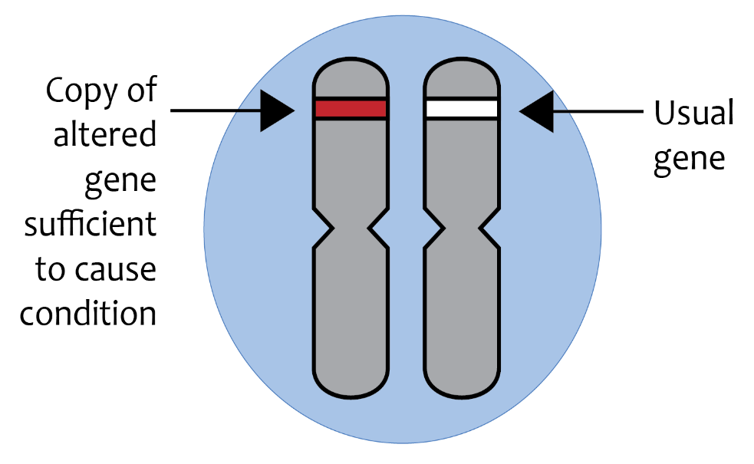
How will it be inherited?
Monogenic autosomal dominant disorders occur through the inheritance of a single copy of a defective gene found on a non-sex chromosome (remember, we each have two copies of each gene, one from each parent).
The single defective copy is sufficient to over-ride the normal functioning copy, resulting in abnormal protein functioning or expression.

Slide 13
conditions
With an autosomal dominant condition, an alteration in one copy of the gene is sufficient to impair cell function, leading to disease.
The alteration is located on an autosome.

Slide 14
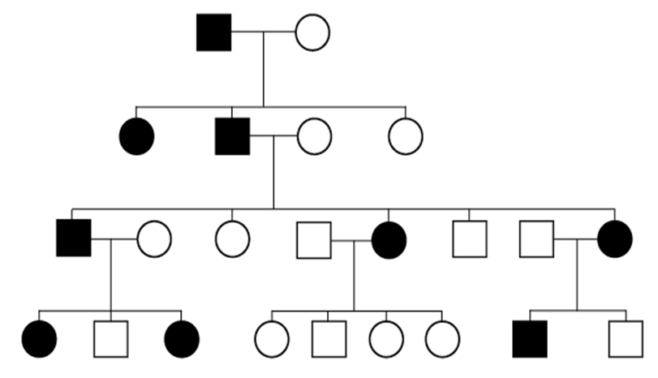
Features of autosomal dominant inheritance that you may see on a family tree include:
•people with the condition in each generation
•males and females affected in roughly equal proportions
•all forms of transmission present (male to female, male to male, female to male and female to female).

Slide 15
Autosomal dominant diseases
Diseases
Inherited colon cancer
Inherited breast cancer
Huntington disease
Myotonic dystrophy
Dominant blindness
Adult polycystic kidney disease
Dominant congenital deafness

Slide 16
SINGLE AUTOSOMAL RECESSIVE GENE - conditions are only manifest in individuals who have two copies of the mutant allele (are homozygous).

Slide 18
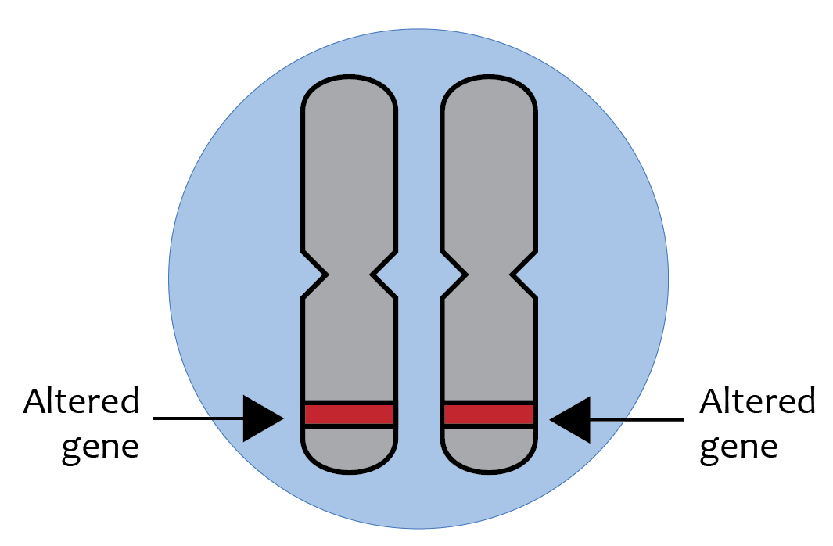
How will it be inherited?
A single gene also causes monogenic autosomal recessive disorders.
But for the disorder to occur, both copies of the gene need to be defective.
If just a single copy is inherited, the single functional copy is sufficient to over-ride the defective copy and the individual is not affected by the disorder, but is rather a carrier of the condition.

Slide 19
Autosomal recessive conditions
With an autosomal recessive condition, a gene alteration needs to be present in both copies of a particular gene to cause sufficient impairment to cell function to cause disease. The alterations are located on an autosome.
A person with an autosomal recessive condition must have inherited one gene alteration from each parent.
In autosomal recessive inheritance, people with one copy of the gene alteration do not have the condition. They are said to be carriers for the autosomal recessive condition.

Slide 20
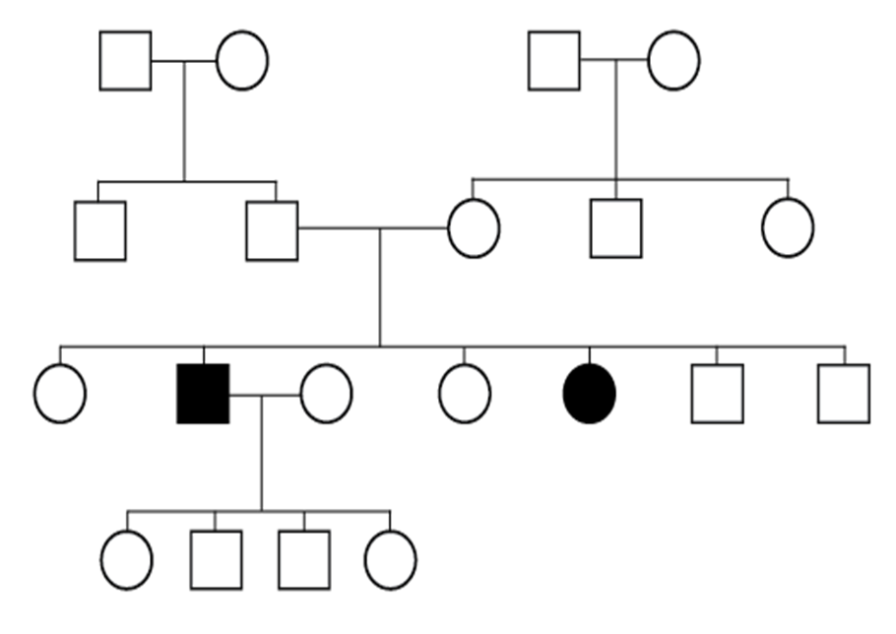
Features of autosomal recessive inheritance that you may see on a family tree include:
males and females have the condition in roughly equal proportions
consanguinity, where both parents have one or more ancestors in common, increases the chance that a condition presenting in a child of theirs might be due to both parents being carriers for the same recessive gene alteration.

Slide 21
At conception each child of parents who are both carriers has a 1 in 4 (25%) chance of being an unaffected non-carrier; a 2 in 4 (50%) chance of being a carrier and a 1 in 4 (25%) chance of inheriting the condition.
Table 1: Proportions of genes in common different relatives
Degree of relationships | examples | Proportions of genes in common
first | Parents to child, sib to sib | ½
second | Uncles or aunts to nephews and nieces, grandparents to grandchildren | 1/4
third | First cousins, great grandparents to great grandchildren | 1/8

Slide 22
Autosomal recessive diseases
Cystic fibrosis
Recessive mental retardation
Congenital deafness
Phynelketonuria
Recessive blindness
Spinal muscular atrophy

Slide 23
Autosomal codominant inheritance
Illustrated by the inheritance of autosomal DNA polymorphism
is defined by the ability to detect either or both of two alleles in an individual.
The two fragments can also be followed through the family pedigree. Hence, the pedigree pattern of human codominant traits resembles that of autosomal dominant inheritance except that both alleles can be distinguished.

Slide 24
Some examples of human codominant traits include:
blood groups: ABO, Duffy, Kell, Kidd, MNS, Rhesus
red cell enzymes: acid phosphatase, adenylate kinase
serum proteins: haptoglobulins
cell surface antigen: human leucocyte antigen (HLA)

Slide 25
Autosomal codomominant inheritance can be demonstrated if consider ABO blood groups:
if two persons with AB blood type have children, the children can be type A, type B, or type AB
the possible phenotypes are
A, AB and B
there is a 1A:2AB:1B phenotype ratio - this compares with a 3:1 phenotype ratio found when one allele is dominant and the other is recessive

Slide 26
Comparison of autosomal dominant and recessive modes of inheritance
Autosomal dominant | Autosomal recessive
Disease express in heterozygote | Disease expressed in homozygote
On average half of offspring affected | Low risk to offspring
Equal frequency and severity in each sex | Equal frequency and severity in each sex
Paternal mutations
Variable expressivity | Constant expressivity in a family
Vertical pedigree pattern | Horizontal pedigree pattern Importance of consanguinity

Slide 27
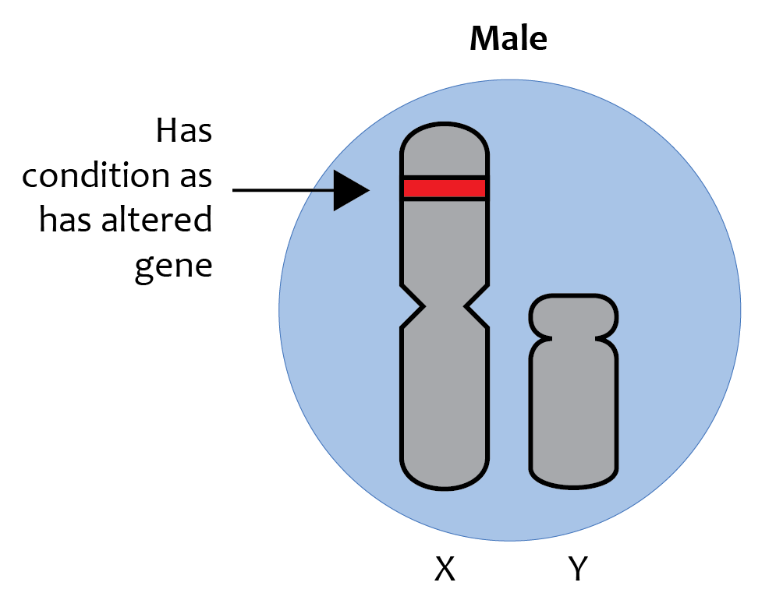
Sex linked inheritance

Slide 28
types
Y- Linked (holandric inheritance)
X- linked recessive
X- linked dominant
X- linked codominant

Slide 29
SeX- linked inheritance
X-linked disorders are those in which the defective gene lies on the X sex chromosome.
If we inherit two copies of the X chromosome, we're female; an X and a Y, and we're male.
We inherit the sex chromosomes along with the other 44 (22 pairs) of non-sex chromosomes from our parents.

Slide 30
This is the reason why a male who carries an abnormal gene on his single X chromosome will express clinical signs of disease
whereas a woman who has an abnormal gene on only one of her X chromosomes will be a carrier.

Slide 31
males
X-linked disorders are most common in males as there is no second X chromosome carrying the normal copy to compensate.
In males therefore a recessive gene can cause a genetic disorder.

Slide 32
females
Females are less likely to be affected as they have the non-affected X chromosome as well.
Females rarely show signs of X-linked recessive conditions as they usually have a second unaltered copy of the gene on their other X chromosome to compensate for an altered gene.
A female who has a gene alteration on one of her X chromosomes is said to be a carrier for the X-linked recessive condition.

Slide 33
Examples for sex-linked inheritance
non-carrier father and a carrier mother
Sons - 50% chance of being affected
Daughters - 50% chance of being carriers.

Slide 34
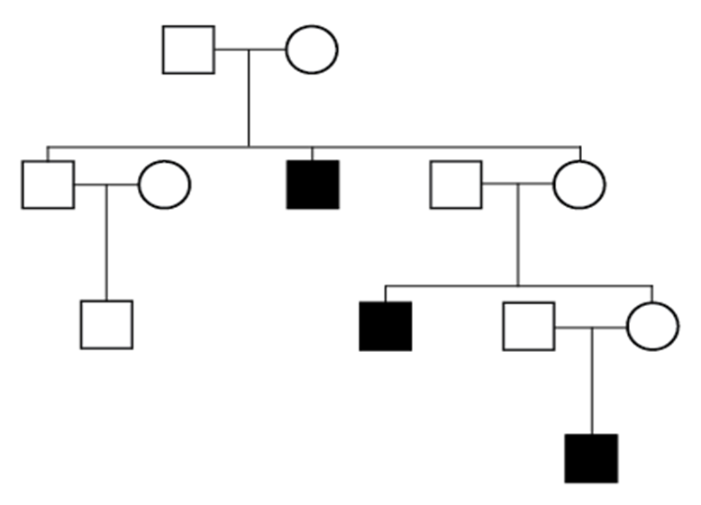
Features of X-linked recessive inheritance that you may see on a family tree include:
males affected almost exclusively
the gene alteration can be transmitted from female carriers to sons
affected males cannot transmit the condition to their sons.
Therefore, male can only be affected but cannot pass on the disease

Slide 35
example
When the mother is a carrier for an X-linked recessive condition,
Each daughter has a 1 in 2 (50%) chance of inheriting the gene alteration and so being a carrier for the condition.
Each son has a 1 in 2 (50%) chance of inheriting the gene alteration and so inheriting the condition.
When the father has an X-linked condition:
his sons will not be affected.
His daughters will be a carrier for the condition.
Males transmit their Y chromosome to their sons.
This means that sons will not inherit an x-linked recessive condition from their father.
Examples of X-linked recessive conditions include:
haemophilia
Duchenne muscular dystrophy.

Slide 36
X-linked dominant
The inheritance pattern describing a dominant trait or condition caused by a mutation in a gene on the X chromosome.
The condition is expressed in heterozygous females as well as males, who have only one X chromosome.
Affected males tend to have more significant disease than affected females.
Disorders inherited in this manner are relatively rare.

Slide 37
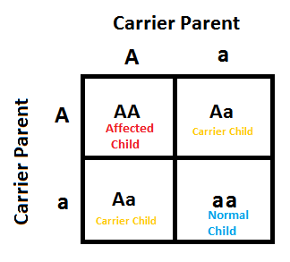
Punnet square

Slide 39
Multifactorial inheritance

Slide 42
Multifactorial conditions

Slide 44
CHARACTERISTICS OF MULTIFACTORIAL INHERITANCE
Polygenic threshold characters tend to run in families because affected individuals have relatives who share their genes with them.
Parents who have several affected children will have more high risk alleles than parents with only one affected child.
Thus recurrence risk increases with increasing number of previously affected children.

Slide 45
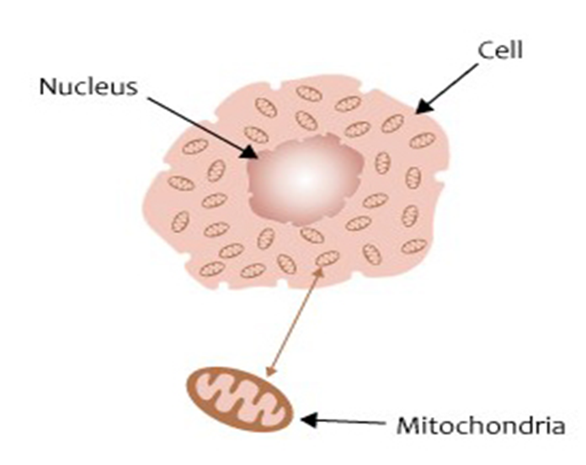
Mitochondrial inheritance
The transmission of the mitochondrial genome from mother to child.
WHY? Since egg cells, but not sperm cells, keep their mitochondria during
fertilization, mitochondrial DNA is always inherited from the female parent.
Causes: mutations in the non-nuclear DNA of mitochondria.
Both males and females are equally affected
An affected male does not pass on his mitochondria to his children, so all his children will be unaffected. This is called mitochondrial (sometimes matrilineal) inheritance.
Neuromuscular Features.

Slide 46
KEY POINTS to remember
The pattern of inheritance associated with alterations in the mtDNA involves both males and females, but always with the condition passed on through the female line (maternal inheritance).
Since many mitochondria are passed into the egg from the cells in the ovary, all the offspring of an affected woman would be expected to inherit the condition.
An affected male does not pass his mitochondria on to his children, so his children will be unaffected.

Slide 47
Examples of mitochondrial inheritance
an eye disease called Leber's hereditary optic atrophy;
a type of epilepsy called MERRF which stands for myoclonic epilepsy with Ragged Red Fibers; and
a form of dementia called MELAS for mitochondrialencephalopathy, lactic acidosis and stroke-like episodes.

Slide 48
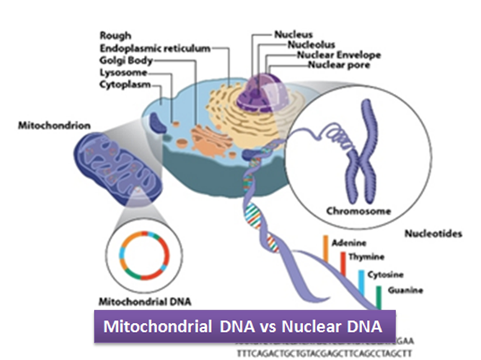
Did you know?
As a mitochondrial condition is caused by incorrectly functioning mitochondria, it may be due to:
- an alteration in the nuclear DNA (e genome)
- an alteration in the mitochondrial DNA

Slide 49
summary
Single Gene Inheritance
Changes or mutations occur in DNA sequence of a single gene
Multifactorial Inheritance
A combination of environmental factors and multiple gene
Mitochondrial Inheritance
Mutations in the non-nuclear DNA mitochondria

Slide 50
activity
What is the difference between the following?
Single gene inheritance
Mitochondrial Inheritance
Multifactorial Inheritance

Slide 51
Thank you

