Slide 1
Unit VIIII: Data Collection in nursing research
Prepared by: NUR 500 Research team
1ST semester 38/39. H

Slide 2
OBJECTIVES
On completing this Unit, you will be able to:
Outline the differences between structured and unstructured data collection methods
Explain two criteria for selecting a data collecting technique
Describe the major strengths and weaknesses for one type of data collection technique

Slide 3
Data Collection Plan
Well designed data collection
– Enhance the quality of the data
– Ensure the usefulness of study evidence
Poor quality data undermines study results
“A prime consideration in selecting a data collection method should be the conceptual congruence between the constructs of interest & the method, and the quality of data that method yields” (Polit & Beck, 2017)
Garbage In = Garbage Out
Polit & Beck 2017

Slide 4
Data Collection Methods
Most Common Approaches used in Nursing Research
– Self Reports
– Observation
– Biophysiologic Measures
Polit & Beck 2017

Slide 5
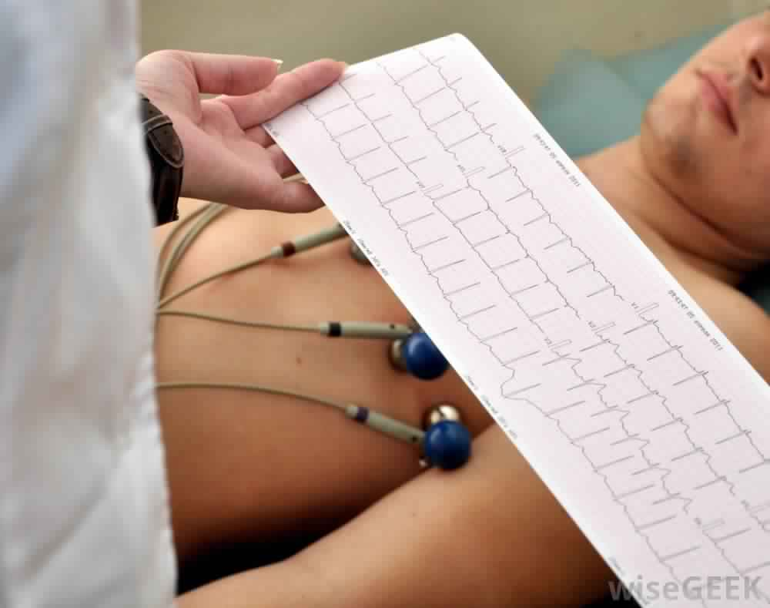
Types of Observation Data
Scientific Structured Observation
– Molar
– Molecular
Unscientific Unstructured Observation
–Unknown
–Participant
Polit & Beck 2017

Slide 6
Data Collection Techniques
Structured
– Quantitative research studies
– Data collected from study participants
Response categories are specified in advance
Self administered questionnaires
Interviews
Observations
Polit & Beck 2017

Slide 7
Scientific Observation
Different than ordinary observations during daily life
Objective
Systematic
Examines specific behaviors, activities, conditions, & characteristics
Identify what you want to observe before you make the observation
Polit & Beck 2017

Slide 8
Structured Observation
Molar Approach: observe large units of behavior & treat them as a whole
Combining several verbal and nonverbal behaviors to determine one global behavior
Susceptible to observer error re: ambiguity in observations
Polit & Beck 2017

Slide 9
Structured Observation
Molecular Approach : Small, specific behaviors and/or verbal phrases are the observational units
Reduces behavioral observations to concrete & specific elements
Action, gesture, phase = separate entity
May fail to understand how smaller elements contribute to the whole pattern
Polit & Beck 2017

Slide 10
Unstructured Observation
Most qualitative research studies
Data collected from study participants
Interview
Participant asked questions without a predetermined plan regarding the content or flow of interview information
Observation
No formal, predetermined plan for observing, counting, naming, or recording the information
Polit & Beck 2017

Slide 11
Unstructured Observation
Unknown: concealed observation
Real-world setting data
One way mirrors, hidden cameras/people
Behaviors might change if aware of researcher
Unethical when done without consent
Participant: social interaction
Participation in the observation of a group or culture
Polit & Beck 2017

Slide 12
Interviews
Unstructured Interviews
Grand Tour Questions: Broad, open-ended question that leads to more focused questions guided by responses
Descriptive Questions: Participants describe experiences in own words
Contrast Questions: Differences between the meaning of terms & symbols
Polit & Beck 2017

Slide 13
Interviews
Focused or Semi-structured Interviews
Pre-prepared written topic guide
List of areas or questions to be covered
May have follow-up or probing questions
Participants speak to the listed topics freely and in their own words
Polit & Beck 2017

Slide 14
Interviews
Structured Interviews
Instrument = interview schedule
Questions asked orally via face-to-face or telephone interviews
Various degrees of structure
Open-ended vs. closed-ended questions:
Open: “What prevented you from making the appointment?”
Closed ended: rate, scale
Polit & Beck 2017

Slide 15
Questionnaires
Self Administered Questionnaires (SAG)
Open and/or closed-ended questions distributed via in person, mail, e-mail, or web
Advantages
Reduced time and cost versus interviewing
Anonymous
Less interviewer bias
Easy to analyze
Disadvantages
Low response rates
Survey fatigue: too long or too many given
Polit & Beck 2017

Slide 16
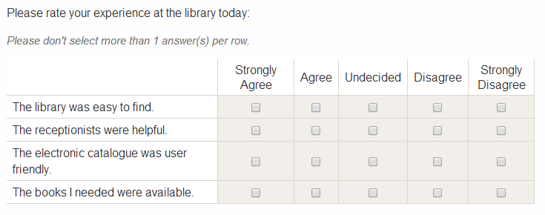
Scales
Nurse researchers often use pre-existing scales that are valid and reliable, rather than develop
their own
Measures degrees of something
Produces a numeric score
Examples: Likert, Visual Analogue
Although some scales and instruments are either free or in the public domain, many must be purchased from the publisher or developer and/or require the author’s permission to use.
Polit & Beck 2017

Slide 17
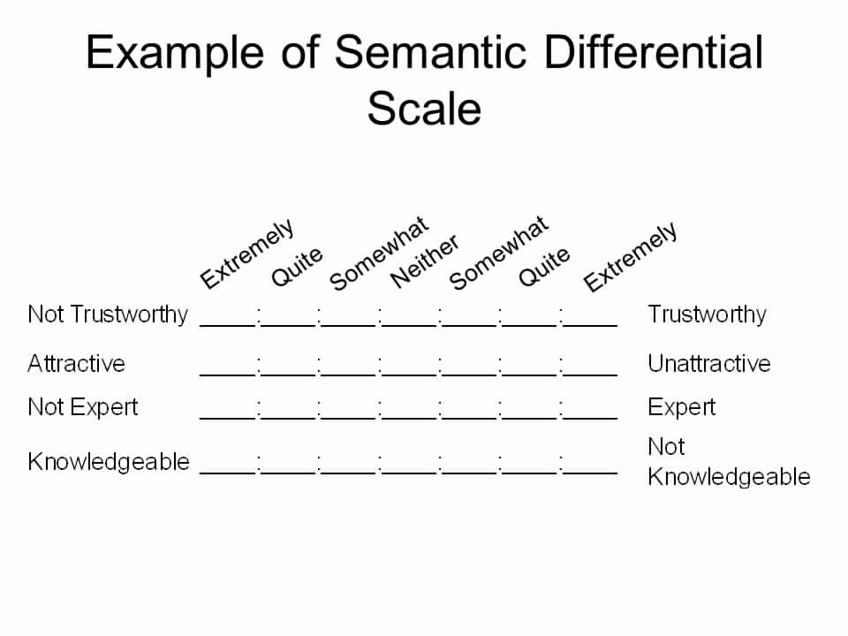
Scales
Semantic Differential (SD) Scales
Used to measure psychosocial traits
Rate a concept on a series of bipolar adjectives
Effective/ineffective; active/passive, good/bad
Advantages: flexible & easy to construct
Disadvantages: Adjective pairs can be inappropriately linked to the concepts
Polit & Beck 2017

Slide 18
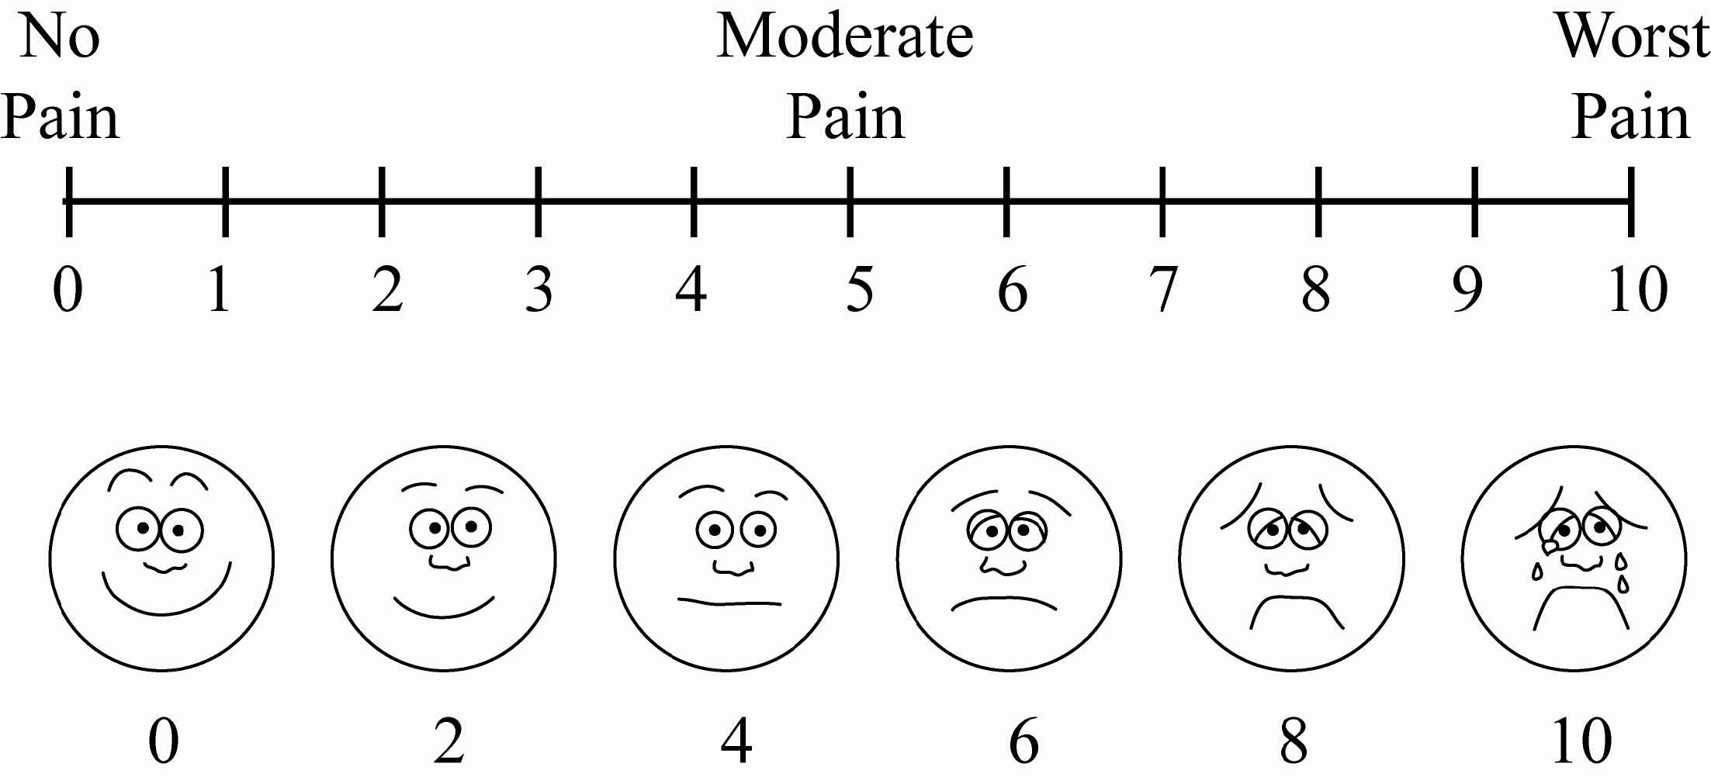
Scales
Visual Analogue Scale (VAS)
Polit & Beck 2017

Slide 19
Delphi Technique
Survey technique for obtaining expert panel opinion & judgment on a specific topic or concern
Individual experts are asked questions in a series of survey rounds
Summary data circulated between rounds
Final goal: Expert consensus; forecasting
Example: Rand Corporation surveys
Polit & Beck 2017

Slide 20
Delphi Technique
Survey technique for obtaining expert panel opinion & judgment on a specific topic or concern
Individual experts are asked questions in a series of survey rounds
Summary data circulated between rounds
Final goal: Expert consensus; forecasting
Invented by Rand Corporation
Polit & Beck 2017

Slide 21
Existing Databases
Many healthcare institutions have preexisting databases with patient outcome measures and nurse sensitive indicators
Quality Improvement & Risk Management
CalNOC (Collaborative Alliance for Nursing Outcomes)
Fall, Pressure Ulcers, Restraints
Economical method of measuring trends
Quality of data entry and database maintenance has been questioned
Polit & Beck 2017

Slide 22
Physiologic Measures
Increased use of measures
Assess biophysiologic status of patients
Evaluate clinical outcomes
Types of Measures
In vivo: in or on living organisms
Body temp, BP, HR, Oxygen Saturation
In vitro: outside living organisms
Serum lab values
Polit & Beck 2017

Slide 23
Physiologic Measures
Advantages
Accurate & precise, Objective
Valid measures of targeted variables
Thermometer always measures temperature
Available equipment in most healthcare settings
Disadvantages
Measuring tool might affect the variable
Arterial line might block artery & alter pressure
Artifact interference
Possible Injury
Polit & Beck 2017

Slide 24
Summary
Available Resources
Tool Reputation, Availability & Familiarity
Tool Validity & Reliability
Norms & Comparability
Population Appropriateness
Administration Issues
Ethics – just because you can do, doesn’t mean you should do it!
Polit & Beck 2017

Slide 25
Conclusion
When selecting data collection methods & instruments consider the following:
– Is the technique appropriate to the research question & study design?
– Do you understand the practical, technical, financial, and ethical issues?
Quality data collection methods ensure that data results are appropriate, accurate, robust, and MEANINGFUL
Polit & Beck 2017

Slide 26
Question?

