Slide 1
Arthropod-borne Viruses
Arthropod-borne viruses (arboviruses) are viruses that can be transmitted to man by arthropod vectors.
Arboviruses belong to three families:
Togaviruses
Bunyaviruses e.g. Sandfly Fever.
Flaviviruses e.g. Yellow Fever, dengue, Japanese Encephalitis

Slide 2
Transmission Cycles
Man - arthropod -man
e.g. dengue, urban yellow fever.
Reservoir may be in either man or arthropod vector.
Animal - arthropod vector - man
e.g. Japanese encephalitis, jungle yellow fever.
The reservoir is in an animal.
The virus is maintained in nature in a transmission cycle involving the arthropod vector and animal. Man becomes infected incidentally.
Both cycles may be seen with some arboviruses such as yellow fever.

Slide 3
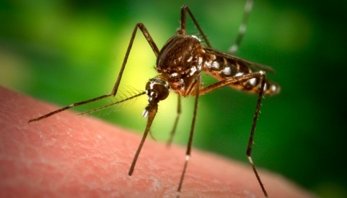
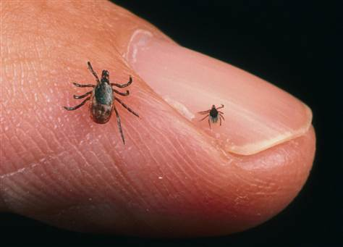
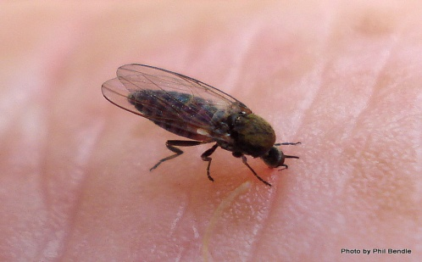
Arthropod Vectors
Mosquitoes
Japanese encephalitis, dengue, yellow fever.
Ticks
Crimean-Congo haemorrhagic fever.
Sandflies
Sicilian sandfly fever, Rift valley fever.
Animal Reservoirs
In many cases, the actual reservoir is not known. The following animals are implicated as reservoirs
Birds Japanese encephalitis.
Pigs Japanese encephalitis
Monkeys Yellow Fever
Rodents Russian Spring-Summer encephalitis

Slide 4
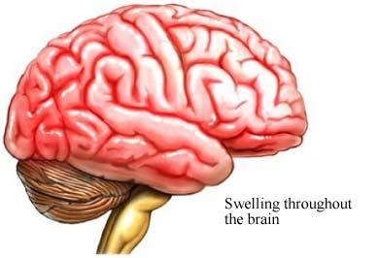
Diseases Caused
Fever and rash - this is usually a non-specific illness resembling a number of other viral illnesses such as influenza, rubella, and enterovirus infections. The patients may go on to develop encephalitis or haemorrhagic fever.
Encephalitis - e.g. Japanese encephalitis
Haemorrhagic fever - e.g. yellow fever, dengue, Crimean-Congo haemorrhagic fever.

Slide 5
Diagnosis
Serology - usually used to make a diagnosis of arbovirus infections.
Culture - a number of cell lines may be used, including mosquito cell lines. However, it is rarely carried out.
Direct detection tests - e.g detection of antigen and nucleic acids are available.

Slide 6
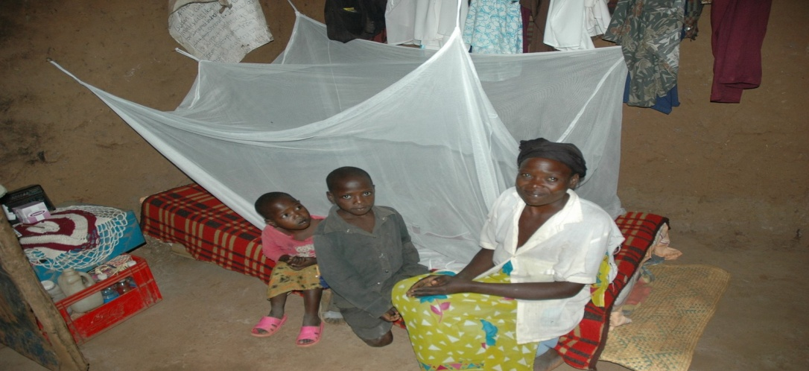
Prevention
Surveillance - of disease and vector populations
Control of vector - pesticides, elimination of breeding grounds
Personal protection - screening of houses, bed nets, insect
Repellants
Vaccination - available for a number of arboviral infections e.g. Yellow fever, Japanese encephalitis, Russian tick-borne encephalitis

Slide 7
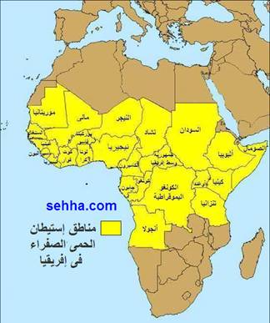
1- Yellow Fever
Flavivirus, mainly found in West Africa and South
America
Yellow fever occurs in 2 major forms:
Urban
Jungle yellow fever.
In the Jungle YF, the natural reservoir of the
disease in a cycle involving nonhuman primates
and forest mosquitoes. Man may become incidentally infected on venturing into jungle areas.
The urban form is transmitted between humans by the Aedes aegypti mosquito
Classically Yellow Fever presents with chills, fever, and headache. Generalized maligns and complaints.

Slide 8
Some patients may experience an asymptomatic infection or a mild undifferentiated febrile illness.
After a period of 3 to 4 days, the more severely ill patients with a classical YF course will develop bradycardia (Faget's sign), jaundice, and haemorrhagic manifestations.
50% of patients with frank YF will develop fatal disease characterized by severe haemorrhagic manifestations, oliguria and hypotension.
Diagnosis is usually made by serology.
There is no specific antiviral treatment.
An effective live attenuated vaccine is available against yellow fever and is used for persons living in or traveling to endemic areas.

Slide 9
2- Dengue (1)
Prior to 1953, infections caused by dengue viruses were rarely fatal. In recent years however, a sever and often fetal form of dengue has developed which affects mainly infants and young children. This form of dengue virus referred to as Dengue Haemorrhagic Fever (DHV), has become a major form of sever illness and death in children in tropical South-East Asian countries.
Dengue is the biggest arbovirus problem in the world today with over 2 million cases per year. Dengue is found in parts of Asia, Africa and the Caribbean and S America.
Flavivirus, 4 serotypes, transmitted by Aedes mosquitoes which inhabit in water-filled containers.
.

Slide 10
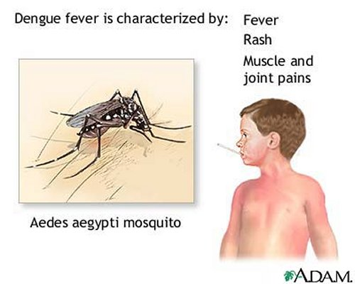
Human infections arise from a human-mosquitoe-human cycle.
In early stages: Fever, rash, headache, and pains in the muscles and joints. The fever is more marked than the classic form of dengue, and there is bleeding into the skin and from the mucous membranes. There is also abdominal pain and liver enlargement.
About 25% of children show reduced
platelets leading to sever haemorrhage.
There is no specific treatment for
Dengue Haemorrhagic Fever, because
the reasons are not fully understood

Slide 11
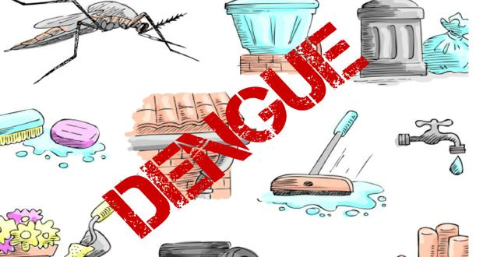
Classically, after that dengue presents with a high fever, lymphadenopathy, myalgia, bone and joint pains, headache, and a maculopapular rash.
Diagnosis is made by serology.
No specific antiviral therapy is available.
Prevention of dengue in endemic areas depends on mosquito eradication. The population should remove all containers from their premises which may serve as vessels for egg deposition.
A live attenuated vaccine is being tried in Thailand with encouraging results.

Slide 12
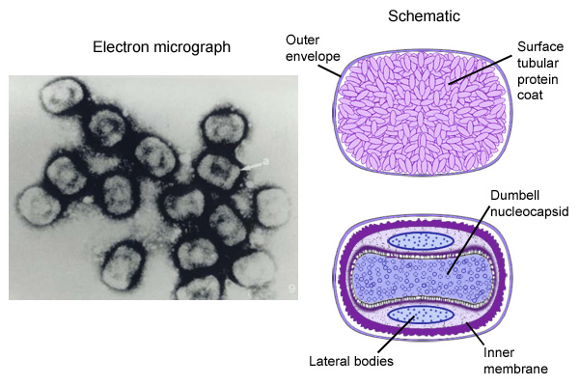
POXVIRUSES
INTRODUCTION
A range of pox viruses cause febrile illnesses in
man and animals with a prominent vesicular rash.
The most prominent of them was smallpox virus (variola) which caused a severe disease in man but which has now been eliminated by intensive international vaccination.
Current interest in poxviruses centers around their possible use as vaccine vectors.
Double stranded of DNA, brick-shape or oval particles with complex symmetry.
The Poxviruses are the largest of viruses.
They are called so because of the pox (rash of pus-filled blisters, known as pocks) produced in response to infection.
The Poxvirus family contains the following medically important viruses:
Viruses of the Orthopox genus (vaccinia, smallpox, and monkeypox and other animal poxviruses).
Unclassified poxviruses.
True pox viruses are antigenically rather similar, so that infection by one elicits immune protection against the others.

Slide 13
Laboratory diagnosis of pox viruses:
Specimen must be collected with great care and sent to the Virology lab with facilities for testing dangerous pathogens.
Such specimen should include material from pustules spread on a slide, collected on swabs, or placed directly in a sterile airtight container.
May be undertaken by electron microscopy of negatively stained vesicle fluid or lesion material.
Some pox viruses can be cultured on a special membrane of chick embryos, where they form pocks, and some can be isolated by cell-culture.

Slide 14
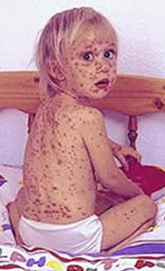
HUMAN INFECTION
variola
In 1979 the WHO declared the eradication of smallpox
through the world after a successful international
vaccination campaign.
All vaccines against the disease have now been
discontinued. Infection with smallpox virus (variola) produced a sever and fetal disease.
Vaccinia
a virus strain which has been used for immunization against smallpox and now being used to immunize against other orthopox viruses including monkeypox virus.
Rarely causes diseases in human.
It's origins are not known but it seems to be a genetically distinct type of pox virus which grows readily in a variety of hosts.

Slide 15
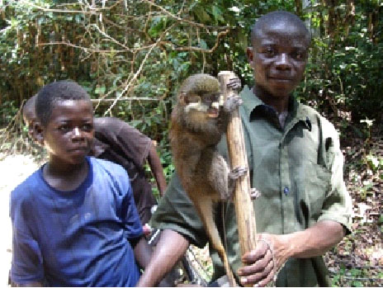
Monkeypox
Human infection with monkeypox viruses have been
reported from Central and West Africa in persons had
contact with infected wild monkeys.
The virus causes sever and fetal generalized disease
(undistinguished from smallpox), with fever, pain, and rash. Pustules form on the conjunctiva and mucous membranes of the mouth.
It is not easy for this disease to spread from one person to person.
Cowpox
Is acquired by humans usually by milking cows; it then manifests as ulcerative lesions (sometimes called "milkers nodules") on the hands of dairy workers.
It was noted to protect against smallpox and was used by Jenner as a vaccine strain to protect persons against smallpox.
Despite its name, rodents are the main reservoir of cowpox; it spreads secondarily to cows and domestic cats.

Slide 16
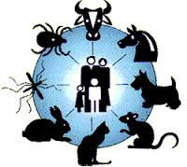
Viral Zoonosis
Definition
Zooneses are diseases of vertebrate animals that can be transmitted to man: either directly or indirectly through an insect vector.
When an insect vector is involved, the disease is also known as an arboviral disease.
However, not all arboviral diseases are zoonosis: where the transmission cycle takes place exclusively between insect vector and human e.g. dengue and urban yellow fever.
Examples of viral zoonoses that can be transmitted to man directly include rabies, lassa and ebola fevers.

Slide 17
Rabies Virus
Member of the Lyassavirus. family Rhabdovirus and genus Lyssavirus.
ssRNA enveloped virus, characteristic bullet-shaped appearance with helical capsid symmetry.
Exceedingly wide range of hosts.
It is surrounded by an envelope which has short protrusions.
Wild rabies virus is often referred to as "street virus".

Slide 18
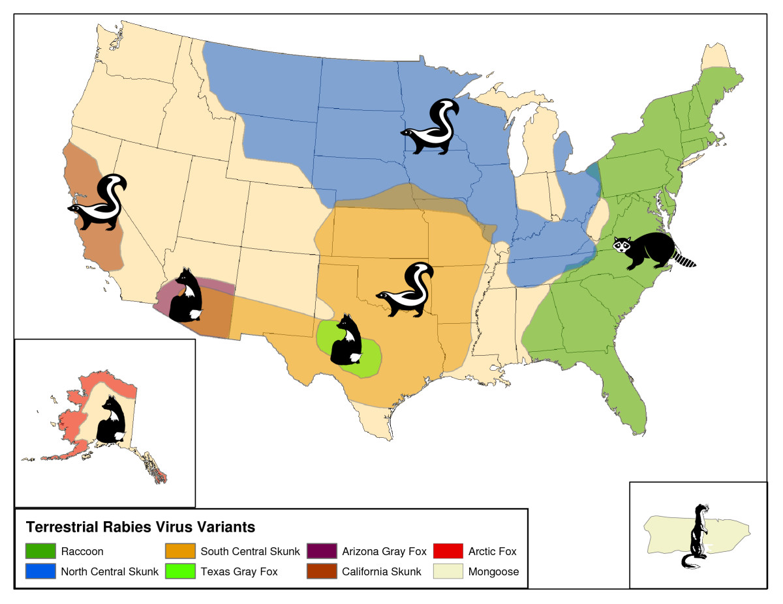
Epidemiology
Rabies is a zoonosis which is prevalent in wildlife. The main animals involved differs from continent to continent.
Europe fox, bats
Middle East wolf, dog
Asia dog
Africa dog, mongoose
N America foxes, raccoons, insectivorous bats
S America dog, vampire bats

Slide 19
Laboratory Diagnosis
Histopathology - Negri bodies are pathognomonic of rabies. However, Negri bodies are only present in 71% of cases.
Rapid virus antigen detection - in recent years, virus antigen detection by IF had become widely used.
Virus cultivation - The most definitive means of diagnosis is by virus cultivation from saliva and infected tissue.
Serology - In late stages, a diagnosis of rabies can usually be confirmed by serological tests, circulating antibodies appear slowly in the course of infection but they are usually present by the time of onset of clinical symptoms.

