Slide 1
Viruses & fungi
By:Afnan Bakhsh

Slide 2
Fungi:
:
Mycology: study of fungi.
Fungi: group of heterotrophic eukaryotic cells.
Fungi called saprophytes because they obtain their nutrients from dead organic material.

Slide 3
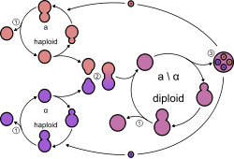
Classification of fungi:
1) Yeast:
Oval or spherical in shape.
Single cell (unicellular), one nucleus.
Multiply by asexual reproduction (Budding).

Slide 4
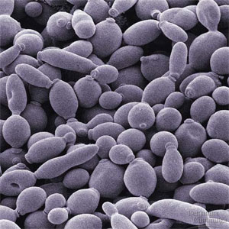
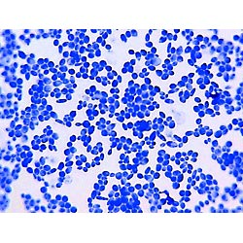

Slide 5
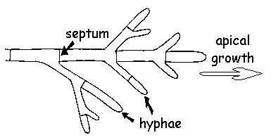
2) Mold:
Multicellular (multinucleated cell).
Consists of branching hyphae forming Mycelium.
Multiply both sexually and asexually.

Slide 6
What are the best conditions to grow fungi?
Media: Sabouraud Dextrose Agar (SDA).
PH: wide range of PH especially acidic.
Moisture.
Temperature

Slide 7
Tempreature:
Room temp: causing superficial infection.
37 C: cause systemic infection, called pathogenic fungi
Cold temp: cause spoilage of food.
Lacto Phenol Cotton blue: Reagent used to stain fungi for microscopic examination.
Use iron needle for culturing.

Slide 8
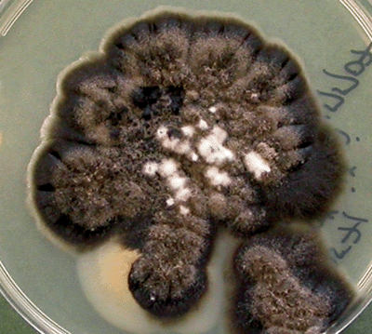
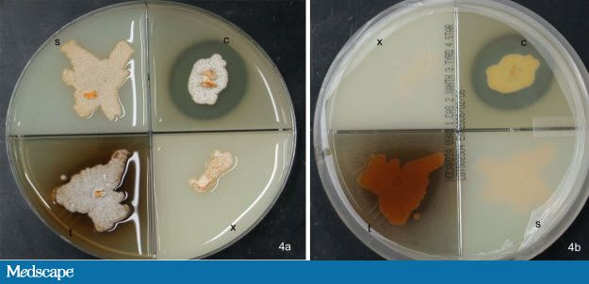

Slide 9
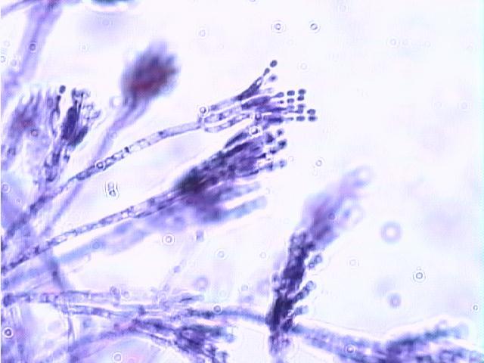
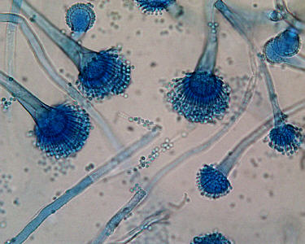

Slide 10
Benefits of fungi:
Baking by using yeast.
Brewing.
Breaking down of dead organic material.
Antibiotics. Ex: penicillin extracted from penicillium.

Slide 11
Viruses:
Virology: study of viruses.
Viruses are obligate intracellular agents (they can multiply only in living cell).
They have single type of nucleic acid (DNA /RNA) enclosed in a capsid.
Some viruses have envelop other are naked (none enveloped).
Viruses size vary from 20-300 nm.

Slide 12
We can see it by electron microscope.
Viruses infect human, plants, animals and bacteria.
Viruses that infected bacteria are called: bacteriophage.

Slide 13
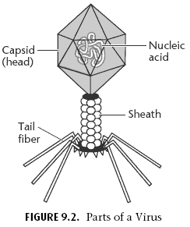

Slide 14
Cultivation of viruses:
Inoculation of lab animals (ex: mice, hamster).
Inoculation of embryonated egg.
Tissue cultured cells. Use it to see
Cytopathic effect: it is morphological changes in the cell caused by viruses when they multiply inside the cell.
Why we do cultivation:
a. Diagnosis. b. research.
c. production of vaccines

Slide 15
Virus life cycle:
Adsorption to the cell.
Penetration.
Multiplication.
Budding outside the cell.

Slide 16
