Slide 1
Decision making
If.. else statement

Slide 2
1. Decision making – fig. 1
Condition?
True
False
Block of Statements (1)
Block of Statements (2)
Block of Statements (3)
END
Dr. Soha S. Zaghloul 2

Slide 3
2. The if…else Statement
The if…else selection statement allows you to specify that different actions are to be performed when the condition is true and when it is false.
It is also called two way selection
Syntax:
if (condition)
{
block of statements 1;
}// end if
else
{
block of statements 2;
}//end else
block of statements 3;
Dr. Soha S. Zaghloul 3

Slide 4
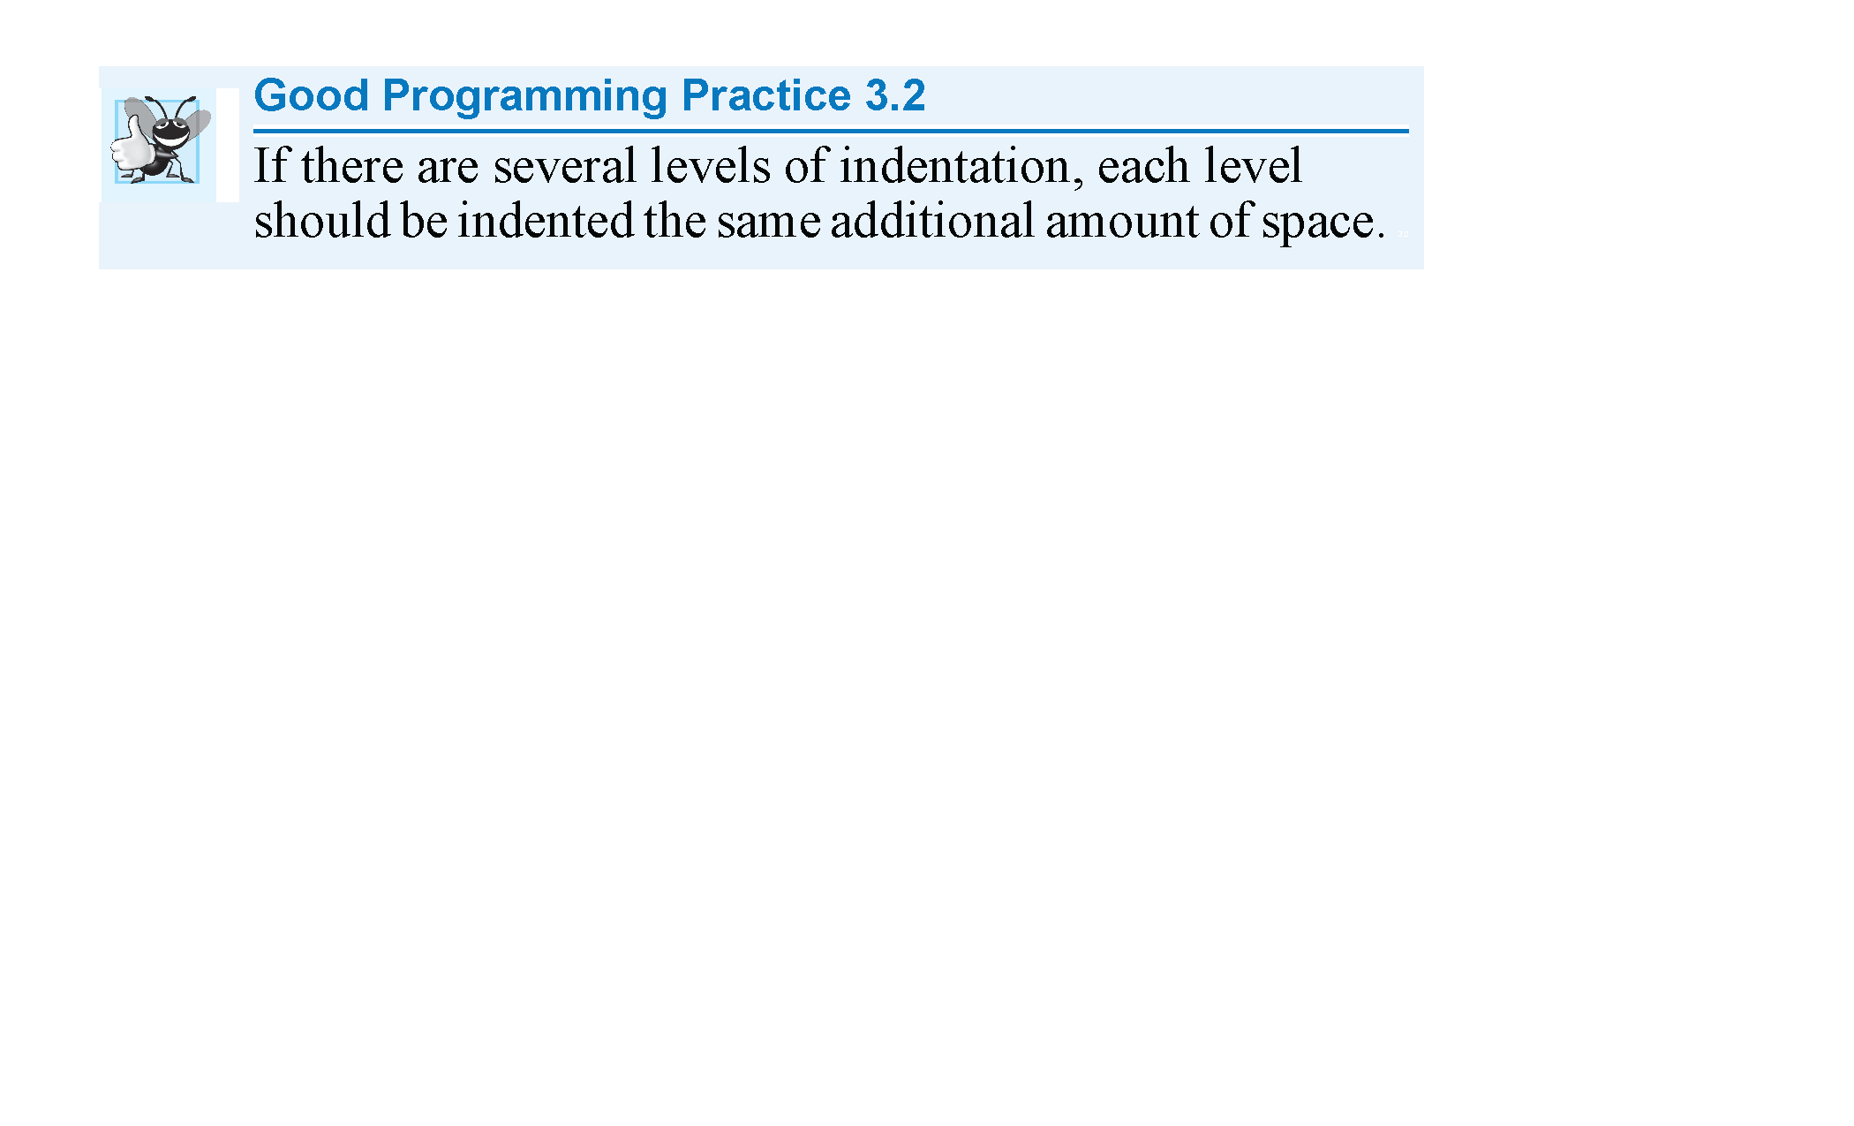
indentation
Error:
If ( grade>=60);
Dr. Soha S. Zaghloul 4

Slide 5
3. if…else - EXAMPLE
Write a program that prints “Passed” or “Failed” depending on the student’s grade. The program should finally print a “Good bye” message.
ALGORITHM
Get the grade from the user
Check if grade is greater than or equal to 60
Condition true: print “passed”
Condition false: print “failed”
Print a “Good bye” message
Dr. Soha S. Zaghloul 5

Slide 6
3.if…else – EXAMPLE Flowchart
START
READ grade
grade >= 60?
True
False
Print “passed”
Print “failed”
Print “Good bye”
END
FLOWCHART
Dr. Soha S. Zaghloul 6

Slide 7
3.if…else – EXAMPLE pseudocode
PSEUDOCODE
Scanf grade
If (grade >= 60)
Condition true: Printf “passed”
Condition false: Printf “failed”
Printf “Good bye”
Dr. Soha S. Zaghloul 7

Slide 8
3.if…else – EXAMPLE code
scanf (“%d”, &grade); //read grade from user
PSEUDOCODE
Scanf grade
If (grade >= 60)
Condition true: Printf “passed”
Condition false: Printf “failed”
Printf “Good bye”
Dr. Soha S. Zaghloul 8

Slide 9
3.if…else – EXAMPLE code
printf (“Enter grade: \n”); // prompt
scanf (“%d”, &grade); // read grade from user
PSEUDOCODE
Scanf grade
If (grade >= 60)
Condition true: Printf “passed”
Condition false: Printf “failed”
Printf “Good bye”
Dr. Soha S. Zaghloul 9

Slide 10
3.if…else – EXAMPLE code
int grade; //declaration of grade
printf (“Enter grade: \n”); //prompt
scanf (“%d”, &grade); //read grade from user
PSEUDOCODE
Scanf grade
If (grade >= 60)
Condition true: Printf “passed”
Condition false: Printf “failed”
Printf “Good bye”
Dr. Soha S. Zaghloul 10

Slide 11
3.if…else – EXAMPLE code
PSEUDOCODE
Scanf grade
If (grade >= 60)
Condition true: Printf “passed”
Condition false: Printf “failed”
Printf “Good bye”
int grade; //declaration of grade
printf (“Enter grade: \n”); //prompt
scanf (“%d”, &grade); //read grade from user
if (grade >=60)
{
printf (“passed \n”); // if condition is true
} // end if
else
{
printf (“failed \n”); // if condition is false
} //end else
Dr. Soha S. Zaghloul 11

Slide 12
3.if…else – EXAMPLE code
PSEUDOCODE
Scanf grade
If (grade >= 60)
Condition true: Printf “passed”
Condition false: Printf “failed”
Printf “Good bye”
int grade; //declaration of grade
printf (“Enter grade: \n”); //prompt
scanf (“%d”, &grade); //read grade from user
if (grade >=60)
{
printf (“passed \n”); // if condition is true
} // end if
else
{
printf (“failed \n”); // if condition is false
} //end else
printf (“Good bye \n”);
Dr. Soha S. Zaghloul 12

Slide 13
3.if…else – EXAMPLE code
#include <stdio.h>
int main (void)
{
int grade; //declaration of grade
printf (“Enter grade: \n”); //prompt
scanf (“%d”, &grade); //read grade from user
if (grade >=60)
{
printf (“passed \n”); // if condition is true
} // end if
else
{
printf (“failed \n”); // if condition is false
} //end else
printf (“Good bye \n”);
} // end of main
PSEUDOCODE
Scanf grade
If (grade >= 60)
Condition true: Printf “passed”
Condition false: Printf “failed”
Printf “Good bye”
Dr. Soha S. Zaghloul 13

Slide 14
4. The logical operators - AND
Logical operators are used to combined multiple condition statements.
The AND Operator is written as && in C
It is a binary operator
Its truth table is as follows:
The result of an AND operation is TRUE only when both operands are TRUE; otherwise it is FALSE.
Operand 1 | Operand 2 | Result
True | True | True
True | False | False
False | True | False
False | False | False
Dr. Soha S. Zaghloul 14

Slide 15
5. The logical operators - OR
The OR Operator is written as || in C
It is a binary operator
Its truth table is as follows:
The result of an OR operation is FALSE only when both operands are FALSE; otherwise it is TRUE.
Operand 1 | Operand 2 | Result
True | True | True
True | False | True
False | True | True
False | False | False
Dr. Soha S. Zaghloul 15

Slide 16
6. The logical operators - NOT
The NOT Operator is written as ! in C
It is a unary operator
Its truth table is as follows:
Operand | Result
True | False
False | True
Dr. Soha S. Zaghloul 16

Slide 17
7. The logical operators - example
Write a program that outputs the letter grade of a student given his score.
ALGORITHM
Get the score from the user
Check if score is greater than or equal to 90
Condition true: the letter grade is ‘A’
Check if score is greater than or equal to 80 and less than 90
Condition true: the letter grade is ‘B’
Check if score is greater than or equal to 70 and less than 80
Condition true: the letter grade is ‘C’
Check if score is greater than or equal to 60 and less than 70
Condition true: the letter grade is ‘D’
Check if score is less than 60
Condition true: the letter grade is ‘F’
Dr. Soha S. Zaghloul 17

Slide 18
7. The logical operators - example
START
READ SCORE
SCORE >= 90?
GRADE=‘A’
FALSE
SCORE >= 80 AND <90?
TRUE
GRADE=‘B’
PRINT GRADE
FALSE
SCORE >= 70 AND <80?
END
TRUE
GRADE=‘C’
FALSE
SCORE >= 60 AND <70?
GRADE=‘F’
FALSE
TRUE
GRADE=‘D’
FLOWCHART
Dr. Soha S. Zaghloul 18

Slide 19
7. The logical operators - example
PSEUDOCODE
Scanf score
If (score >= 90) then grade = ‘A’
If (score >= 80) and (score < 90) then grade = ‘B’
If (score >= 70) and (score < 80) then grade = ‘C’
If (score >= 60) and (score < 70) then grade = ‘D’
If (score < 60) then grade = ‘F’
Printf grade
Dr. Soha S. Zaghloul 19

Slide 20
7. The logical operators - example
#include <stdio.h>
// This program calculates the letter grade given the score
int main (void)
{
int score; // student’s score
char grade; // stduent’s letter grade
printf (“Enter student’s score \n”); //prompt
scanf (“%d”, &score); //get score from user
} //end of main
Dr. Soha S. Zaghloul 20

Slide 21
7. The logical operators - example
#include <stdio.h>
// This program calculates the letter grade given the score
int main (void)
{
int score; // student’s score
char grade; // stduent’s letter grade
printf (“Enter student’s score \n”); //prompt
scanf (“%d”, &score); //get score from user
if (score >= 90)
{
grade = ‘A’;
} //end (score >=90)
} //end of main
Dr. Soha S. Zaghloul 21

Slide 22
7. The logical operators - example
#include <stdio.h>
// This program calculates the letter grade given the score
int main (void)
{
int score; // student’s score
char grade; // stduent’s letter grade
printf (“Enter student’s score \n”); //prompt
scanf (“%d”, &score); //get score from user
if (score >= 90)
{
grade = ‘A’;
} //end (score >=90)
if ((score >=80) && (score < 90))
{
grade = ‘B’;
} // end ((score >=80) && (score < 90))
} //end of main
Dr. Soha S. Zaghloul 22

Slide 23
7. The logical operators - example
if ((score >= 80) && (score < 90))
{
grade = ‘B’;
} // end ((score >=80) && (score < 90))
if ((score >= 70) && (score < 80))
{
grade = ‘C’;
} // end ((score >= 70) && (score < 80))
if ((score >= 60) && (score < 70))
{
grade = ‘D’;
} // end ((score >= 60) && (score < 70))
if (score < 60)
{
grade = ‘F’;
} // end (score < 60)
Dr. Soha S. Zaghloul 23

Slide 24
7. The logical operators - example
printf (“The grade corresponding to %d is %c”, score, grade);
} //end of main
Dr. Soha S. Zaghloul 24

Slide 25
8. an alternative solution 1
if ((score >= 80) && (score < 90))
{
grade = ‘B’;
} // end ((score >=80) && (score < 90))
if ((score >= 70) && (score < 80))
{
grade = ‘C’;
} // end ((score >= 70) && (score < 80))
if ((score >= 60) && (score < 70))
{
grade = ‘D’;
} // end ((score >= 60) && (score < 70))
if (score < 60)
else
{
grade = ‘F’;
} // end of else
Dr. Soha S. Zaghloul 25

Slide 26
9. an alternative solution 2
#include <stdio.h>
int main (void)
{
int score;
char grade;
printf (“Enter student’s score \n”);
scanf (“%d”, &score);
if (score >= 90) { grade = ‘A’; }
else
{ if ((score >= 80) && (score < 90)) { grade = ‘B’;} }
else
{ if ((score >= 70) && (score < 80)) { grade = ‘C’;} }
else
{ if ((score >= 60) && (score < 70)) { grade = ‘D’;} }
else
{ grade = ‘C’ };
printf (“The grade corresponding to %d is %c”, score, grade);
} //end of main
One Statement
Dr. Soha S. Zaghloul 26

Slide 27
10. NESTED IF
#include <stdio.h>
int main (void)
{
int score;
char grade;
printf (“Enter student’s score \n”);
scanf (“%d”, &score);
if (score >= 90) { grade = ‘A’; }
else
{ if ((score >= 80) && (score < 90)) { grade = ‘B’;} }
else
{ if ((score >= 70) && (score < 80)) { grade = ‘C’;} }
else
{ if ((score >= 60) && (score < 70)) { grade = ‘D’;} }
else
{ grade = ‘C’ };
printf (“The grade corresponding to %d is %c”, score, grade);
} //end of main
NESTED IF
Dr. Soha S. Zaghloul 27

Slide 28
11. nested if - syntax
Nested if statements are used for multiple-alternative decision.
Syntax:
if (condition 1)
Statement 1
else if (condition 2)
Statement 2
…
…
…
else if (condition n)
statement n
Dr. Soha S. Zaghloul 28

Slide 29
12. NESTED IF - EXAMPLE
Consider the following code segment
num_pos counts the number of positive numbers.
num_neg counts the number of negative numbers.
num_zero counts the number of zeroes.
if (x > 0) num_pos = num_pos +1;
else
if (x < 0) num_neg = num_neg +1;
else /* x equals zero */
num_zero = num_zero +1;
Dr. Soha S. Zaghloul 29

Slide 30
13. The ternary “?” conditional operator
C provides the conditional operator (?:) which is closely related to the if…else statement.
The conditional operator is C’s only ternary operator—it takes three operands.
These together with the conditional operator form a conditional expression.
The first operand is a condition.
The second operand is the value for the entire conditional expression if the condition is true
The third operand is the value for the entire conditional expression if the condition is false.
Dr. Soha S. Zaghloul 30

Slide 31
13. The “?” operator - example
#include <stdio.h>
int main (void)
{
int grade; //declaration of grade
printf (“Enter grade: \n”); //prompt
scanf (“%d”, &grade); //read grade from user
if (grade >=60)
{
printf (“P \n”); // if condition is true
} // end if
else
{
printf (“F \n”); // if condition is false
} //end else
printf (“Good bye \n”);
} // end of main
Char Res;
Res =((grade >=60)? “P”:”F”);
printf (“Result = %c \n”, Res);
Dr. Soha S. Zaghloul 31

